Slide 1
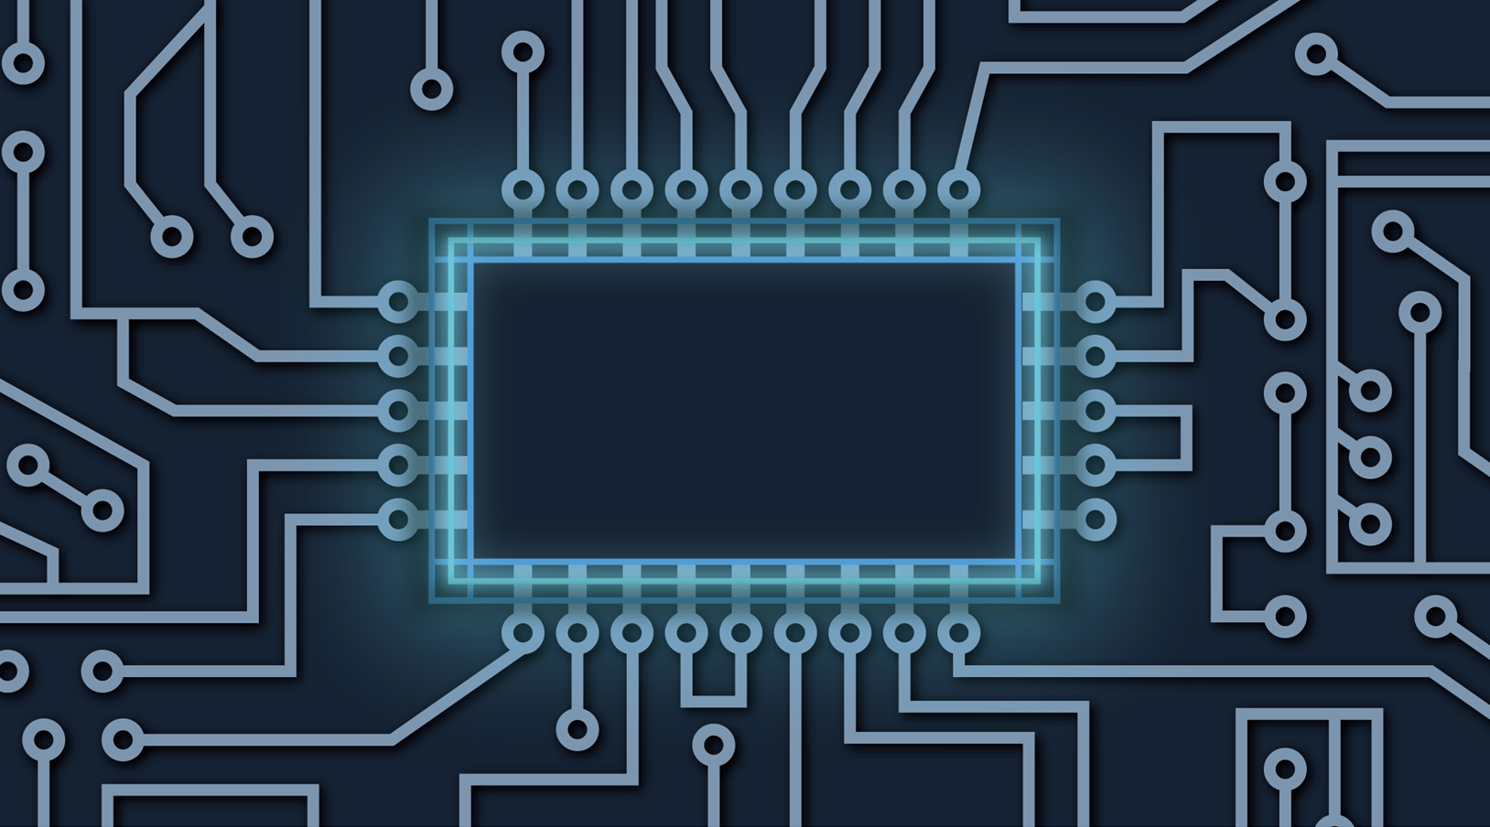
Intelligence in the AI Era?
EnergIntell Conference

Slide 2

CONTENT
Introduction
1
Objective and Motivation
Hypothesis, Methodology
Results
Definitions
2
Artificial Intelligence, Digital twin
Findings
3
Data collection
Statistical analysis
Legislative framework
4
Conclusions

Slide 3
01 Introduction
To provide a data collections about how Artificial Intelligence is used in current digital space
To identify the main benefits which came form its usage
To establish trends of using AI in the next future
The adoption of usages of the AI in Intelligence

Slide 4
01 Introduction
Objective and Motivation, Hypothesis, Methodology, Results
The data can be improved by using AI technologies but need a regulathory work frame
There are specific AI technologies for improving the efficiency in different sectors of activities
The AI technologies dedicated need to be permanently updated
AI technology reshape the traditional ways of Intelligence?

Slide 5
01 Introduction
Objective and Motivation, Hypothesis, Methodology, Results
The time allocated for different tasks can be reduced by implementing AI technologies
AI technologies integrated IT&C solutions are tools that can assure a safe environment for economic and social growth
Using AI can significantly reduce the economic losses of government and private sector
AI technology need constat update and supervision

Slide 6
02 Definitions
Artificial Intelligence, Digital twin
Artificial Intelligence
Artificial Intelligence is a computer programme that is capable to simulate human mind way of thinking in taking decisions
Digital Twin
Digital twin can be described as a digital version of a specific individual, object, or process created with the scope of improving decisions and simulating real situation

Slide 7
03 Findings
Data collection, Statistical analysis, Conlcusions
8%
EU enterprises using AI technology
30,4%
Large EU enterprises using AI technology
Eurostat, data for 2023
Eurostat, data for 2023

Slide 8
03 Findings
Data collection, Statistical analysis, Conlcusions
22%
92%
EU enterprises used at least one ICT security measure
EU enterprises suffering ICT incidents
Eurostat, data for 2023
Eurostat, data for 2023

Slide 9
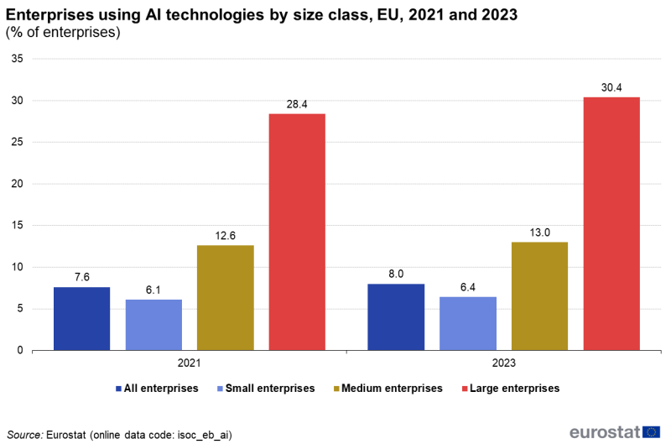
03 Findings
Data collection, Statistical analysis, Conlcusions
The most significant difference in the use of artificial intelligence in companies is registered at the level of large companies, with a rate of 2%, and a smaller dynamic in small and medium companies

Slide 10
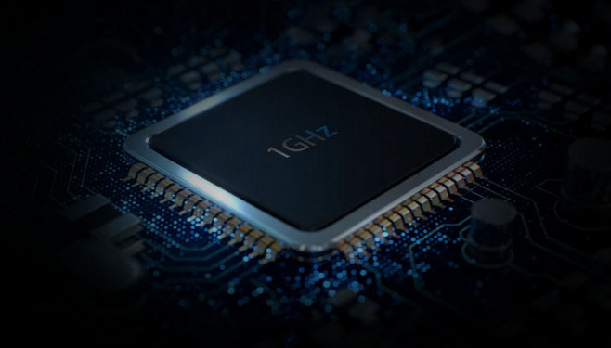
03 Findings
Data collection, Statistical analysis, Legislative framework
Hybrid warfare
AI Cyber security driven vs AI Cyberattacks driven
AI-generated content and social media amplification
Using AI in cybersecurity can significantly reduce the economic losses of government and private sector. The adoption of artificial intelligence in the field of cybersecurity is becoming a necessity both at the government level and at the private sector level, having a direct impact in reducing the number of security incidents as well as in reducing financial or time losses, but also in increasing the confidence of users of computer systems and consumers of online services.

Slide 11
03 Findings
Data collection, Statistical analysis, Legislative framework
Both the governmental and the private sectors continue to adopt artificial technology within the computer systems, at a rate that can be accelerated in the coming years
EU - AI ACT - first regulation on AI
The adoption of artificial intelligence, particularly in the field of cybersecurity is supported by existing legal regulations, in a predictable framework that ensures the efficient and transparent use of these technologies. It is necessary to continue and permanently adapt these technologies and legal regulations according to future developments in the demon of cybercrime to ensure a sustainable economic and social development.

Slide 12
THANK YOU!

