Slide 1
Because the 1st edition was a real success, we made a second one!

Slide 3
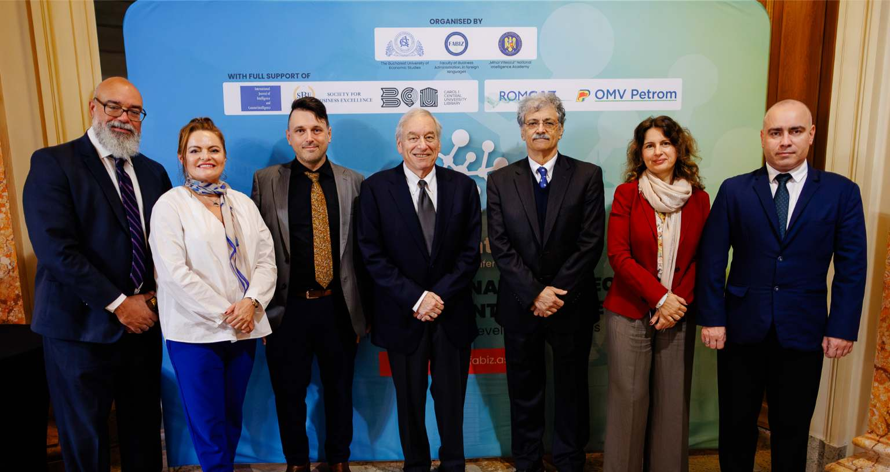
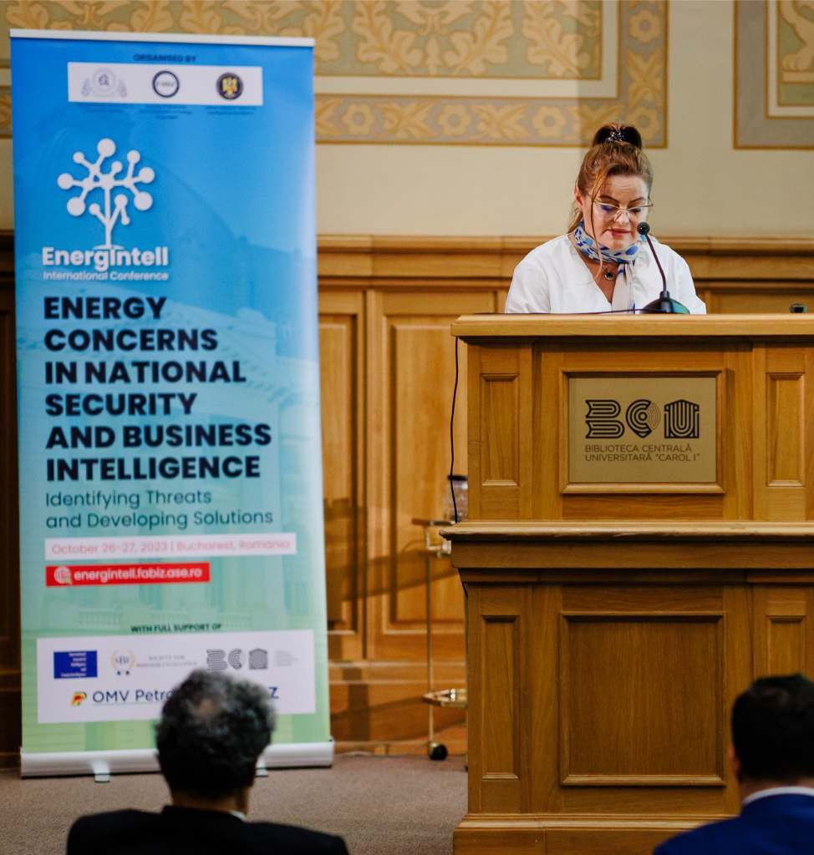
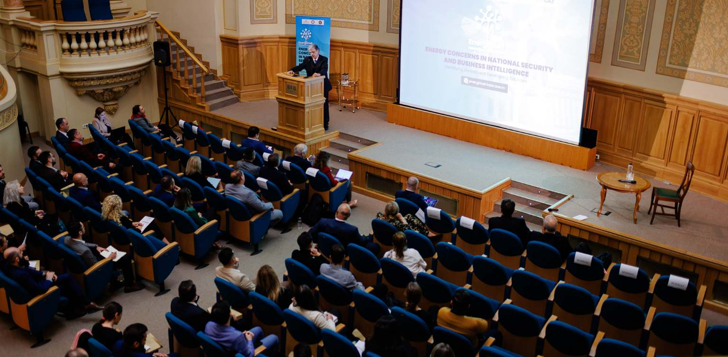

Slide 4
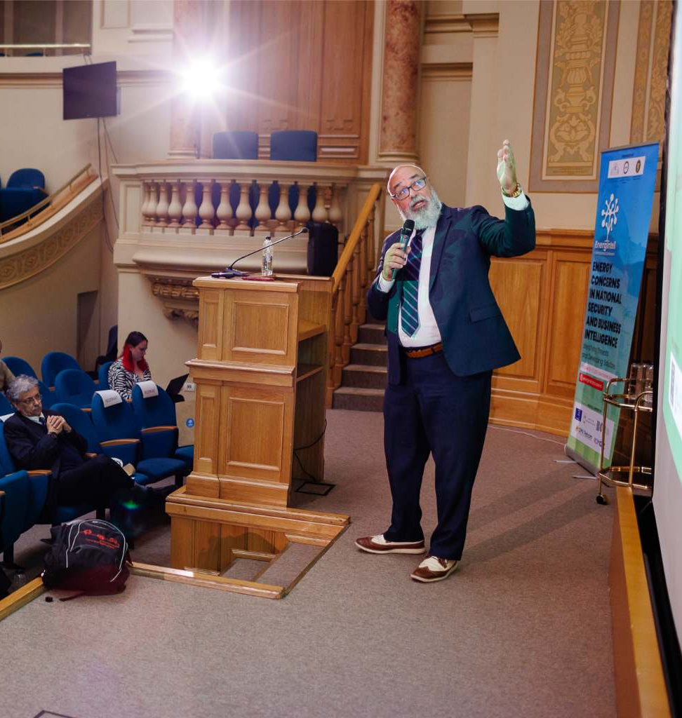
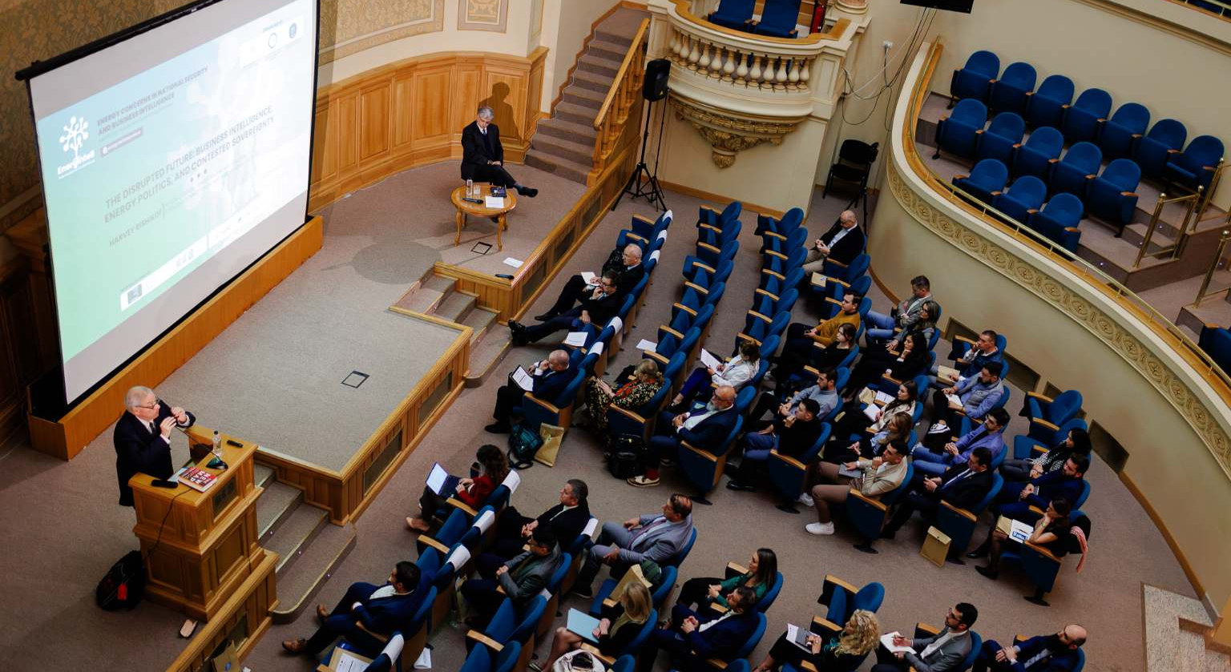
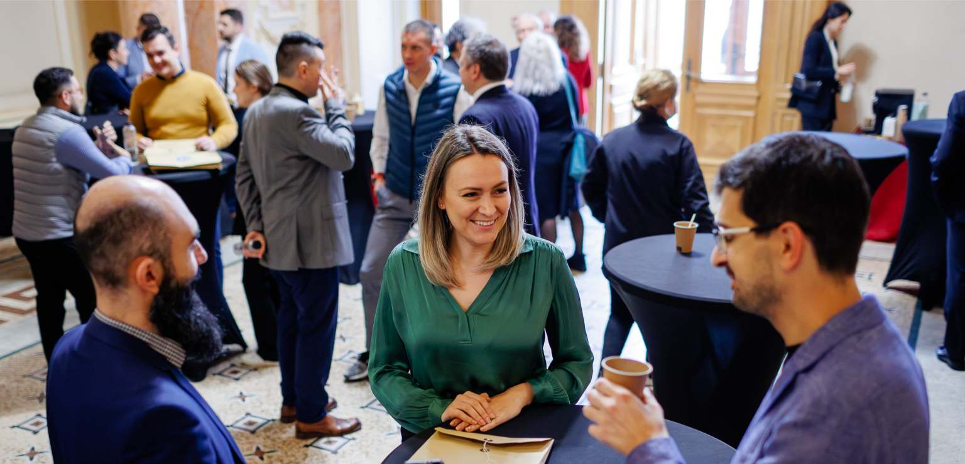

Slide 5
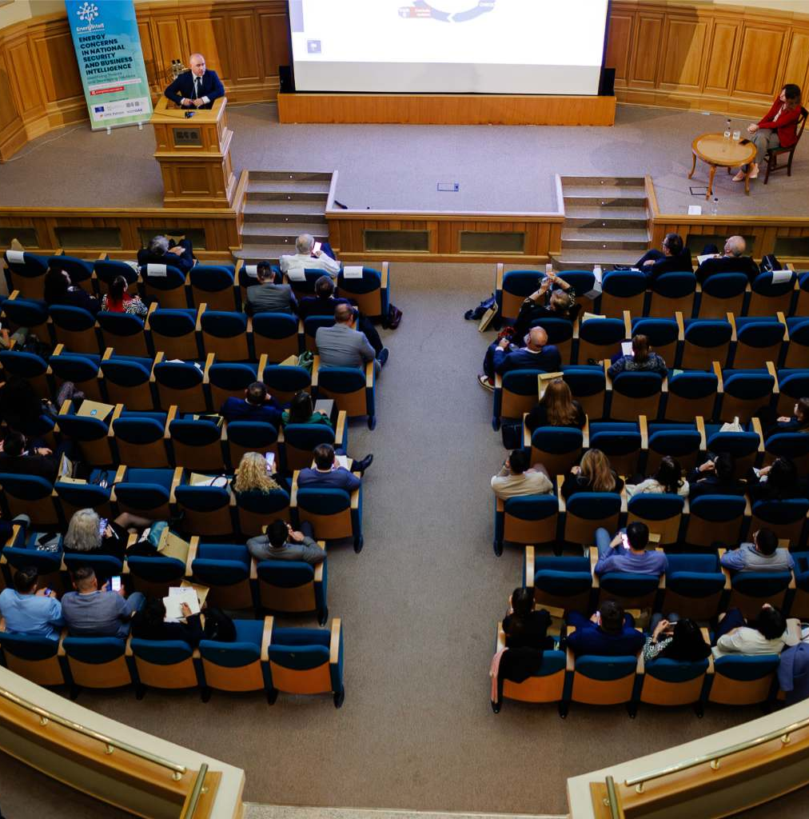

Slide 6
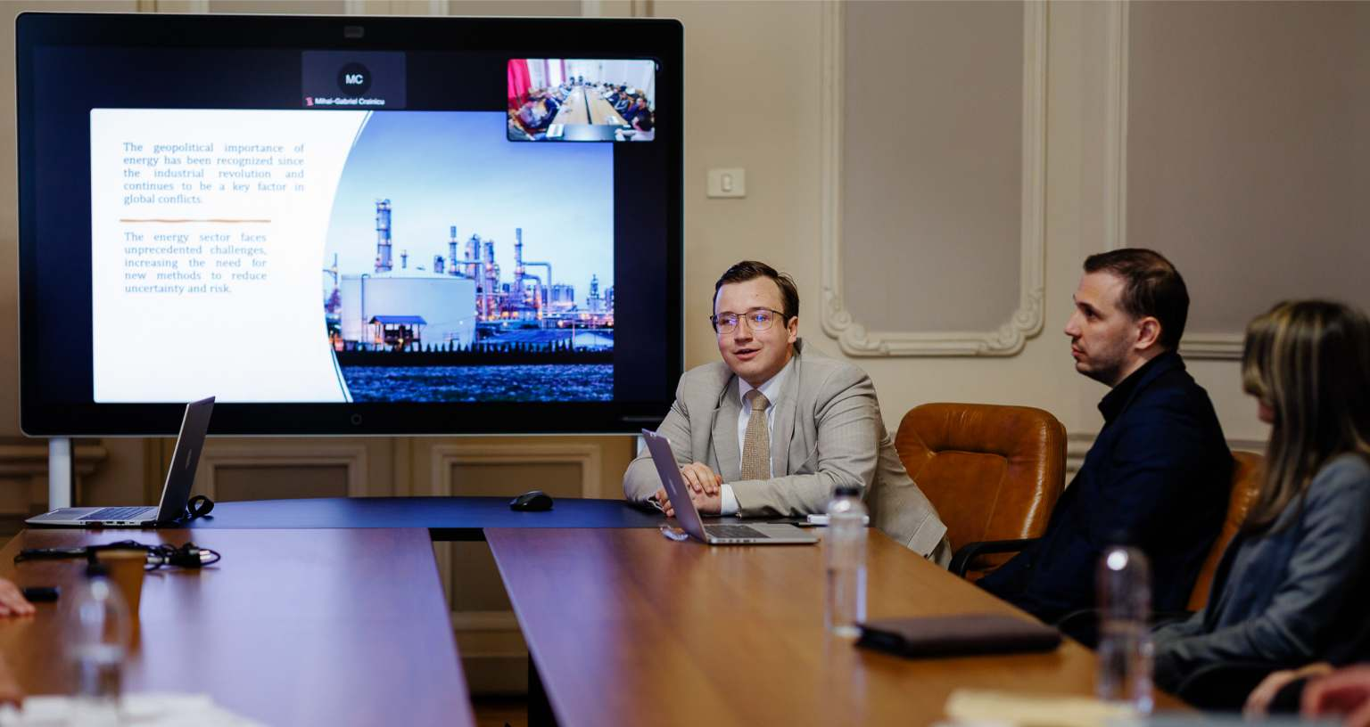
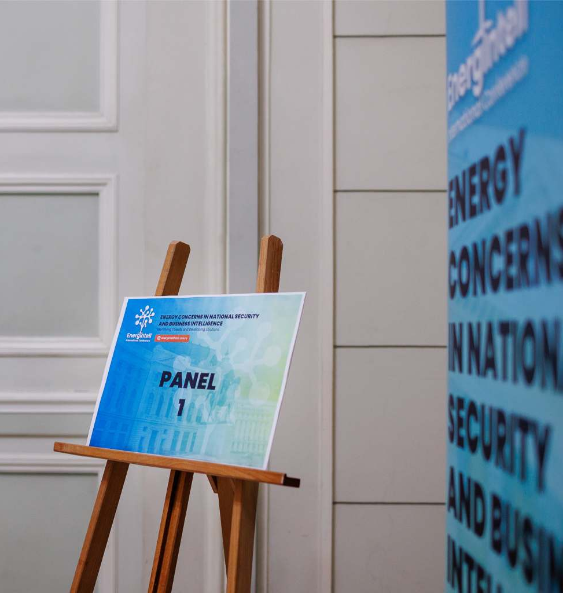
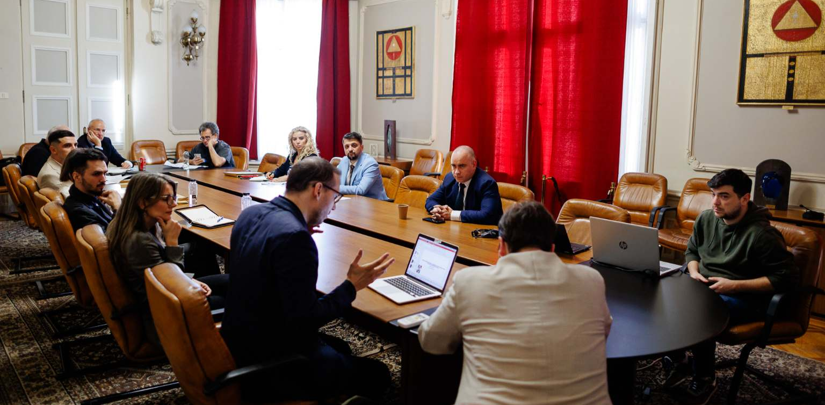

Slide 7
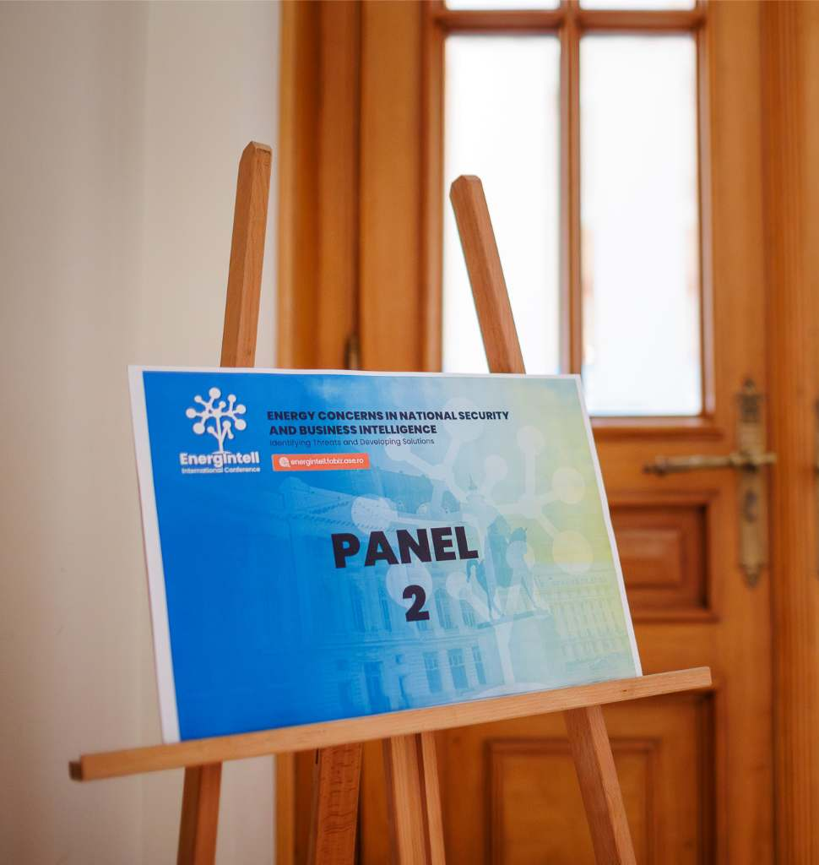
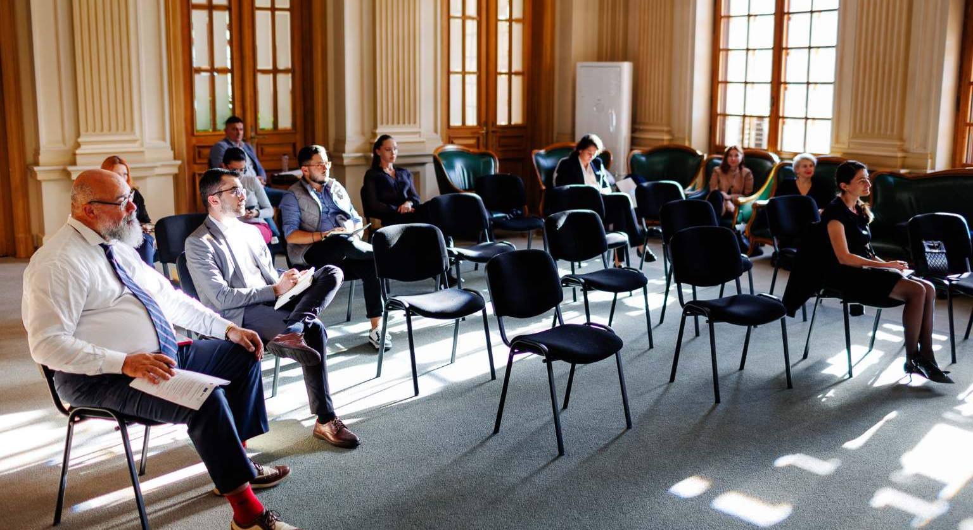
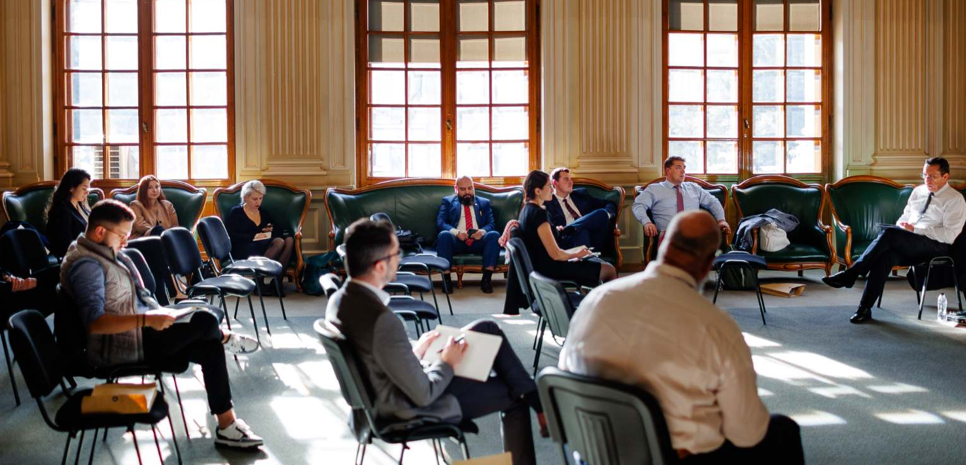

Slide 8
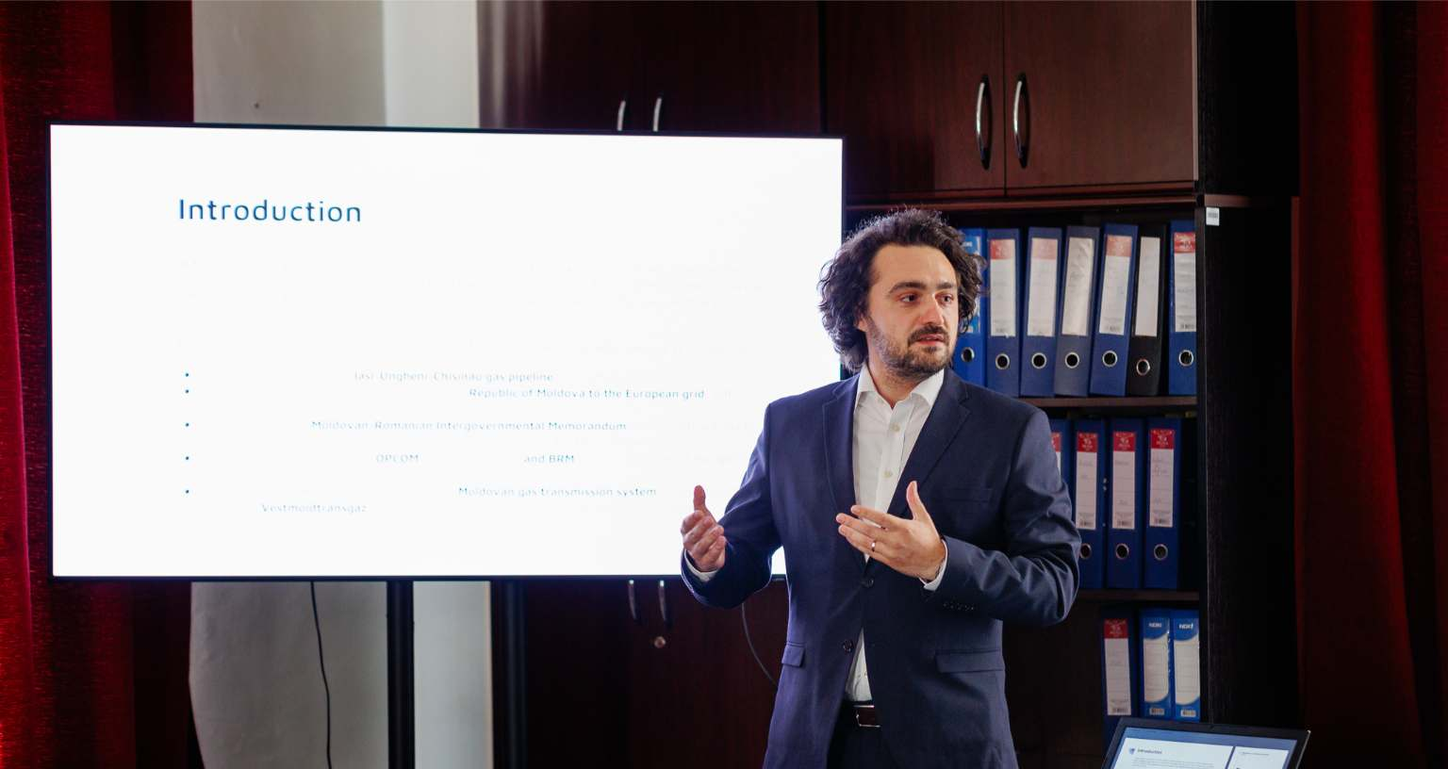
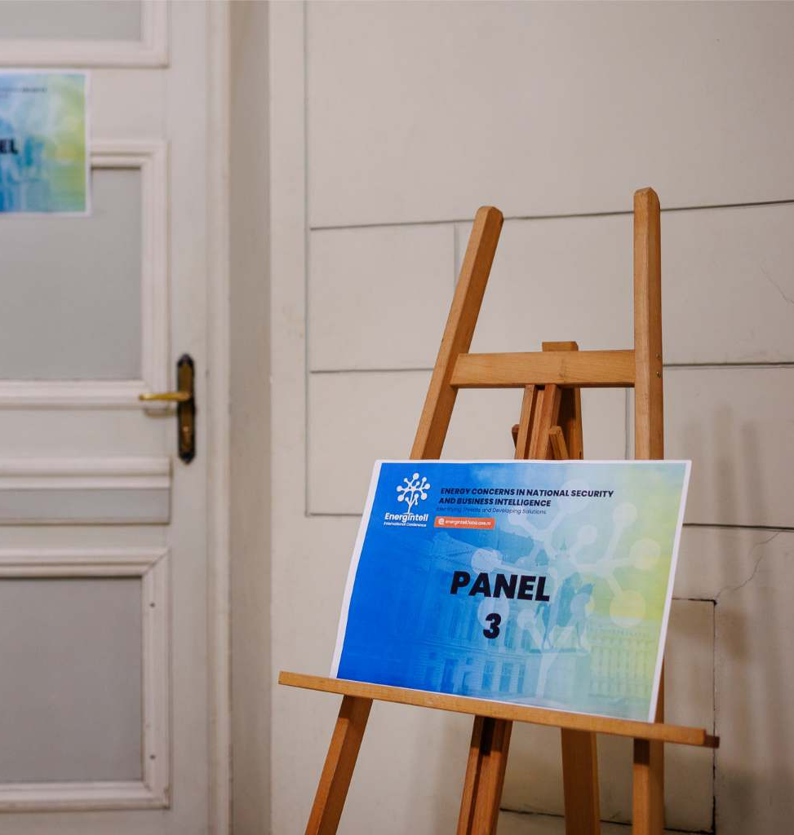
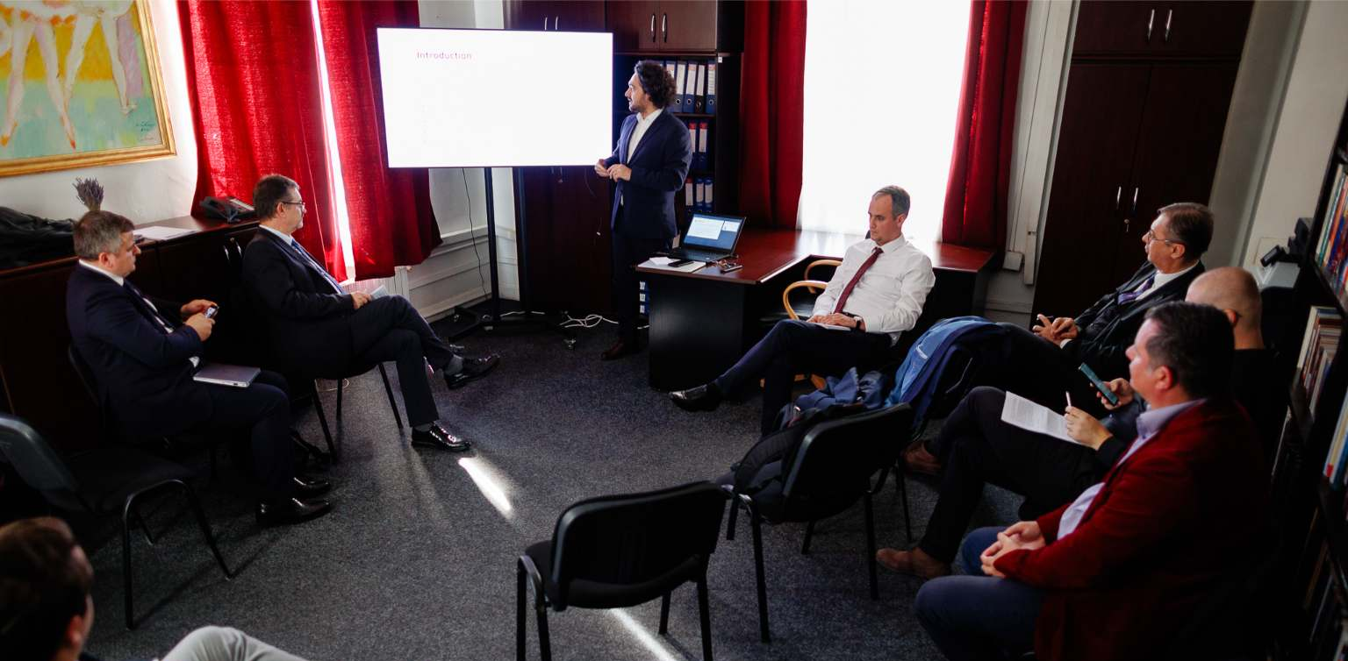

Slide 9
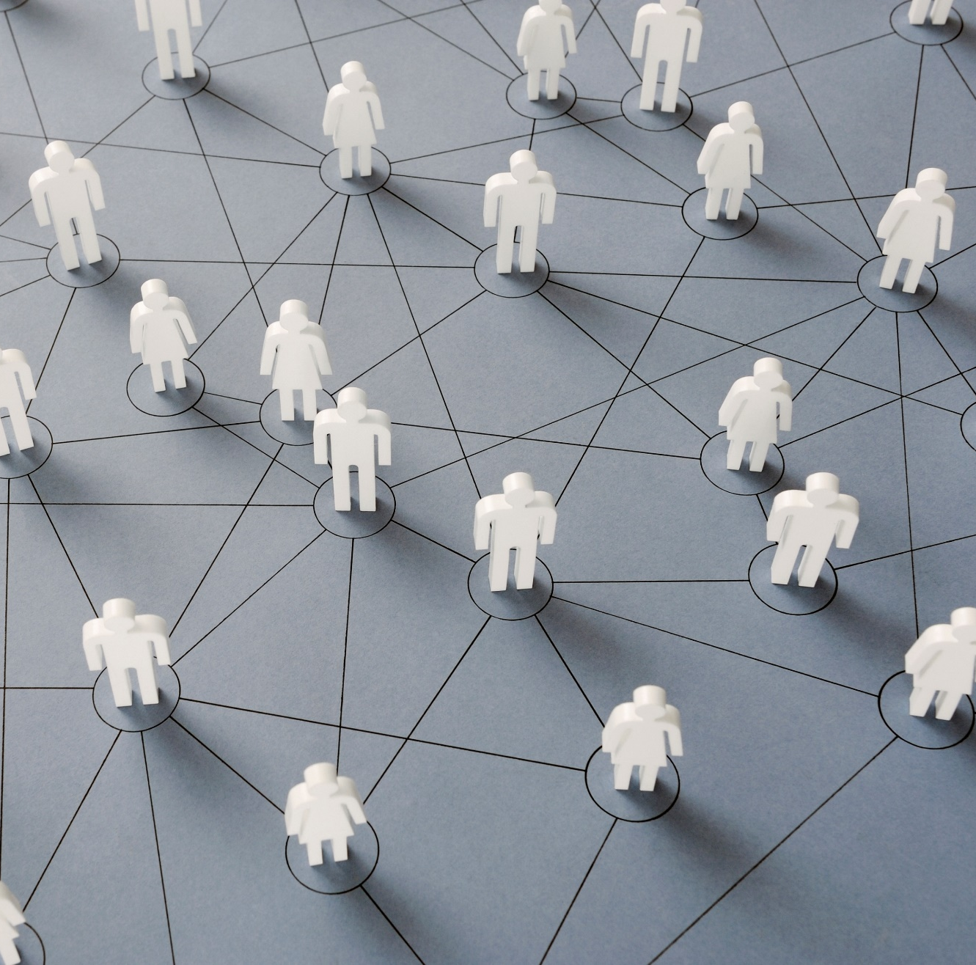
EnergIntell connects experts from different countries

Slide 10
1st EnergIntell
Country Distribution
Romania
Bosnia and Herzegovina
Croatia
The Netherlands
Belgium
France
Israel
The United Arab Emirates
Australia
USA
With full support of:

Slide 11
2nd EnergIntell
Country Distribution
Romania
Bulgaria
Serbia
Republic of Moldova
Albania
France
Germany
Belgium
Danemark
Sweden
Finland
USA
Australia
With full support of:

Slide 12
BUILDING A BRIDGE
to connect the world
1st & 2nd EnergIntell
With full support of:
1st EnergIntell

Slide 13
Energy is the backbone of an economy, social welfare and development of a country or region. That's why it's vital to have accurate and timely intelligence about key players in energy markets, trends and the implications of technological changes to stay competitive.

Slide 14
Thus, we created a conference that explores the connection between the two fields.

Slide 15
The Pulse of Power
In shadows deep where silence lay,
A web of light holds night at bay.
Through wires strung like threads of fate,
Energy flows, a vital state.
From distant sun to river's grace,
In every current, life we trace.
The hum of turbines, whispers low,
A symphony of power's flow.
In homes, in hearts, our dreams ignite,
With every spark, we chase the night.
Industries thrive, ideas bloom,
With energy's warmth, dispelling gloom.
Yet storms may rage, and darkness creep,
When infrastructure falters, we weep.
So let us tend this lifeline true,
For future generations, too.
Invest in strength, in bridges wide,
In solar rays and oceans' tide.
For in this dance of light and heat,
Lies hope and progress, bold and sweet.
Together, we’ll build, renew,
A world empowered, strong and true.
For every watt that lights the way,
Is a promise kept for a brighter day

Slide 16
The Backbone of Power
Steel veins stretch wide, a country’s spine,
Carrying force from dam to mine.
The hum of life in every wire,
A network fed by wind and fire.
Pillars rise where rivers bend,
Bridges where the skylines blend.
Substations pulse beneath the soil,
Transforming light from labor’s toil.
The turbines spin, the engines roar,
Silent keepers at the core.
Pipelines buried, deep and cold,
Transport energy bought and sold.
Yet in the hands of those who dream,
A future forged in solar beams,
Where grids grow green, the earth’s refrain,
No wasted spark, no loss, no strain.
A world rebuilt on vision’s spark—
Where energy flows, but leaves no mark.
The future stands on what we lay,
The power built, the price we pay.

