Slide 1
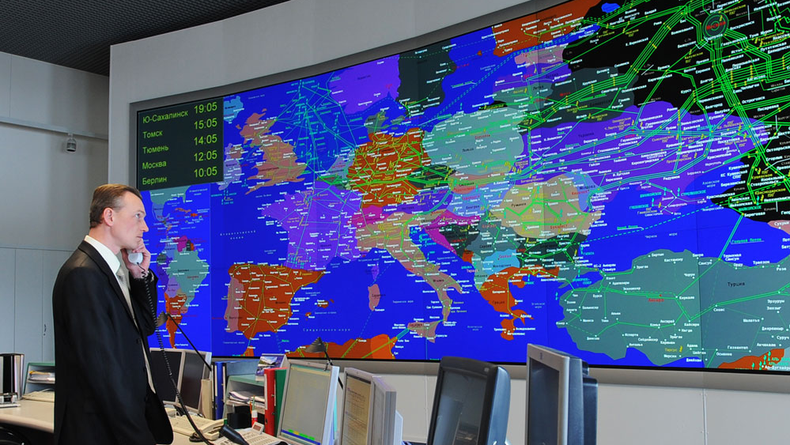
Russia's Weaponization of Natural Gas as Part of its Economic Warfare Strategy
Prisăcaru Ștefan
Energy Concerns in National Security and Business Intelligence
24 October 2024

Slide 2
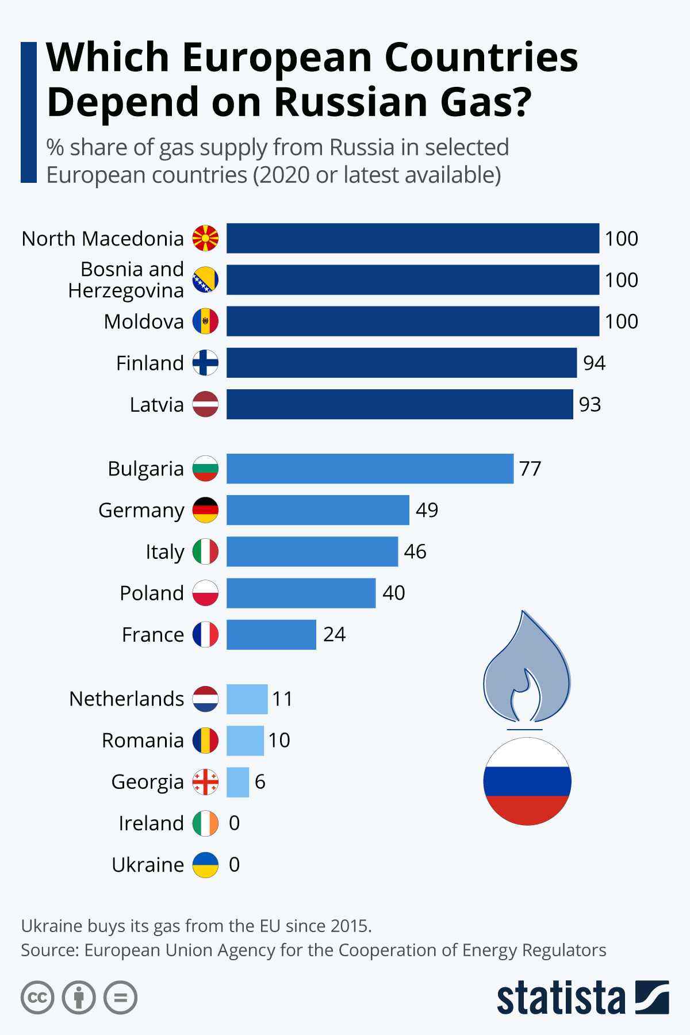
Introduction and Objective
Through this analysis, we aim to contribute to the understanding of the geopolitical dynamics in the region and provide perspectives on how Moldova and other states affected by Russia's energy policies can respond to these challenges. This study offers an overview of the tense relationship between Russia and the Republic of Moldova in the energy sector and highlights the lessons that can be learned from Moldova's experience.

Slide 3
Hypothesis & Methodology
The central hypothesis of this study is that Russia leverages its natural gas resources as a geopolitical tool to influence neighboring countries, particularly Moldova, using economic pressure tactics. This involves pricing manipulation, supply disruptions, and strategic infrastructure investments.
To test this hypothesis, I conducted a comprehensive review of historical data, case studies, and economic reports. This included analyzing gas pricing trends, supply disruption events, and the geopolitical context of energy policies between Russia, Moldova and secessionist territory Transnistria.

Slide 4
Findings - Economic Warfare
Economic warfare involves using economic measures to weaken an opponent. Russia employs natural gas as a strategic tool in its economic warfare arsenal. This includes blockades, embargoes, and exploiting economic dependencies to exert influence and achieve geopolitical goals

Slide 5
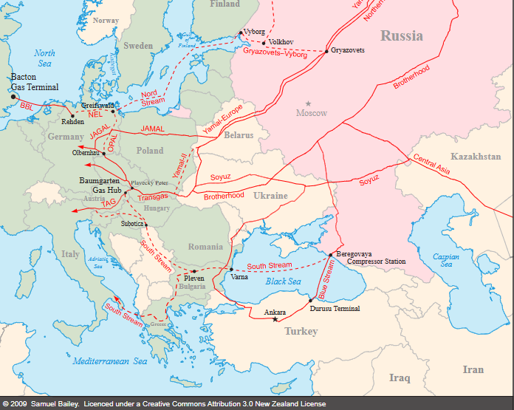
Findings - Historical Context and Strategies
Historically, Russia has used natural gas to exert influence over its neighbors: In Ukraine, gas supply disruptions were used as leverage during political disputes. In Belarus, pricing manipulations and supply cuts were tactics used during negotiations. The construction of the Nord Stream pipelines bypassed traditional transit countries, increasing Russia's control over gas supplies to Europe.

Slide 6
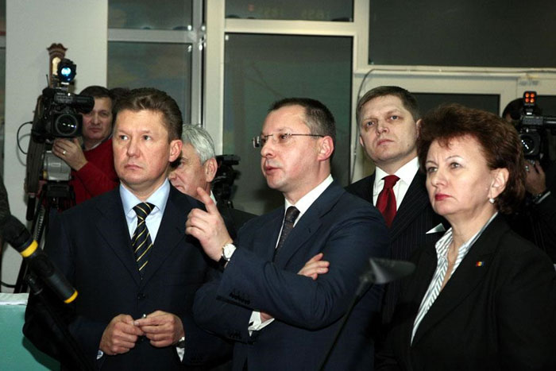
Moldova-Gazprom Relationship
Moldova relies heavily on Russian gas, which has created significant vulnerabilities. Key points include: Historical background and initial supply contracts. Establishment of Moldovagaz, a joint venture with Gazprom. Financial controversies and disputes, including the accumulation of debt and the impact on Moldova's energy security.
Alexei Miller, Robert Fico, and Zinaida Greceanîi at the Gazprom control room, January 2009

Slide 7
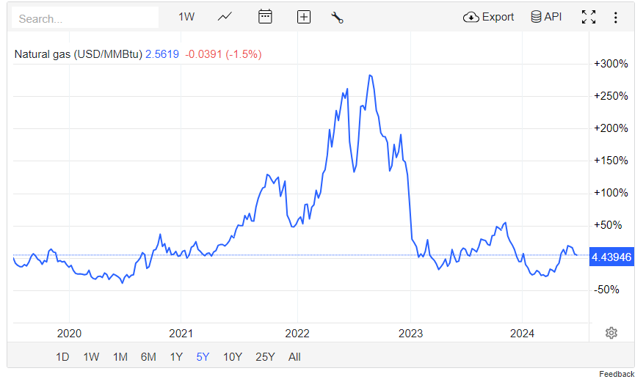
2021 - 2024
Energy Crisis
In 2021, Moldova faced an energy crisis due to rising gas prices and contract renegotiations with Gazprom. Key events included: Significant price increases throughout the year. Emergency measures by the Moldovan government to secure alternative gas supplies. A state of emergency in the natural gas sector and negotiations for a new contract.

Slide 8
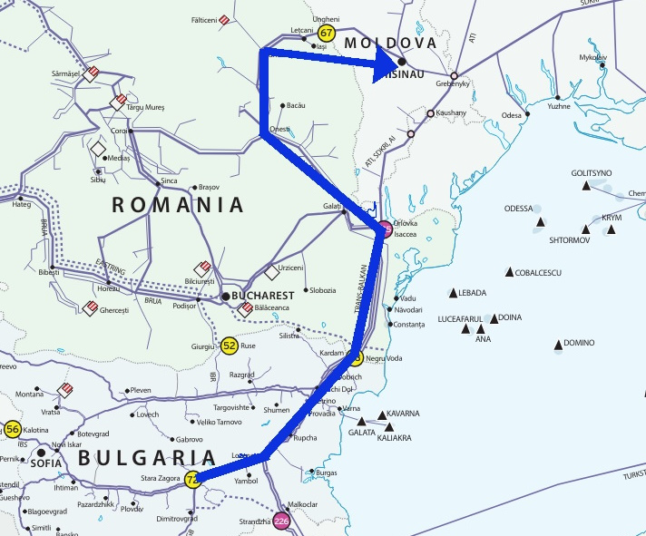
Measures to Address the Energy Crisis in Moldova
1. Energy Source Diversification:
- Joined the Energy Community (2009)
- Adopted EU's Third Energy Package
2. Iași-Ungheni-Chișinău Gas Pipeline:
- Construction started in 2013, completed in 2021
- Connects Moldova with EU energy market
3. Legislative Reforms:
- Law No. 108/2016 on Natural Gas
- Introduced competitive market principles
- ANRE aligned national legislation with EU directives
4. Energy Efficiency Initiatives:
- Projects to improve energy efficiency
- Reduced overall consumption
- Improved residential gas consumption and living standards

Slide 9
Conclusions
The results confirm the hypothesis that Russia uses natural gas as a tool of economic warfare. Moldova's reliance on Russian gas has made it vulnerable to political and economic pressure. The study highlights the need for Moldova to diversify its energy sources and enhance its energy security to reduce dependence on Russia.

Slide 10
Key References
- Buchholz, S. (2022). The impact of energy dependence on Moldova.
- Kelly, M., et al. (2016). Supply Chain and Infrastructure Attacks in Economic Warfare.
- European Commission (2009). The Third Energy Package.
- ANRE (2022). Annual Report on Natural Gas Market in Moldova.
- Ministry of Energy of the Republic of Moldova, 2023 Audit Report
- Moldovagaz, 2024. Financial Report 2023

