Slide 1
ENERGY SECURITY IN THE WESTERN BALKANS Albanian Case
PhD. Eva Hyna
Board Advisor at ERE
(Albanian Energy Regulatory)

Slide 2
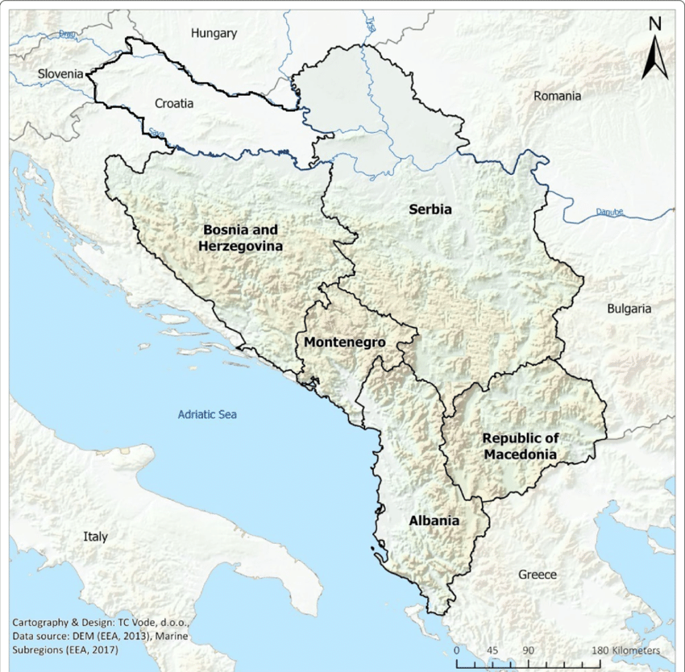
Declaration on energy security and green transition in western Balkans.
3 November 2022 -Berlin
“ …Western Balkans region is a globally significant repository of biodiversity, ecological processes and associated values and that the energy transition and climate action must go hand in hand with the protection of our nature and biodiversity.…
HAVE TODAY AGREED TO TAKE MULTIPLE ACTIONS TO ENHANCE OUR ENERGY SECURITY AND THE GREEN TRANSITION:
We will accelerate the implementation of the Green Agenda for the Western Balkans at both national and regional level, including through regional cooperation for the implementation of its Action Plan….. “
The Western Balkans consists of Albania, Bosnia and Herzegovina, North Macedonia, Montenegro, Kosovo* and Serbia.
Notes:
Energy security depends also on the commitments taken by the members of the WB countries.
At the Berlin summit, the leaders of the Western Balkans (Albania; Bosnia and Herzegovina; North Macedonia; Montenegro; Serbia; Kosovo) adopted the Declaration on Energy Security and Green Transition, which emphasized the commitment of the countries of the region to improving cooperation in the process of transformation of energy sectors and the European Green Deal.
By the 23 points of the declaration, the energy production structure in the WB countries will suffer big changes to reach the European Green Deal.

Slide 3
The Western Balkan countries, as EU candidates, have a special negotiations chapter dedicated to the energy which faces of 21st century’s global energy challenges.
The EU is leading the clean energy transition to striving for a more secure, competitive and sustainable energy system which will address the existential challenge of our time - climate change.
By setting ambitious energy and climate targets for 2030, the EU is giving a clear sense of direction; in addition to these targets, it provides a stable legal framework to foster the necessary investment.
With its 2050 long-term climate neutrality strategy, the EU is also looking further ahead than 2030.

Slide 4
The EU Energy Support Package to help the Western Balkans on December 2022
*To balance the increase of energy prices for businesses and the energy sector.
*To keep energy prices affordable especially for vulnerable households.
To support policy measures to accelerate the energy transition
01
IMMEDIATE MEASURES
to tackle the energy crisis during the 2022 - 2023 winter
02
SHORT AND MEDIUM TERM MEASURES
EU support for the diversification of energy supply through the Western Balkan Investment Framework (WBIF): (2/1)
EU supports, through WBIF, the clean energy transition and energy security with: (2/2)
02/1
To upgrade gas and electricity interconnectors.
For the construction of renewable energy projects and energy efficiency installations
For next 1-2 year
02/2
For the next 3-4 year
Large scale renewable energy generation projects, upgrade of electricity transmission systems, and district heating.
Energy efficiency support schemes for multi-apartment buildings and old blocks-of flats.
Guarantees support schemes
*European Union, Western Balkans Focus on energy, December 2022
Notes:
EU supports the WB region by different programs to reach the EU established goals for 2030 and 2050.
During the energy crisis of 2022 winter, EU gave support of 1 billion Euro for:
The immediate measures – half of the EU’s 1 billion Euro package provided direct funds to the region’s economies through budget support measures to overpass the crisis impact.
For the short and medium term measures - The second part of the package the other 500 million Euro covered the investment to diversify energy supplies boost renewable energy and energy efficiency

Slide 5

Power production structure in the Western Balkans countries
Albania: 97,7% in hydropower and 2,3% solar power
Bosnia and Herzegovina: 67,4% coal, 0,3% oil, 28,9% hydro, 2,4% wind & solar
Kosovo: 58,6% coal, 29,2% oil, 3,7% hydro, 5,2% wind
Montenegro: 46,7% coal, 45,5% hydro, 9,8% wind
North Macedonia: 46,7% coal, 9,7% oil, 16,7% natural gas, 22,7% hydro, 1,8% wind, solar, biofuels
Serbia: 66,3% coal, 4,1% natural gas, 26,1% hydro, 2,7% biofuels & wind
* IEA (International Energy Agency) 2023
Notes:
Analyzing the structure of the power production, we can see Albania has a 100% green energy and all countries must invest in changing the sources structure, specially Kosovo, Bosnia and Herzegovina and Serbia.
The biggest problem is in Kosovo which cannot support from its own economy the huge investments for reducing the pollutant energy production which represents 90%.

Slide 6
CO2 emissions and share of global emissions
from power generation
Electricity production and trade balance
Country | CO2 emissions from power generation | Share of global emissions
Albania | 0 | 0%
Bosnia and Herzegovina | 21 Mt CO2 | 0,06%
Kosovo | 8 Mt CO2 | 0,02%
Montenegro | 3 Mt CO2 | 0,01%
North Macedonia | 8 Mt CO2 | 0,02%
Serbia | 45 Mt CO2 | 0,13%
Western Balkans Countries | 85 Mt CO2 | 0,25% (7,8% of Europe)
EUROPE | 1 092 Mt CO2 | 3,2%
Country | Total electricity production in 2022 (GWh) | Net electricity balance imports / exports
Albania | 7 002 | 14%
Bosnia and Herzegovina | 16 381 | 18.5%
Kosovo | 6 997 | 9.6%
Montenegro | 3 322 | 4%
North Macedonia | 5 933 | 24%
Serbia | 35 510 | 9,5%
* IEA (International Energy Agency) 2023
* IEA (International Energy Agency) 2023
Notes:
Albania has to increase production in solar to cover the imports
B & H exports energy from pollutant sources and will face energy problems when the coal power plans will be closed
Kosovo has a big problem with 90% energy production from pollutant sources and imports of 9,6%
Montenegro has to develop the solar and wind production to reduce the coal energy production
North Macedonia will be faced with problems considering the 55% production from pollutant energy and 24% import
Serbia must take immediate measures: huge CO2 emissions, 66% energy from pollutant sources and 9,5% import
Europe is at the same level of emission with almost all world regions (3,2%). North America is the biggest pollutant with 16,15% (USA = 13,51%)

Slide 7
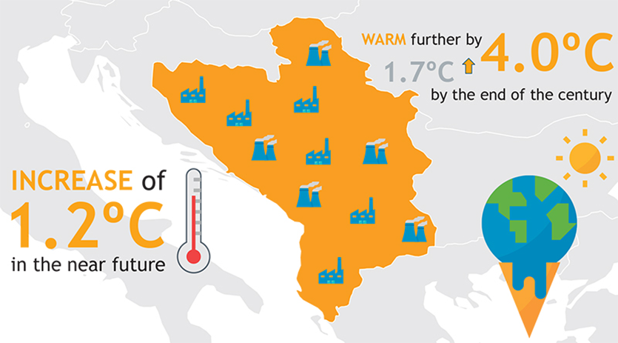
Facing the climate change in WB by pollutant emission
* Regional Cooperation Council (RCC) 2018
Notes:
Regional Cooperation Council (RCC) in Sarajevo, published a Study on climate change in the Western Balkans, showing alarming increase of temperature over the whole territory, with observed temperature increase of 1.2ºC in the near future, destined to warm further by 1.7 – 4.0°C and even exceeding 5.0°C by the end of the century, depending on the global effort in greenhouse gasses (GHG) emission reduction.
Analyses of the climate change in the region recognize that human health, safety and life quality are highly vulnerable to natural hazards and sectorial weather related losses, while also identifying sectors that will experience the biggest impacts:
• Agriculture (food quality decrease, land erosion and degradation, etc.);
• Forestry (high risk of widespread forest degradation, fires, etc.);
• Water resources (deficiency in drinking water, etc.); and
• Human health (increase of heat waves, intrusion of new vector-borne diseases, etc.)

Slide 8
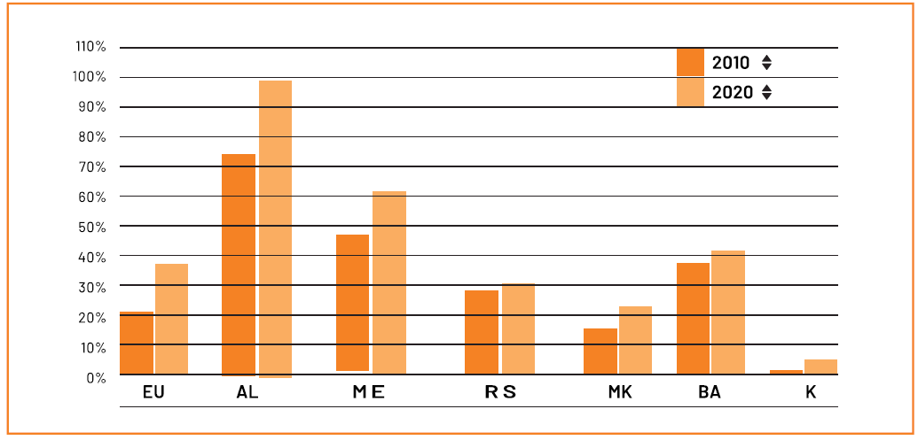
Electricity generated from renewable energy sources, 2010 and 2020 [% of gross electricity consumption] source: Eurostat
Country codes: AL = Albania, ME = Montenegro, RS = Serbia, MK = North Macedonia, BA = Bosnia and Herzegovina, K = Kosovo

Slide 9
ALBANIA
- ENERGY SECURITY -

Slide 10
Some factors which are influencing the Albanian energy security: a) Structure of the sources in power production – 100% green energy from hydro and solar, but not diversified strong dependence on hydro. b) Energy transport and interconnectivity in a modern electricity market design - The transmission system operator is unbundled and certified. c) Decarbonizing the energy sector - The National Energy and Climate Plan (NECP) of Albania was adopted in December 2021, but there are many delays in implementation. d) Renewable energy - The National Energy and Climate Plan (NECP) was adopted in line with the 2030 EU target of 54,4% of renewable energy in gross ﬁnal energy consumption. e) Energy efficiency - energy efﬁciency and climate action were introduced of its 2030 energy efﬁciency targets and associated policies and measures, in the NECP, but they are not aligned with the 2030 targets set by the Energy Community.
Notes:
Added comments for:
Energy security is the association between national security and the availability of natural resources for energy consumption.
- The access to cheaper and non-pollutant energy has become essential to the functioning of modern economies.
b) The TEN-E Regulation is transposed, but no progress has been made in its implementation. The PECI project from 2018, the 400 kV OHL between Albania and North Macedonia, is still in the construction phase. For gas: The Trans Adriatic Pipeline (TAP) is certiﬁed unbundled, under the independent transmission operator model. Albgaz, the national transmission system operator, is certiﬁed according to the ownership unbundling model. However, not all certiﬁcation conditions, including the competence to take an investment decision, have been met.
c) The work on the review continued in 2023 but was not ﬁnalized by the deadline set in the Governance Regulation. Albania has not deﬁned the 2030 climate target in national legislation. Albania has not yet adopted a long-term strategy with a 2050 climate neutrality objective. It remains unclear if and how such an objective will be reached.
d) There is no progress concerning the integration of renewable energy in the heating and cooling sector of Albania, including heat pumps in individual or big buildings heating systems.
e) For the buildings energy efficiency, a long-term building renovation strategy has not yet been adopted in Albania. local Banks are actively involved in promoting energy efﬁciency by offering credit lines for various measures, with a primary focus on enhancing the thermal insulation of building envelopes in private buildings. These initiatives are subsidized with up to 50% of the costs being ﬁnanced by the Municipality of Tirana.

Slide 11
Implementation of the EU energy legislation from the Energy Community Treaty
2023 Implementation overview - Albania
EU Energy Community Secretariat, Annual Implementation Report 2023

Slide 13
National energy security
1. The security of power supply rules, required by the Power Sector Law, have not been adopted yet in Albania.
In December 2022, the Government adopted the national action plan in response to the energy crisis. This plan deﬁned the measures that were undertaken by the Government under the state of emergency for the supply of electricity, prolonged until 31 December 2023.
A cybersecurity strategy is being drafted. In July 2020, the regulator revised the existing cybersecurity regulation.
2. Gas emergency regulations are in place following amendments to the Gas Law in 2021, which incorporate some but not all pro-visions of the Security of Gas Supply Regulation.
3. The emergency oil stockholding system is based on legislation from 1999 (amended in 2004) and two governmental decrees. The entire emergency stockholding obligation is assigned to the oil industry. In 2018, a new law was drafted, but failed to be adopted. As an alternative, three draft regulations and a governmental decision were prepared in 2022
Source: Ministry of Infrastructure and Energy,

Slide 14
RAID summary for the Albanian energy security
R
A
I
D
Risks
Assumptions
Issues
Dependencies
Not enough energy produced from the national sources to cover the need
Energy price increase
Low performance interconnections
Dry summers
Lakes warping
No connection to TAP
97% Hydro energy
Notes:
Depending by 97% on the hydro power, in case of dry summers, considering also the percentage of the lakes warping and no connection to TAP for access to natural gas, under the energy price increasing due to different causes and still national low performance interconnections, Albania can be face with important economical and social problems in covering the energy domestic need. Immediate measures must be taken to significantly reduce the risks.

Slide 15
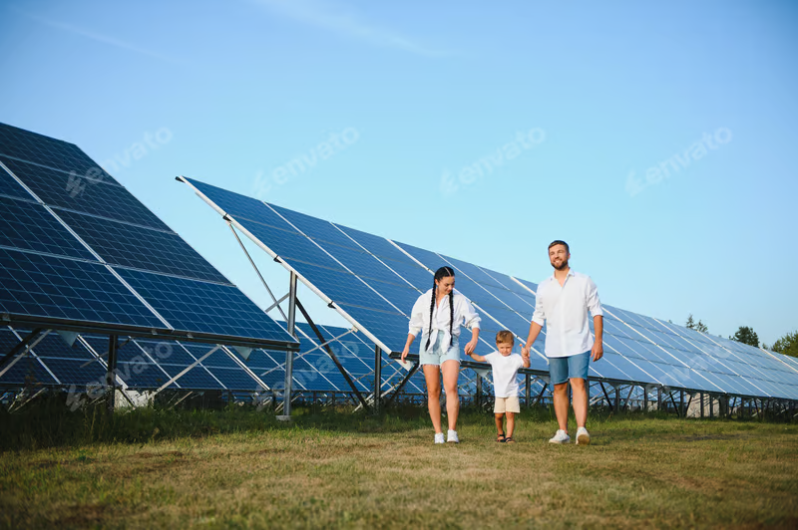
CONCLUSIONS
Albania has the best situation among the Western Balkans countries from the energy security point of view, but some decisions must be taken soonest possible:
To increase the photovoltaic energy up to 10% in the power supply structure in the next five years
To connect the Vlore power plant to TAP and to add another 100 MW to the grid. Project started in 2011 and is on hold!!!
To develop the agrivoltaics systems to all existing and future farms.
To implement the energy efficiency to all buildings, apartments, public and individual.
To implement and update strong security measures at all levels and structures of the national energy.
THANK YOU!
Notes:
Power plant from Vlore was based on the LNG import from USA, but the terminal was not built.

