Slide 1
Energy Concerns in National Security and Business Intelligence
Energy and Security Resilience: Business Intelligence in Times of Conflict

Slide 2
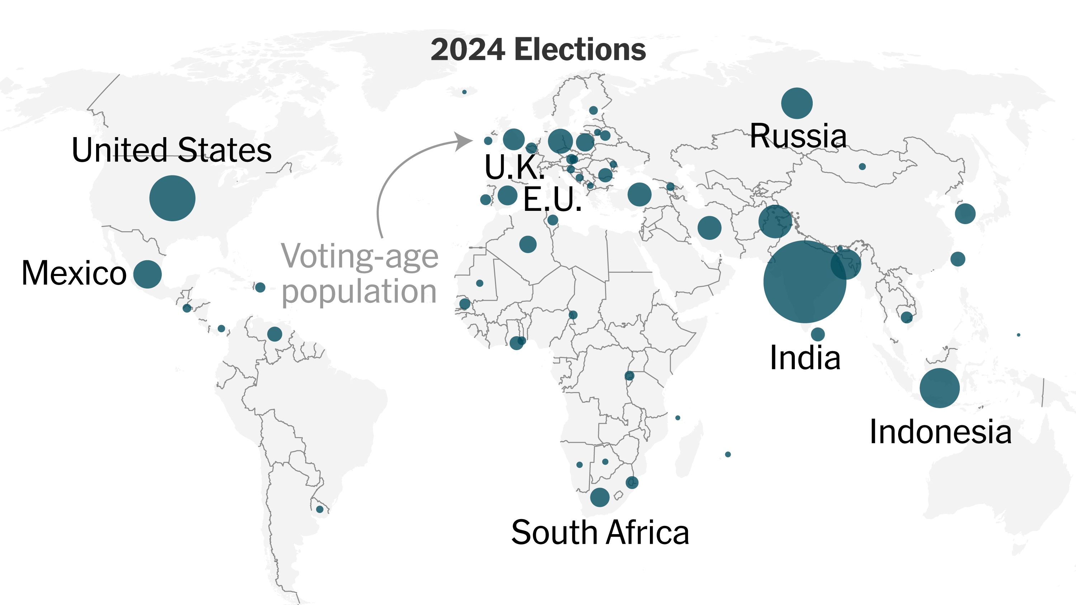
Energy Themes Overview
Energy Security - Global economies are now putting more effort than ever on building domestic clean technology manufacturing capacity to improve energy security and boost economic activity, including through support to domestic production and through trade measures
Uncertainty - Russia’s invasion of Ukraine, conflict in the Middle East, broader geopolitical tensions, and elections in countries accounting for half of global energy demand today mean a very high level of uncertainty
Clean energy transitions +2% was the total global energy demand in 2023, with declines in advanced economies more than offset by large increases in emerging market and developing economies.
A record high level of clean energy came online globally, including more than 560 gigawatts (GW) of new renewable power capacity. Around USD 2 trillion is expected to be invested in clean energy in 2024.
Source: https://www.iea.org/reports/world-energy-outlook-2024
Notes:
Orientation towards business, industries and markets happened more recently and it is related to the within some (mainly US) firms in the ‘70s.

Slide 3
Building a Business Intelligence Education Network.

Slide 4
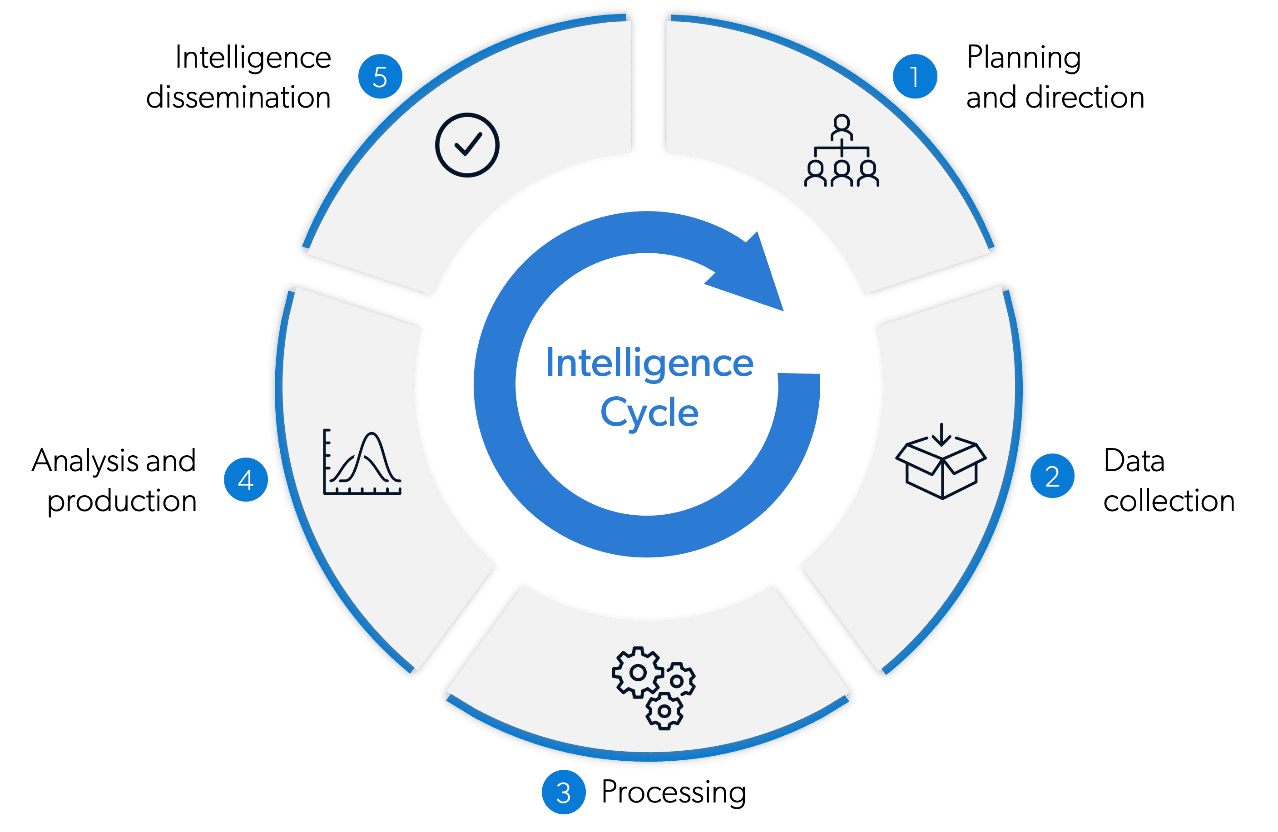
In time the progressive development of what initially were ad hoc and informal processes become:
Assumed
Transparent
Systematized
Professionalized
Intelligence has a long history
As the practice of collecting data in order to inform military and political decisions, one that overlaps with the history of waging wars and outclassing enemies.
Notes:
Orientation towards business, industries and markets happened more recently and it is related to the within some (mainly US) firms in the ‘70s.

Slide 5
The orientation towards business, industries and markets happened more recently, these processes involved circumstantial gathering and indexing data on firms’ competitors as well as on the composition, dynamics of the industry in which they were performing and how the principles of intelligence might be applied to business.
The ideas of strategy and information were brought together, discussed the emergence of “social intelligence” and pleaded for shifting from stealing secrets towards intelligent analysis and “open sources”.
Along these decades of refinement, what we call today competitive intelligence has intertwined and seldom been used as:
Business intelligence
Corporate information
Market research
Knowledge management
CI has undergone significant changes given by the accumulation of tacit and explicit knowledge, lessons learnt, professionalization and specialization of CI experts and, last but not least, by the gradual but decisive technologization that proved to be a crucial element in the development of the field.

Slide 6
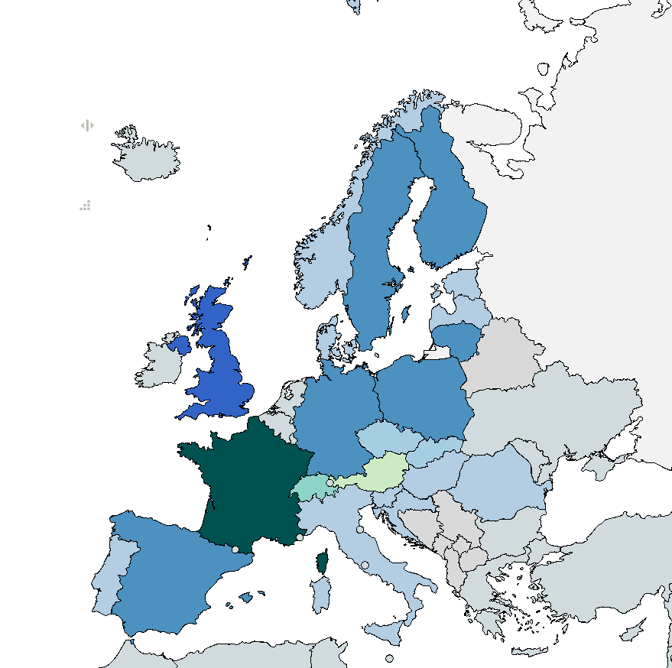
Against this encouraging picture of a more that five decades systematic maturing, the landscape beyond the Anglosphere does not echo the same thriving.
Geographically, in Europe there is an unbalanced dispersion of CI, there are varying levels of competitive intelligence knowledge, practice, and longevity between countries.
Such a diversity that does not allow a “side-by-side” comparison.
The European landscape can be characterized as being:
1) Emergent – progress is visible,
2) Dependent on the national strategic culture and the engagements of the political level – integration in the EU was a trigger,
3) highly receptive to existing legacy of scholars
Notes:
From the multitude of concepts by which CI practices are called (competitor, competitive, business, economic intelligence) to the different organizational functions to which CI is associated (e.g. marketing in Germany, market research, customer management, web searching or environmental scanning in UK) and different level of use (e.g. tactical in Finland and strategic in Sweden), the European landscape proves to be diverse.

Slide 7
The particular example of France is illustrating the footprint of the national strategic culture.
Here, CI is characterized by an interconnection:
Defense
Government
Business.
It is illustrated not only in and by the backgrounds of the reputed figures who have contributed since the ’80s to the development of the discipline, but also in the construction of what it is called “intelligence économique” combining both public and private sector.
In 2016 France created „Service de l’Information Stratégique et Sécurité Économiques” seeking to “raise the awareness of economic actors about economic security”.
Hence, CI in France has its multidimensionality given by the involvement of levels of government, numerous support organizations from the private and the public sectors as well as public private partnerships and quasi‐ governmental organizations.
Le Rapport Martre (1994) on national competitiveness illustratively identified three pillars of CI for France:
1. Encourage the practice of CI at the company level;
2. Optimize the transfer of information between the private and public sectors;
3. Construct data banks in light of the user needs

Slide 8
Romania: the star of the region
A valuable discussion about intelligence practices in Romania cannot be made without the reference to the variables shaping post-communist Romania.
By bleak contrast to events elsewhere in central and eastern Europe during the course of 1989, the collapse of the Ceaușescu regime in Romania was extremely violent
The 1989 Revolution images about the Securitate and its abdominal acts have prolonged by feeding collective perceptions of intelligence as being corrupt, subversive, and against human rights.
After two decades since the 1989 and the Romanian revolution, and assisted by initiatives such as:
The Romanian Intelligence Studies Review (Revista Română de Studii de Intelligence)
The National Institute for Intelligence Studies (Institutul Național de Studii de Intelligence) or
The master's program in Intelligence Analysis (Analiza de Intelligence), intelligence has started to make its way in particular in the academic environment but also with reverberations in mass media.
Relatively similar conceptual struggles has featured the avenue of competitive intelligence.
Its first formalized use goes back to 2012 when the Intelligence for Businessman Association (Asociația Specialiștilor în Informații pentru afaceri - ASIA) and its journal were created with the involvement of several former intelligence officers. Both provide a very good example of the interconnectivity between generally acknowledged concepts (such as intelligence and competitive intelligence) and the local and national variations.

Slide 9
A consistent debate engaging both the scholars from the governmental intelligence schools sector (pertaining to the ministry of interior, internal intelligence service) and also the experts from the very emergent intelligence private sector was initiated about the competencies that intelligence analysts needed jointly with the attempt to formalize a competencies framework.
This led to the creation of a new occupational standard including the skills, knowledge, values, and interests needed and also clarifying the professional contexts and the activities specific to experts in what was called ”private intelligence”
On an academic level, two master's programs were created by the National Intelligence Academy: Competitive Intelligence and Competitive Intelligence for Public Administration. While initiated at the same time (October 2014)
A more recent initiative (2022), the Master of Business Intelligence granted by the Bucharest University of Economic Studies seeks to build competencies in data collection, analysis and communication that will help improve products, services, and strategies in constantly changing markets and realities
Currently, there are several small entities that officially declare their involvement in collecting and analyzing data about markets and competitors.
They seem to embrace a similar portfolio of activities ranging from consulting to training, both in Romania and in the South- Eastern Europe, with a main declared focus on competitive intelligence or to related activities (e.g. risk analysis, due diligence, financial analysis, computer security and forensics, surveillance and counter-surveillance).

Slide 10
In a nutshell, at the moment the landscape of CI in Romania shows a certain dynamic, but looks rather fragmented and solely concentrated on the practice and tradecraft of CI.
What is evidently lacking is the comunity as a reflection of advancement in the knowledge about and in CI as few existing writings are mere reflections of previous non-autochthonous concepts and theories of CI without including a scientific research-driven systematization of best practices and lessons learnt.
And HERMES Association as an education network aims to provide the context, key professional support, the right environment to grow correctly, while safeguarding the CI profession and occupation.
Based on a set of regulations setting general standards, requirements, restrictions and guidelines and professional deontology code of conduct serving as a platform for expressing professionals' public commitments, enforcing norms, values, and ethics.

Slide 11
Conclusions and way ahead
In the last two decades, Romania has witnessed an unceasing process of developing the practices of intelligence, in both the private and the governmental sector. This process, which has indirectly but frequently connected private and governmental intelligence, was initially hampered by a terminological exploration ended with a progressive, however not autochthonous appropriation of ”intelligence” as a concept.
Similar to other Eastern European countries, in Romania scholars and professionals need to devote themselves to empirically investigating the state of play of competitive intelligence by systematically raising questions (e.g. about the role of CI in organizations, the skills required in the field, the benefits of CI, the interconnections of CI with other organizational functions), while moving beyond the simple postulating or recursive invoking of intelligence as an imported practice.
Such a research-driven endeavor requires coordination between academia, business and government bodies stimulating collaborative formats for intelligence professionals, trainers, and scholars.
And this is what HERMES – Business Intelligence Education Network mission is:
To bridge the gap between academia, business, and government in Romania, enhancing CI practices through collaborative research, education, and professional development.

Slide 12
Building a Business Intelligence Education Network.

