Slide 1
CONCERNS ON ENERGY SECURITY: A COMPARATIVE STUDY ON ROMANIA VS OTHER EUROPEAN COUNTRIES
Dr.Dincă Violeta Mihaela
Dr.Bogdan Anca
Dr.Nen Madlena
Drd.Ion Iulian

Slide 2
SUMMARY
EU ENERGY STRATEGIES: EFFICIENCY AND SUSTAINABILITY – REGULATORY FRAMEWORK - documentary analysis
01
02
ENERGY APPROACHES IN EUROPE: FRANCE, GERMANY, NORWAY AND MOLDOVA – documentary comparative analysis
03
THE ENERGY SECTOR IN ROMANIA: MARKET, CONSUMERS AND CHANGES CAUSED BY VARIOUS FACTORS – qualitative analysis – interviews/ focus groups

Slide 3
1.EU ENERGY STRATEGIES: EFFICIENCY AND SUSTAINABILITY – REGULATORY FRAMEWORK - documentary analysis
European Commission
- The Green Deal (2020):
no net emissions of greenhouse gases by 2050
economic growth decoupled from resource use
no person and no place left behind
-European Climate Law (2021):
greenhouse gas emissions should be 55% lower in 2030 compared to 1990
- REPowerEU (May 2022):
save energy (reduce gas consumption)
diversify energy supplies (overcome our dependency on Russian fossil fuels; ensure access to secure and affordable energy)
produce clean energy (produce more electricity from wind and solar; rapidly increase renewable energy installation)

Slide 4
ENERGY APPROACHES IN EUROPE: FRANCE, GERMANY, NORWAY AND MOLDOVA
-documentary comparative analysis-
France:
Nuclear power as the central pillar
Diversification into renewable energies
Reforms and support policies
Germany:
Energiewende: an ambitious project
Nuclear (and coal) phase-out
Energy efficiency and energy demand management
Norway:
Hydropower: a key resource
Investments in Renewable Energies and Carbon Capture (Northern Lights)
Electric Mobility and Technological Innovation
Republic of Moldova:
Fully dependent on fossil fuel and electricity imports
First renewable energy auction (latter this year)
Reducing dependence on the Russian Federation
Ingoude Company

Slide 5
Electricity generation mix, 2023 according to the International Energy Agency (IEA)

Slide 6
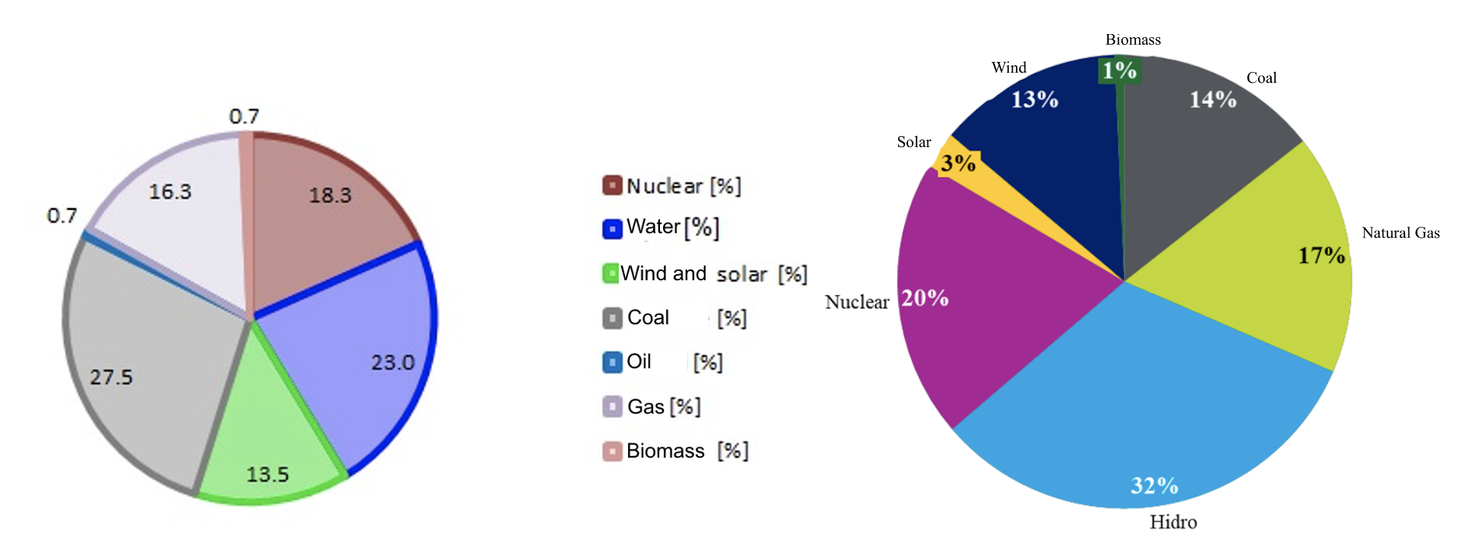
THE ENERGY SECTOR IN ROMANIA: MARKET, CONSUMERS AND CHANGES CAUSED BY VARIOUS FACTORS – documentary and qualitative analysis
Ratio of primary energetic resources in the energy production for 2017 and 2023
-geopolitical tensions and imminent energy challenges
-strategic geographic location and substantial gas production capabilities (ex: Neptun Deep)
-seek alternatives for energy production and supply (ex: development of Units 3 and 4 at the Cernavodă
Nuclear Power Plant)
-improve the % of renewable energies (investments)

Slide 7
ORIGINAL CONTRIBUTION: SURVEY → The aim of the survey was to determine what potential does Romania have so that its energy ecosystem can manage a successful transition to green energy and increase its security.
energy specialists; an interview guide with open-ended questions, ideas, viewpoints of experts who work in the sector and know the current situation. The opinions of 20 experts were gathered (following the structure of the form below), who are working within: Energy Ministry, ANRE, EON, Siemens Energy, ASE Bucharest during the period August-October 2024.
Nr. | Question
1 | How do you think the national energy resources should be managed in order to better contribute to the diversification of the energy portfolio, reduce imports and increase Romania's energy security?
2 | What are the greatest risks to which Romania is exposed in terms of energy in the current geopolitical context (marked by uncertainty and turmoil) and what measures do you consider the most important to be taken to counter these risks?
3 | In your opinion, what is the biggest obstacle to a complete transition from fossil fuels to renewables for Romania?
4 | In many countries we are witnessing an increase in fuel and energy prices, how should the Romanian government intervene (with what concrete measures) to protect consumers and accelerate the transition to a greener and more independent energy market?
5 | With which countries do you consider that Romania can cooperate in the development of joint energy projects to ensure both energy security and geopolitical stability? Give some examples of such projects that you consider important for Romania and other countries.
6 | What changes do you consider that Romania's energy policy needs in order to better consolidate its role as a regional pillar of energy security over the next 10 years?

Slide 8
QUESTION 1 - Respondents' opinion
Development of exploitations in the Black Sea
Investments in renewable energy
Infrastructure modernization
Educating the population
QUESTION 4 - Respondents' opinion
Stimulating investments
Energy subsidy
Price ceiling
Modernization and development of the infrastructure
Incentives and support schemes for prosumers
QUESTION 2 - Respondents' opinion
Price volatility
Energy supply (due to geopolitical instability)
Dependence on imports
Outdated infrastructure
Inability to support consumption from own resources
Legislative instability
QUESTION 5 - Respondents' opinion
Bulgaria
Hungary
Greece
Turkey
Serbia
Ukraine
Further development of the paper:
Increasing the number of respondents
QUESTION 3 - Respondents' opinion
Poorly developed infrastructure
Not enough investments
Legislative instability
Dependence on conventional energy resources (oil, wood heating)
QUESTION 6 - Respondents' opinion
Infrastructure development
Consolidation of legislation
Technological innovation
Educating the population
Attracting investments
Stable fiscal policy

Slide 9
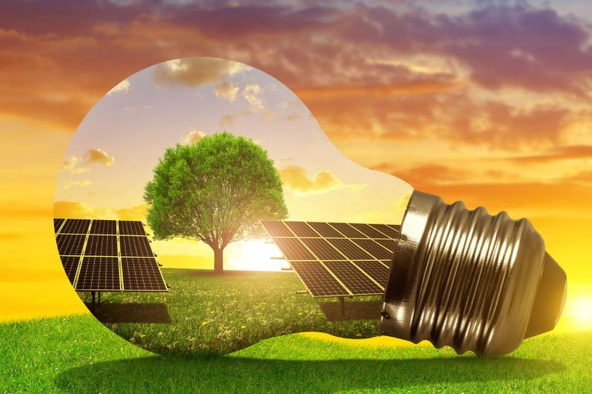
THANK YOU FOR YOUR ATTENTION !
This study is part of the institutional research project of the Bucharest University of Economic Studies
Importanța securității energetice pentru dezvoltarea economică a României în contextul instabilității geopolitice”
Project director: Prof.dr.Violeta Mihaela Dinca

