Slide 1
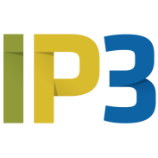
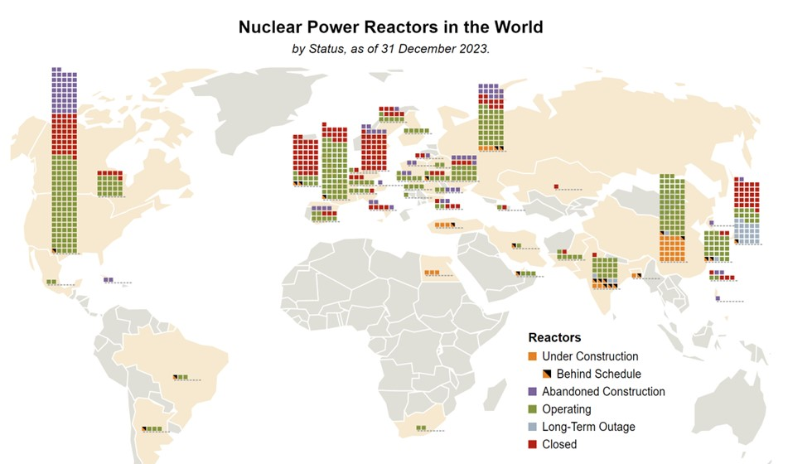
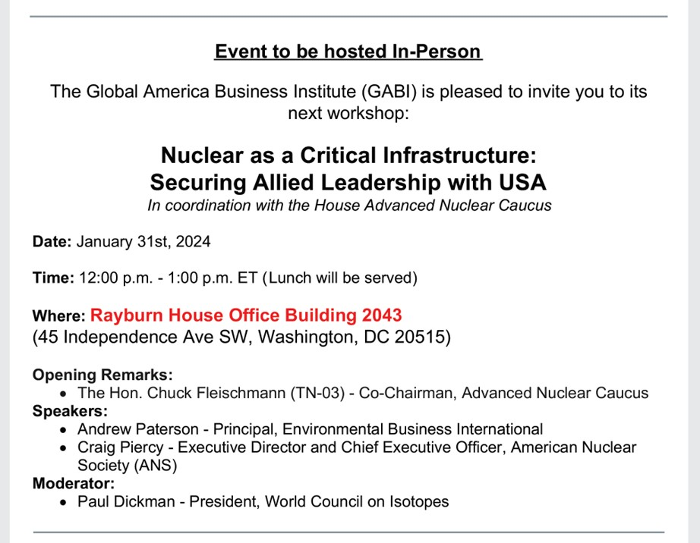
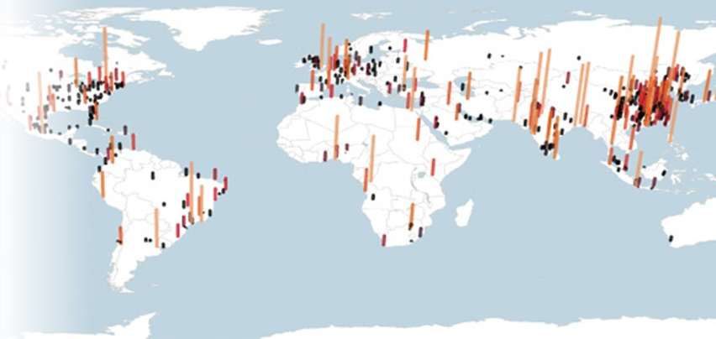
Public-Private Financing of Strategic Partnerships for Energy Security: the case for Nuclear SMRs … and the Evolution of Energy Sovereignty
Andrew Paterson (USA),
Principal at Environmental Business International,
and Strategy & Market Intelligence for
Allied Nuclear Partners @ IP3 Corporation
Andy.Paterson@ip3international.com
Drawn from Briefing to US House Nuclear Caucus
Jan. 31,
2024
Nuclear is for large cities

Slide 2
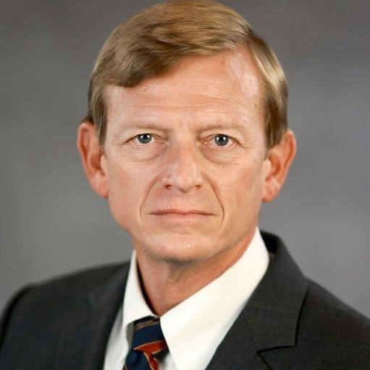



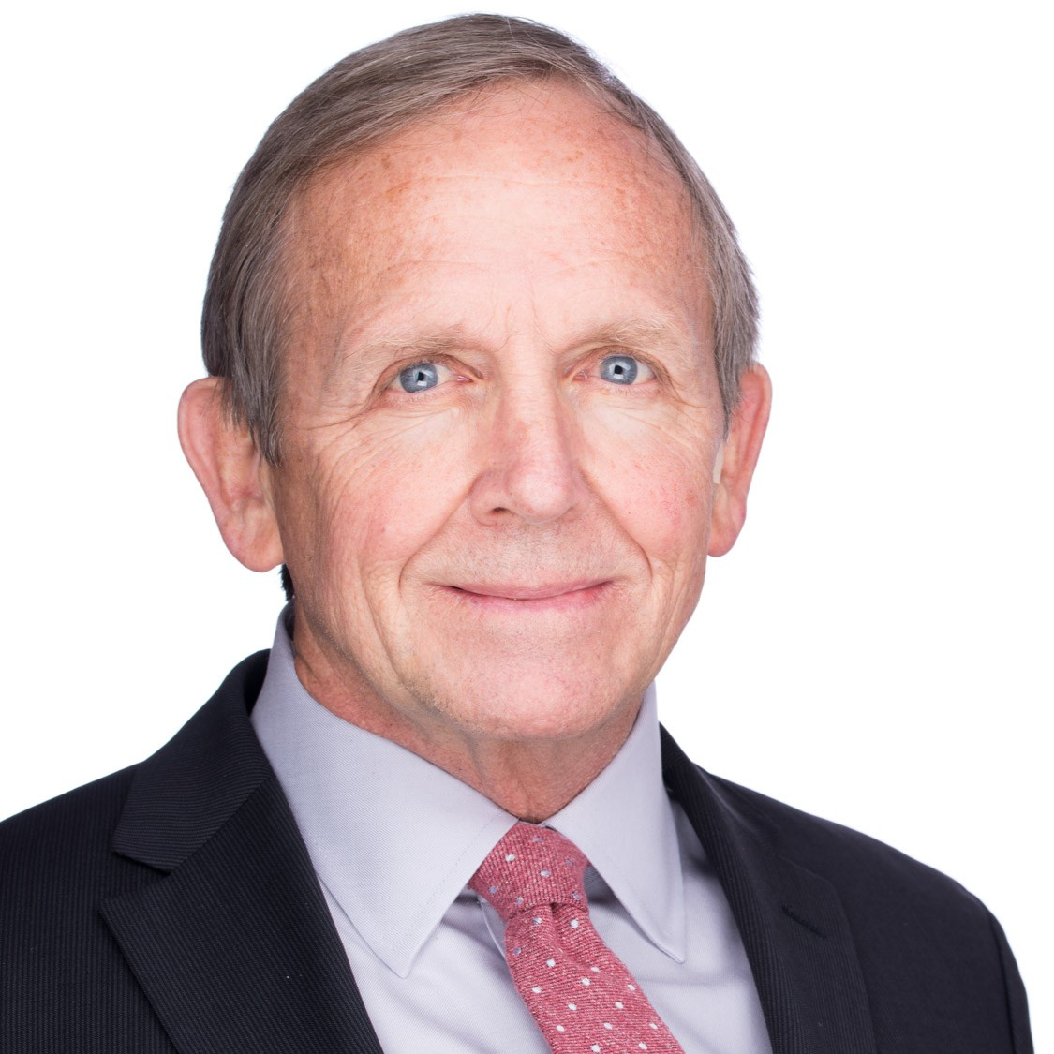
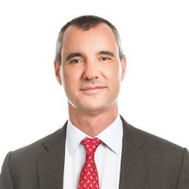

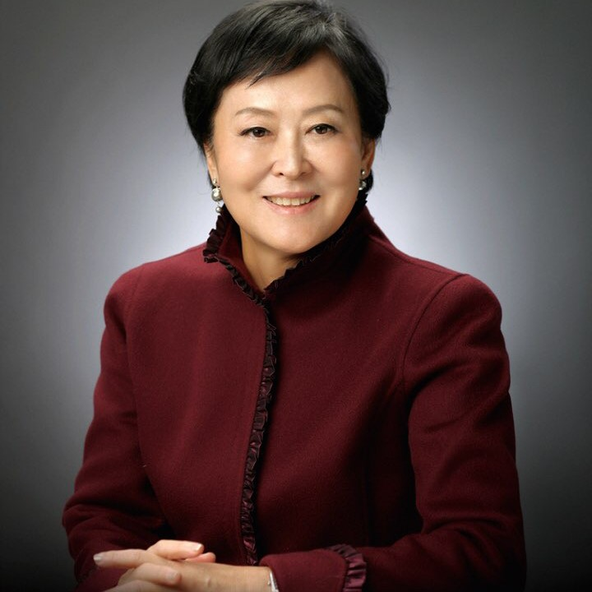
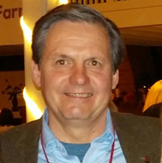
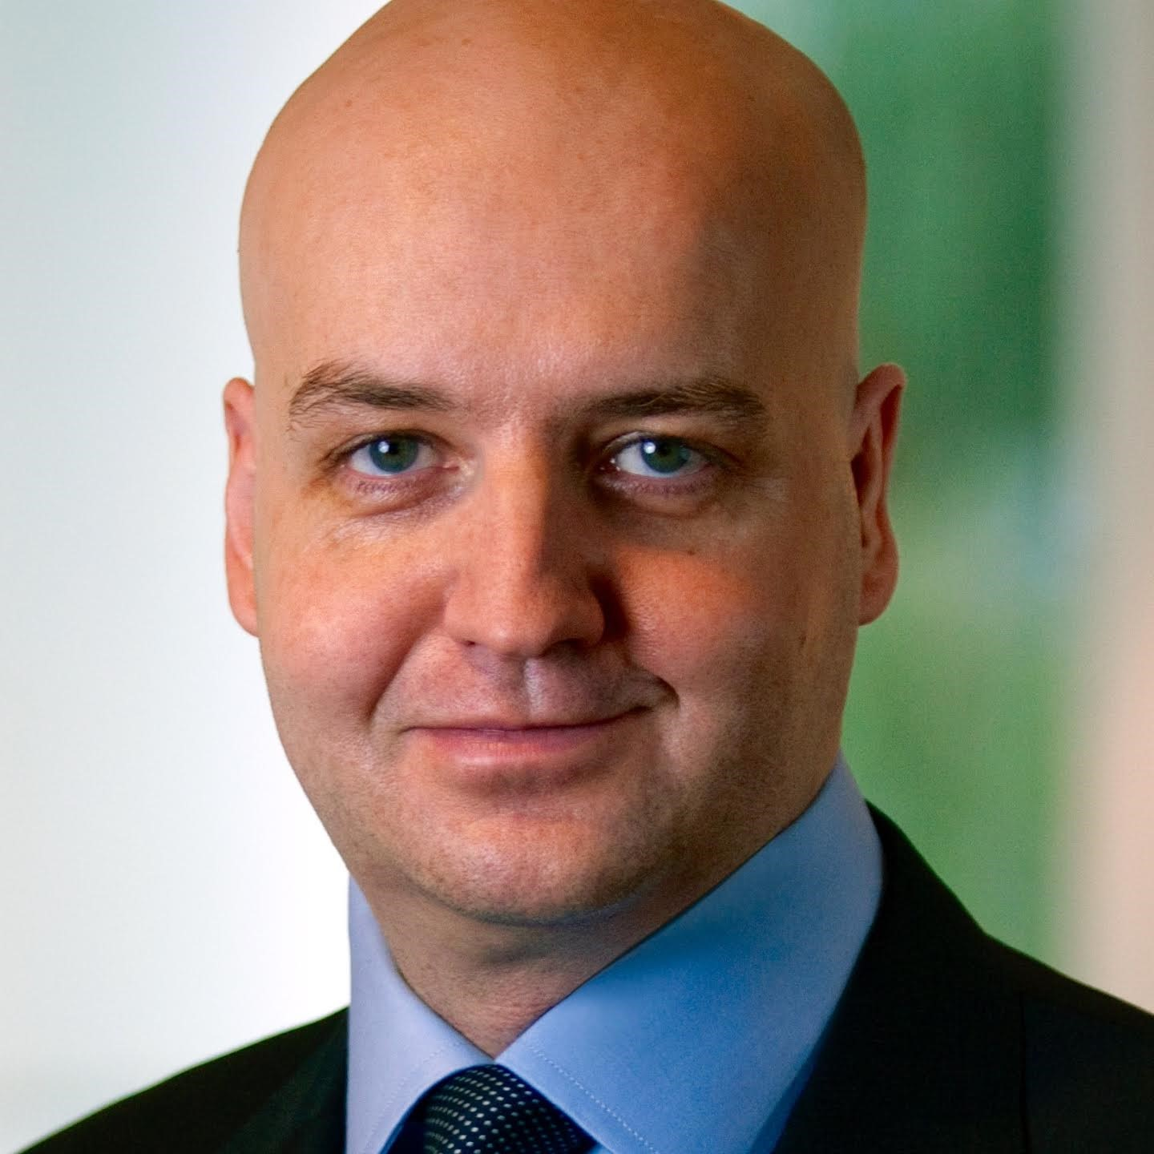


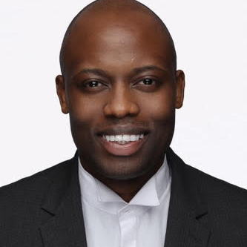
IP3 Leadership
Bi-Partisan leaders in National Security and Sustainable Energy Systems
IP3 Management Team
IP3 Board of Directors
RDML Mike Hewitt
Chief Executive Officer
Expertise in major acquisition programs, information operations, cyberspace operations, and non-kinetic and net warfare
Steve Solomon
Chief Financial Officer
Specializes in development and implementation of business strategies
Alan Dunn
Chief Legal Officer
Former US Assistant Secretary of Commerce and partner at the law firm of Stewart and Stewart
RDML Mike Hewitt
Chief Executive Officer
Expertise in major acquisition programs, information operations, cyberspace operations, and non-kinetic and net warfare
Gen James Cartwright
Chairman
Former Vice Chairman of the
Joint Chiefs of Staff
ADM Eric Olson
Vice Chairman
Former head of US Special
Operations Command
Andy Paterson
Strategy & Markets
Nuclear Hybrid Systems
Rob Sweeney
Technology & Project Development
Nuclear Hybrid Systems
Laura Hermann
Public Relations
Dr Lars Buttler
Director
Leader in private equity and
venture capital financing
Annie Chan
Director
Founder of KCR Development and KCR Management
Amanda Moslé-Friedman
Strategic Partnerships (UK/EMEA)
Andrew Sekandi
Strategic Partnerships
(Africa)
IP3 Advisory Council
Dr Ziad Asali…………...Middle East
Phil Eichensehr……… ISR Security
Andrew Grunstein….Middle East
James Heath….……….Security
Danny W. Mills……….Strategy/Finance
LTG Pat O’Reilly……...Tech & Procurement
LTG Ray Palumbo..…..Intelligence
Amb Dennis Ross…….Middle East
Hon John Tanner….….Government Relations
Proprietary and confidential to IP3.

Slide 3
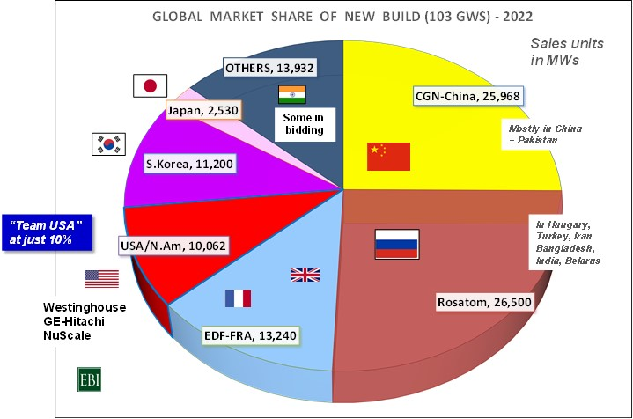
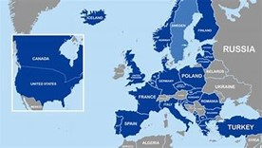
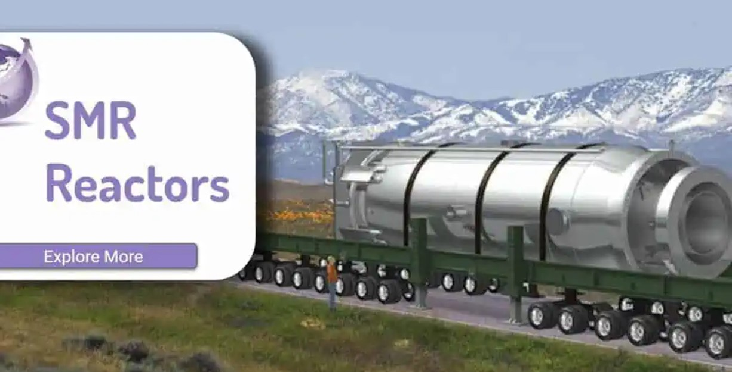
Opening Policy Observations and Financing Considerations
Today, Nuclear Energy is not a “market”, it is an ARENA…
of “Nation-State Gladiators”, like CGN, Rosatom, EDF
Russia and China command >50% of total construction today; USA <5%
Govts are heavily involved in financing new nuclear projects.
1) Look at Industrial Applications First – Steam, Heat, then Power
Take advantage of rising Demand Signals for New Nuclear:
Sharp increase in electricity needs for Data Centers / AI
== Now driving Demand for Nuclear SMRs
2) An “Allied Model” (NATO), working with other countries, is best.
3) Get to “FLEETS” of SMRs sooner… on the BUY-side
Fleets, not “onesies” build supply chain
-- Look to “building airplanes, more than airports” [Jigar Shah, LPO Director]
Not an LCOE Arena

Slide 4
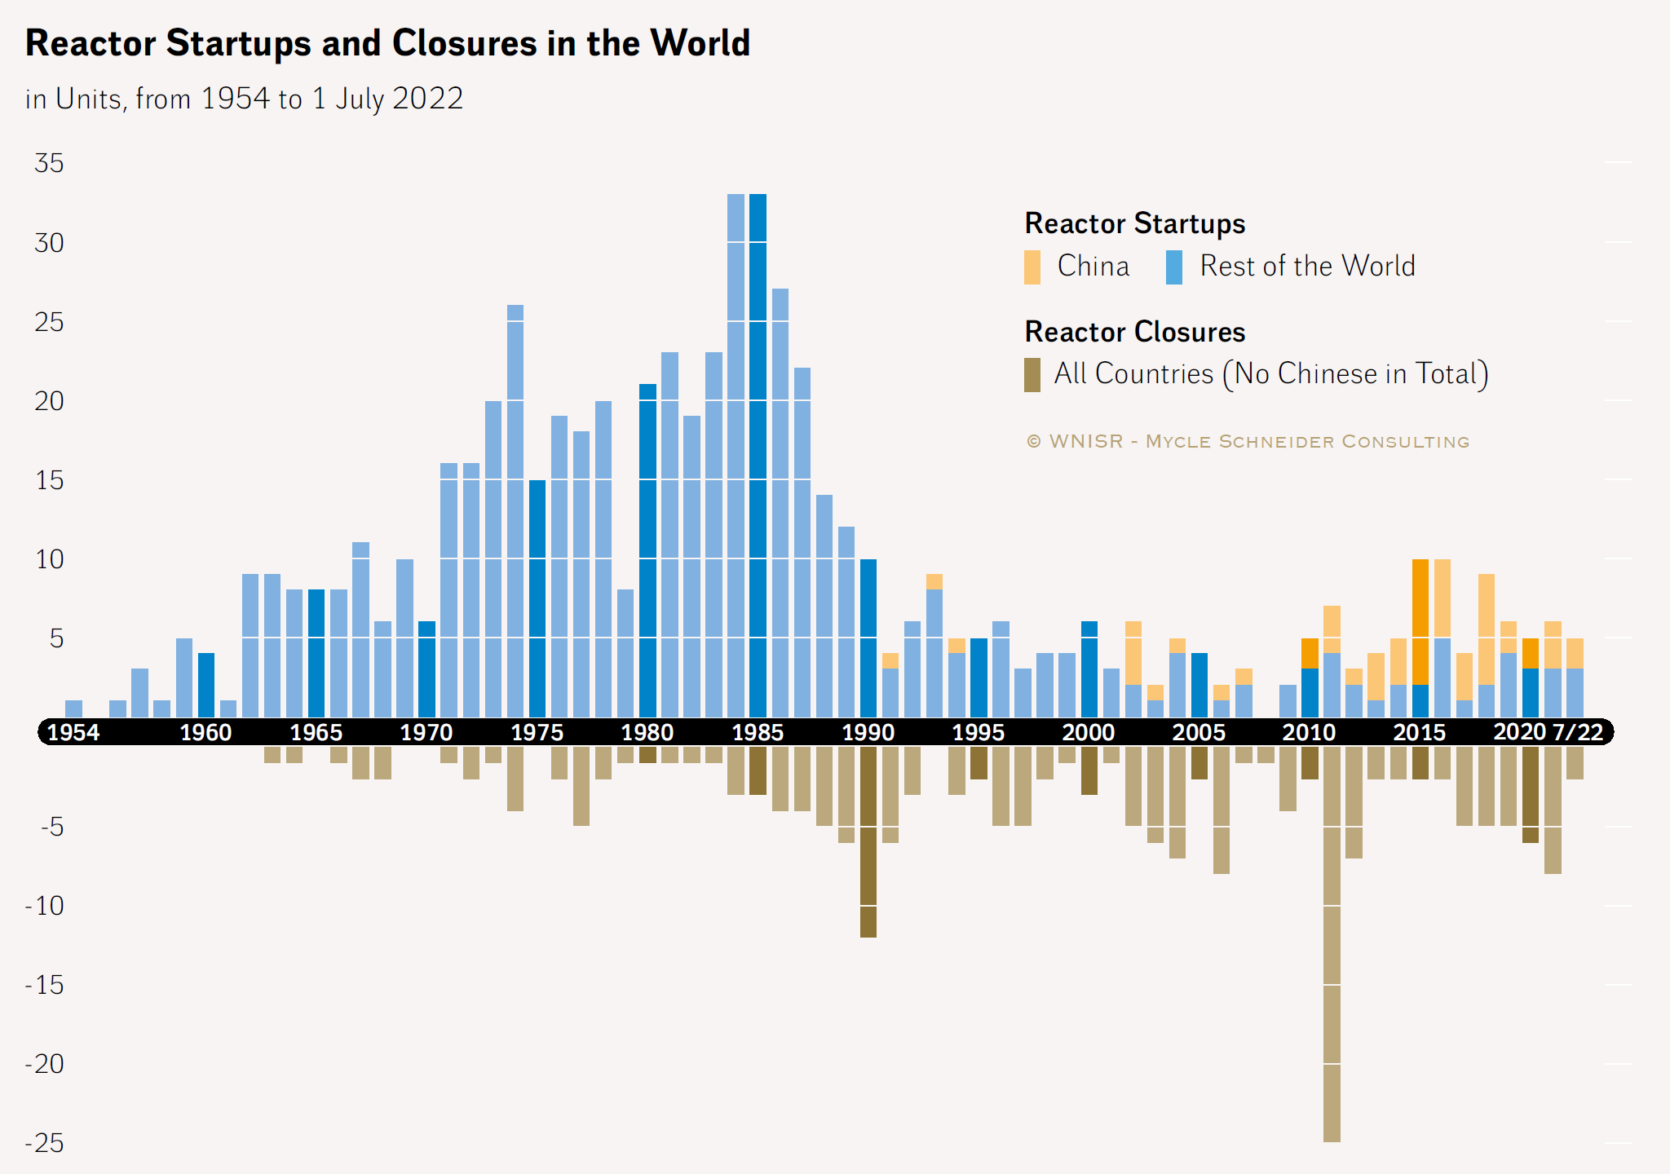
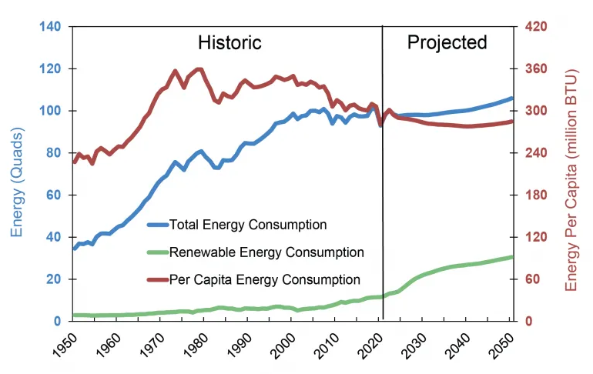
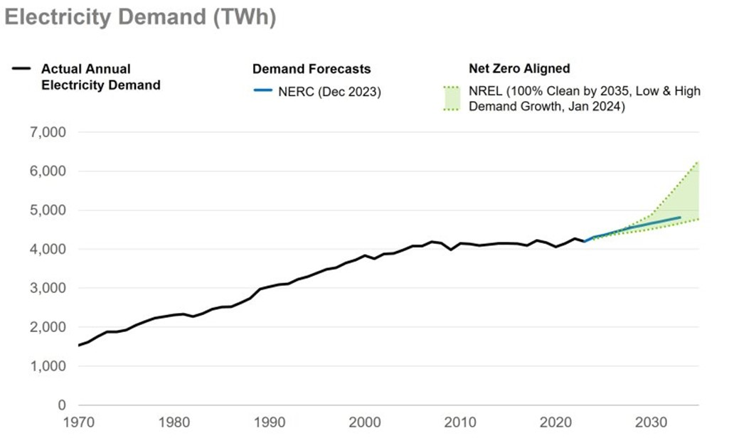
Historically Nuclear Plants are built in Waves… since the 1960s
Not much Energy Growth forecasted to 2050
High Interest rates
TMI
Chernobyl
Electricity demand growth in OECD
Asia Buildup
Cheap
Gas
… until this year with Data Center growth
EPRI: Aug 2024
Fukushima
https://www.worldnuclearreport.org/IMG/pdf/wnisr2022-v3-hr.pdf
https://www.energy.gov/policy/articles/clean-energy-resources-meet-data-center-electricity-demand

Slide 5
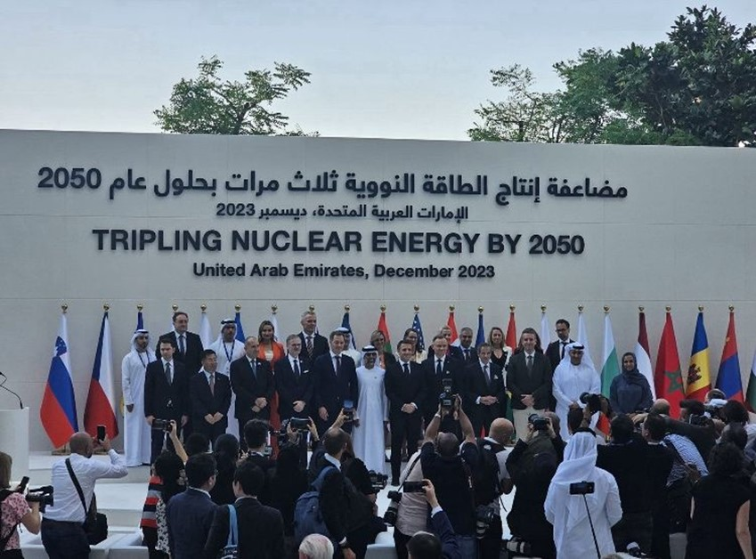
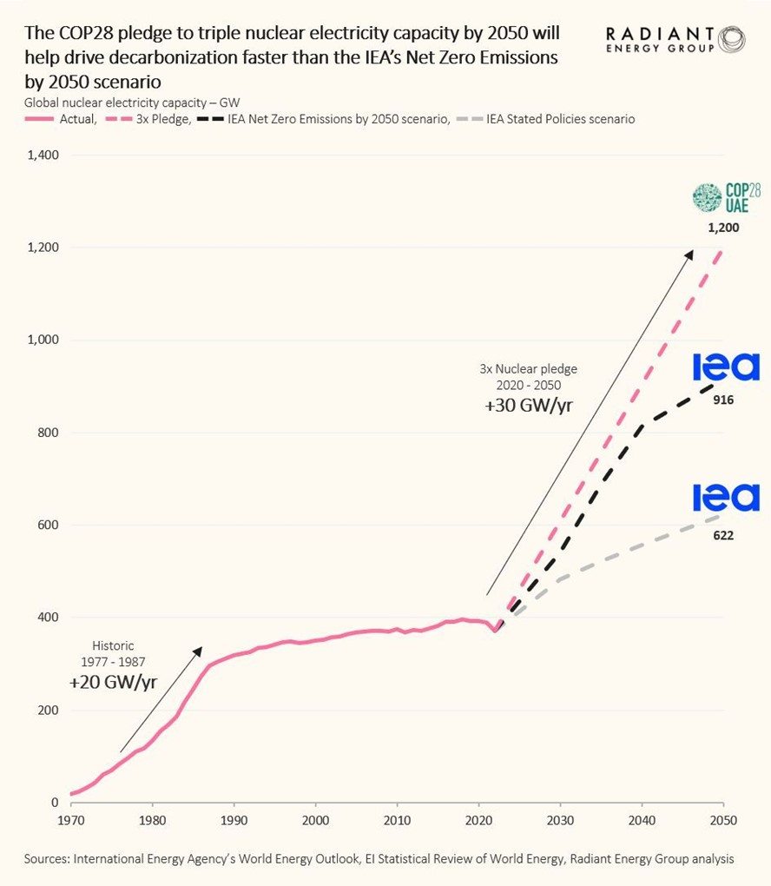
COP28: 25 Countries Pledge to TRIPLE Nuclear Capacity by 2050 (1200 GWs)
This is a LARGE, SERIOUS COMMITMENT… HOW? Where are China, Russia (not on stage)?
New Buyers tend
to be Sovereigns
$5 TRILLION IN
FINANCING…
(over 25+ years)
Public-Private
Partnerships

Slide 6
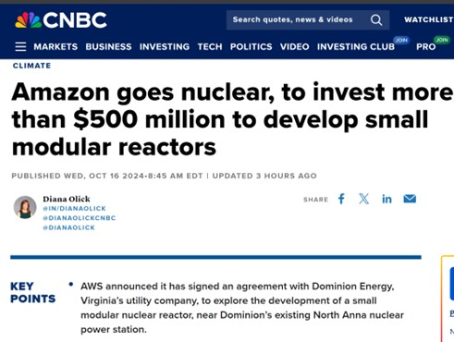
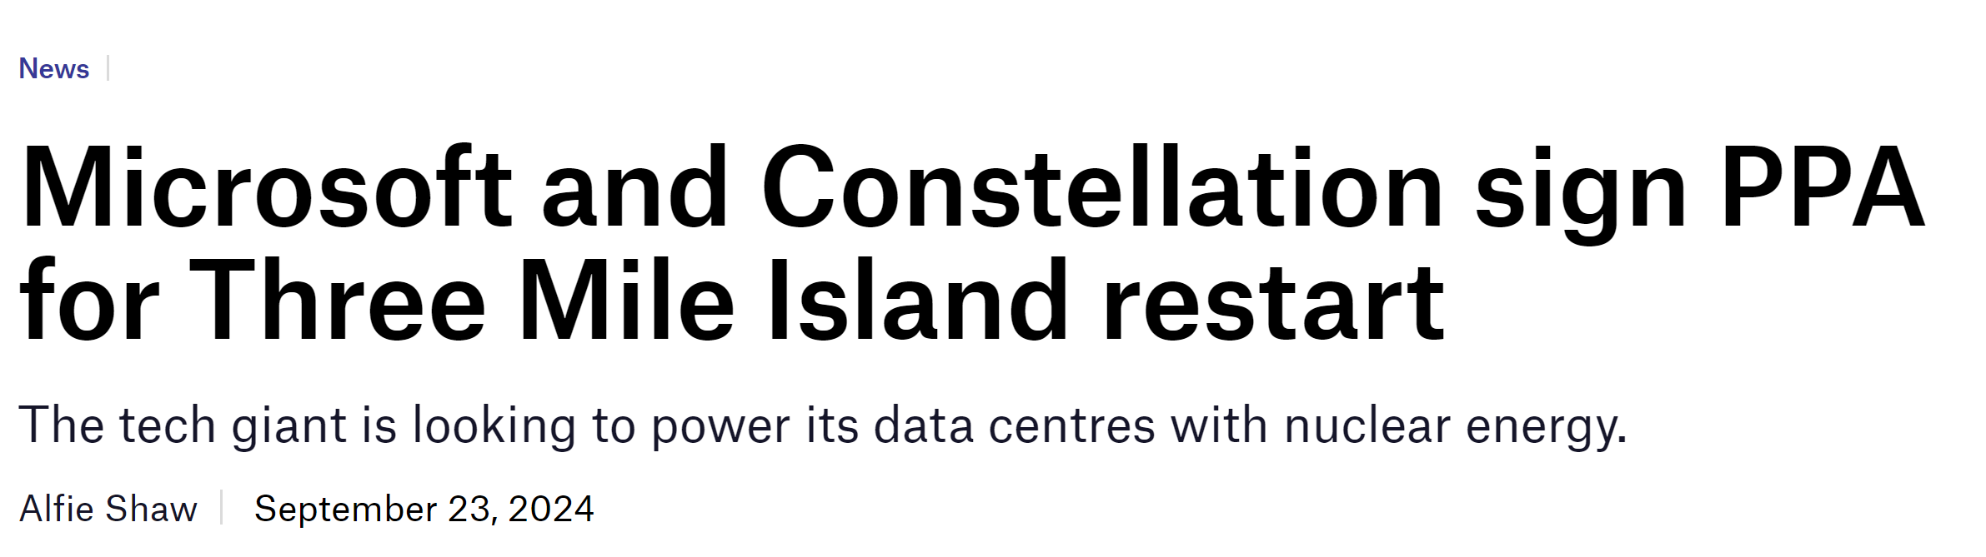
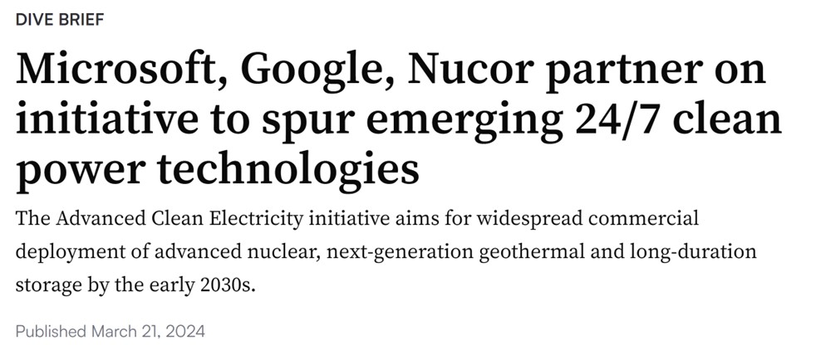
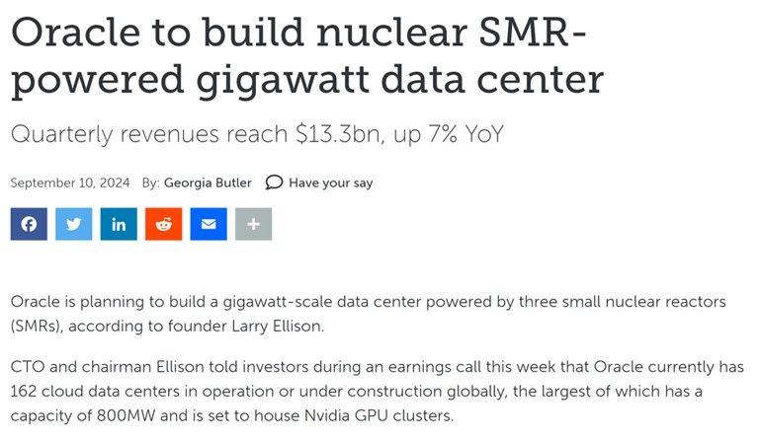
Data Centers / AI Driving Commercial Demand for New Nuclear

Slide 7
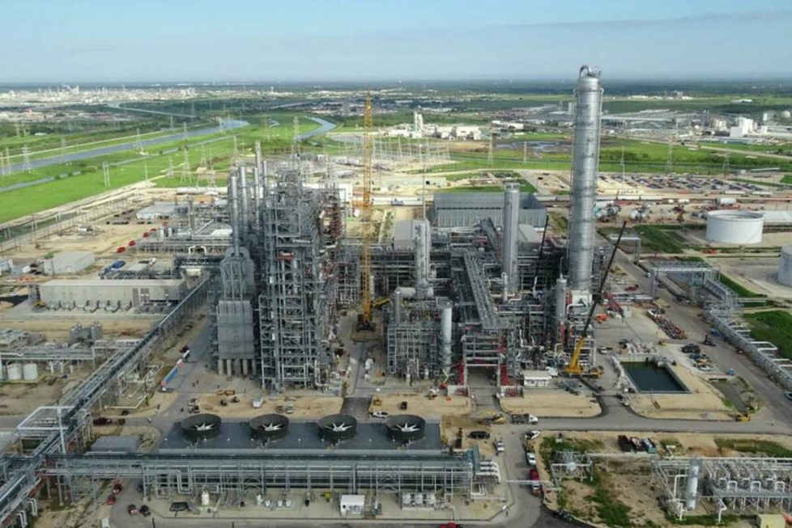
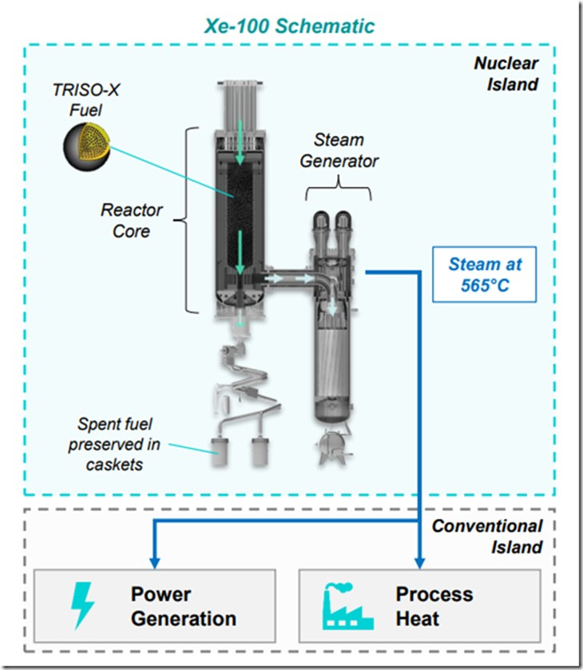

INDUSTRIAL: DOW & X-energy collaborating in Texas
The project will reduce the Seadrift site’s emissions by approximately 440,000 metric tons of carbon dioxide per year, which is equivalent to removing more than 97,000 cars from the road. X-energy’s Xe-100 nuclear reactor will be among the first operational grid-scale INDUSTRIAL reactor plants in the continent. The Seadrift site encompasses 4,700 acres and manufactures more than 4 billion pounds of materials annually. https://c3newsmag.com/dow-and-x-energy-collaborate-on-grid-scale-smr-project/

Slide 8
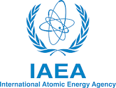
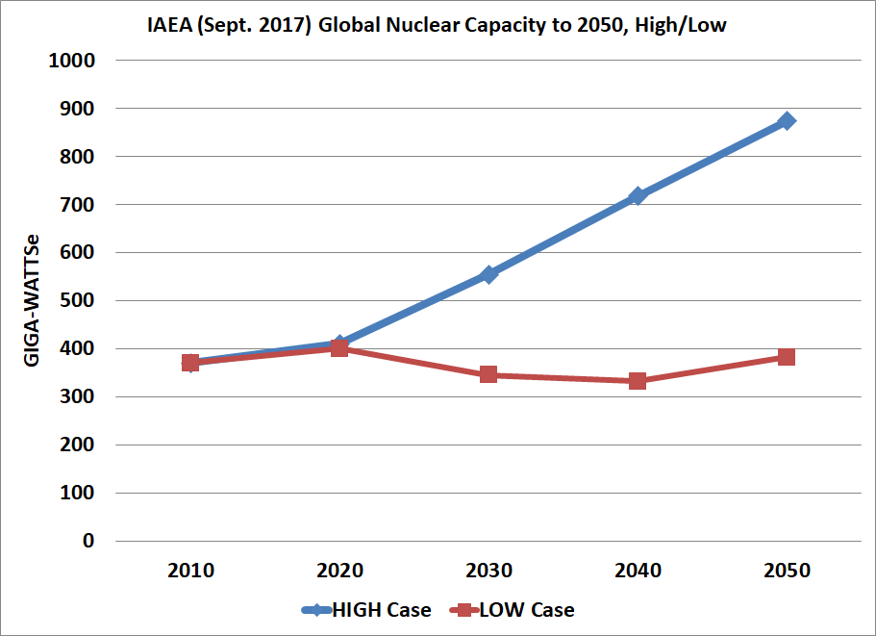
IAEA (Sept 2017 & 2023) – High & Low World Estimates of
Projected Nuclear Capacity PLANNED in 2030, 2040, 2050
How much market could SMRs, AMRs unlock for hybrid systems? >300 GW
What portion of add-on and replacement reactors could be Adv Reactors, SMRs?
Estimates vary with timing of license approvals.
IAEA HIGH Case at 2050
Additions: 700 GWe
[Retired: 285 GWe]
[2023] 890 GW
➔ in 2050
394 GW
IAEA: Even in the LOW case, >300 GWs must be built.
WHAT IS DRIVING NEW GROWTH?
IAEA LOW Case to 2050
Additions: 300 GWe
[Retired: 330 GWe]
www-pub.iaea.org/MTCD/publications/PDF/17-28911_RDS-1%202017_web.pdf Based on Country Plans submitted to IAEA
Notes:
IAEA Projection from 2021
https://www.iaea.org/newscenter/pressreleases/iaea-increases-projections-for-nuclear-power-use-in-2050

Slide 9
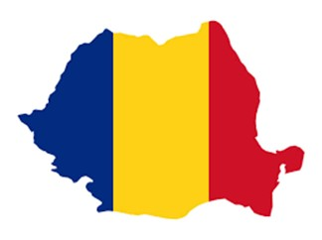

Global SMRs in “Discussion” now nearing $85 Billion in total value, 2022
China & Russia lead deployment of SMRs … Industrial and Arctic applications
What will USA and Europe do to recover leadership? Data Centers. Heavy Industry.
SMR Projects in the Global “Arena” top $80 billion in estimated project value (20+ projects)
At various stages of development, SMR projects announced by vendors, engineering partners and governments (either for siting or investment) have reached near $85 billion in projected capital investment – more than 20 projects including at least 40 reactors for a combined total topping 8-9 GWs. Most of that capital investment lies in the future, as projects are still at various stages of development: from 1) Announced plan and JV by a Government; 2) Selected site with permits in view; 3) Financing signed -- the biggest hurdle it seems; 4) Under construction;
5) Fuel loading and operation in a few cases. Each of these five stages represent a significant milestone with multiple stakeholders and a clear decision point.
Cost estimates are still moving around due to the earlier stage of projects; some estimates are high and some are low, so the combined list should be near an expected value.
The table notes the Stage of Development of a project and highlights China & Russia versus allied actors. Also, whether the reactor design is a conventional LWR (either a BWR or PWR, Gen III) vs a more advanced “AMR” reactor with designer shown.
Micro-reactors (sub-20 MWs) are for specialty applications and remote facilities (e.g., Arctic ports and stations). ADPaterson
© ADPaterson (from PhD work)

Slide 10
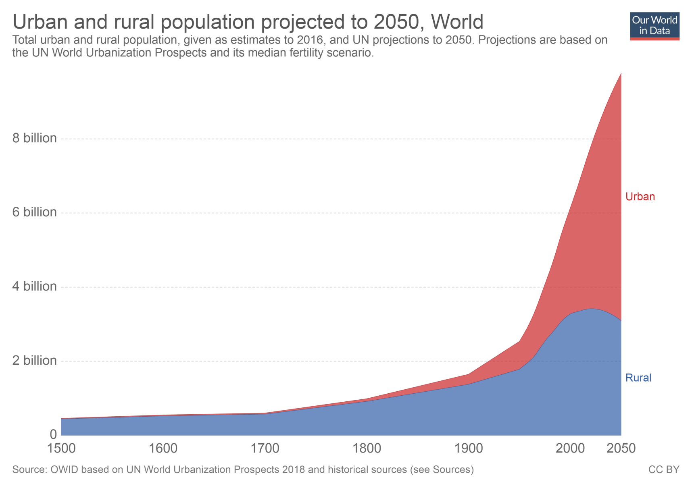
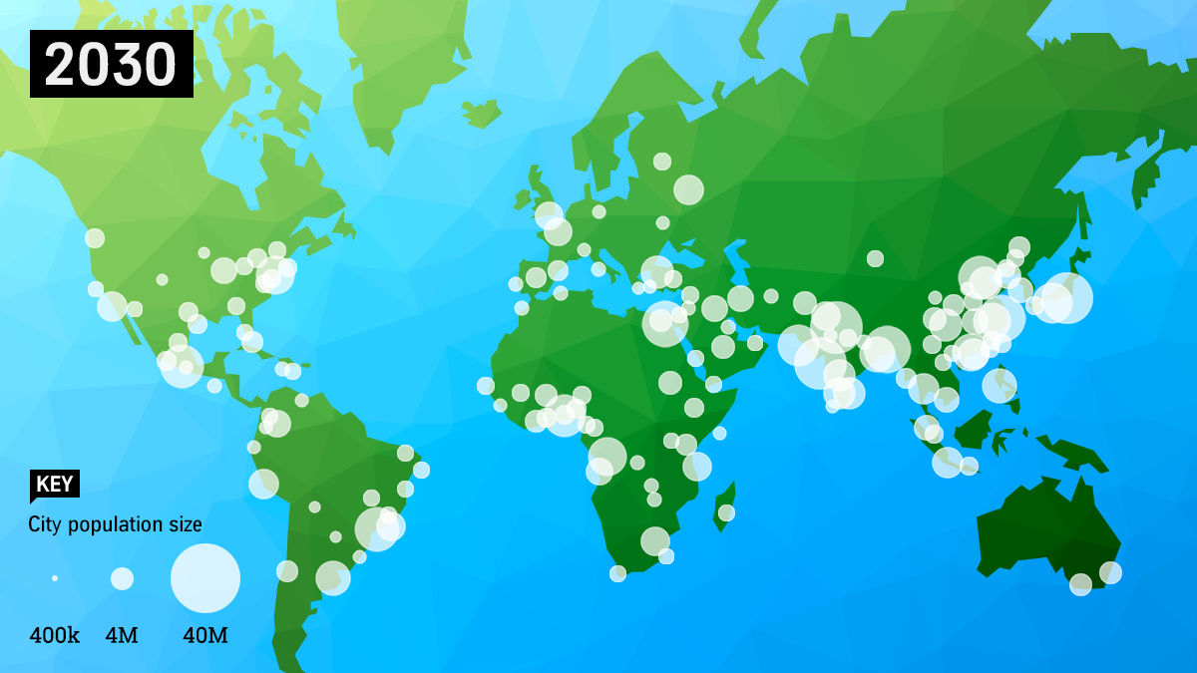
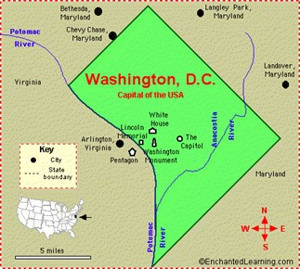
URBAN Growth & Reliability as Top Driver for new nuclear capacity globally
Nuclear Deployment for Cities
-- Massive Demand Signal
Nuclear Power enables Clean Urban Living
6b+ in
Cities
3b more
than in
2000
Urban
SMR Plant requires less than half a square mile for 100 – 300 MWs.
Rural
https://ourworldindata.org/urbanization

Slide 11
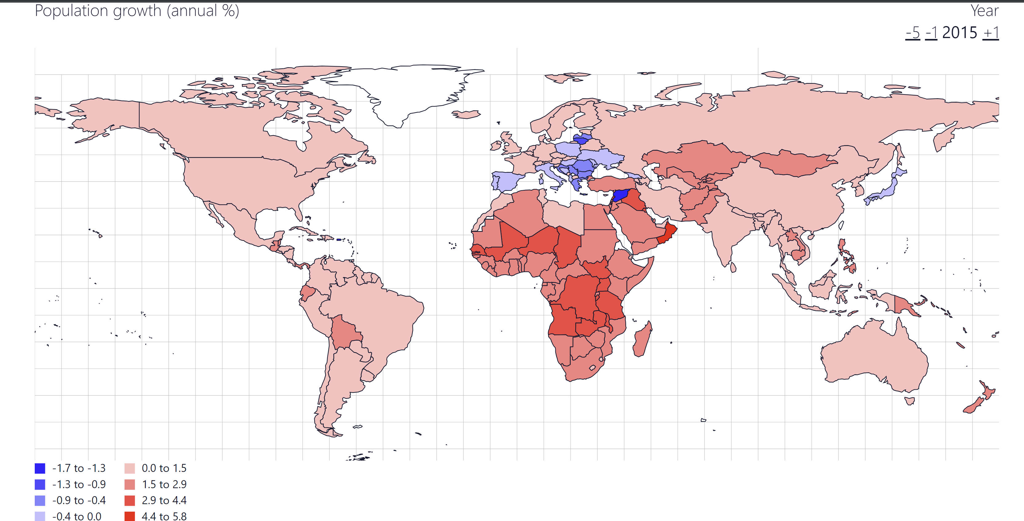
AFRICA is the only Continent that will add 1 billion people 2020 to 2050
Russia -20m
by 2050
Europe
-50m
N.America
+70m by 2050
China
-100m
SouthEast Asia
+400m by 2050
LatAm
+100m by 2050
AFRICA +1,000m
by 2050
https://www.populationpyramid.net/hnp/population-growth/2015/

Slide 12

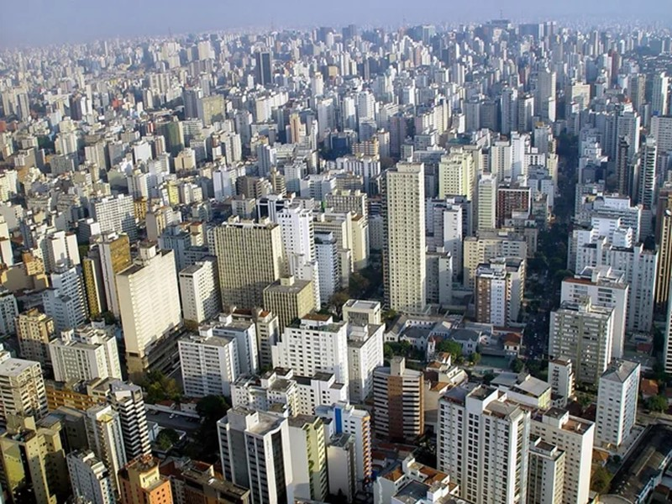
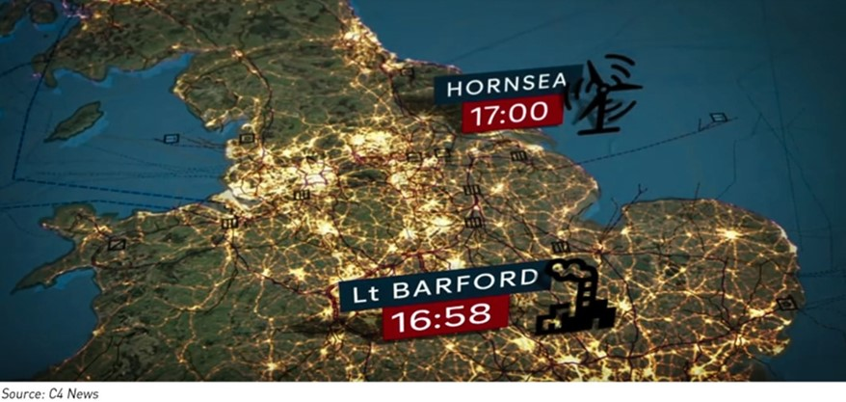
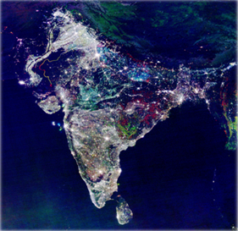
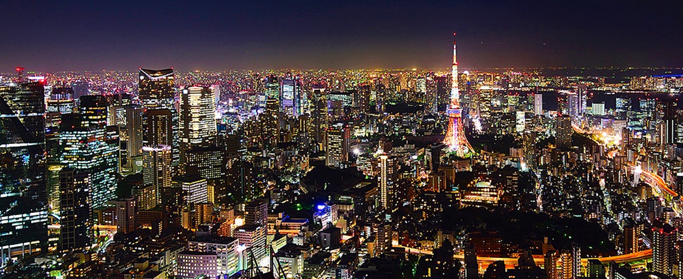
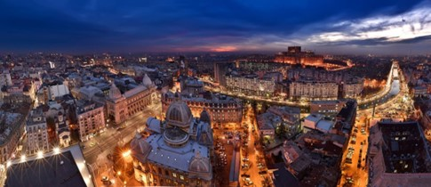
6 Billion City-dwellers by 2050, with electric vehicles, AI, plus electric transit
Urban demand strains power grids. RE is inadequate
Where to put wind and solar?
Dhaka, Bangladesh
UK Blackout – August 2019
SAO PAULO
Bucharest at night
TOKYO
INDIA

Slide 13
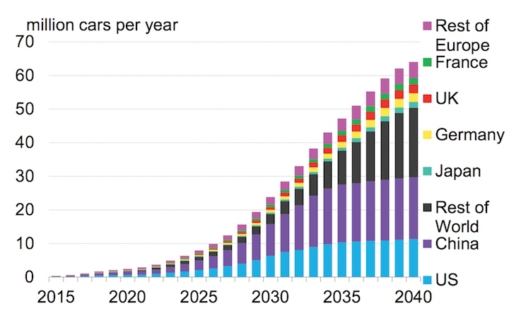
Concentrated in Urban Areas:
Ramping Electric Vehicle production Globally for Net Zero
Passenger electric vehicle sales are set to jump more than 80% in 2021 to 5.6 million units, up from 3.1 million in 2020 (and 2.1 million in 2019), according to the Zero-Emission Vehicles Factbook, a special report published today by BloombergNEF (BNEF).
More Tsunami of Nuclear Deployment Demand”
www.climatecentral.org/news/world-electric-car-revolution-21597

Slide 14

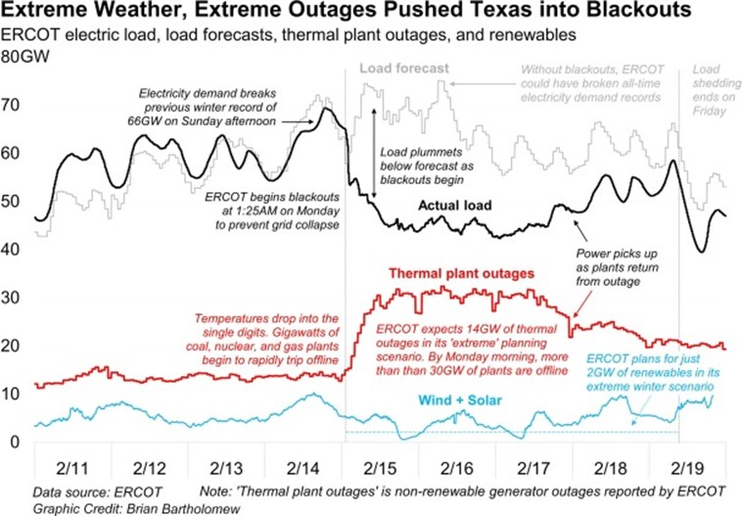
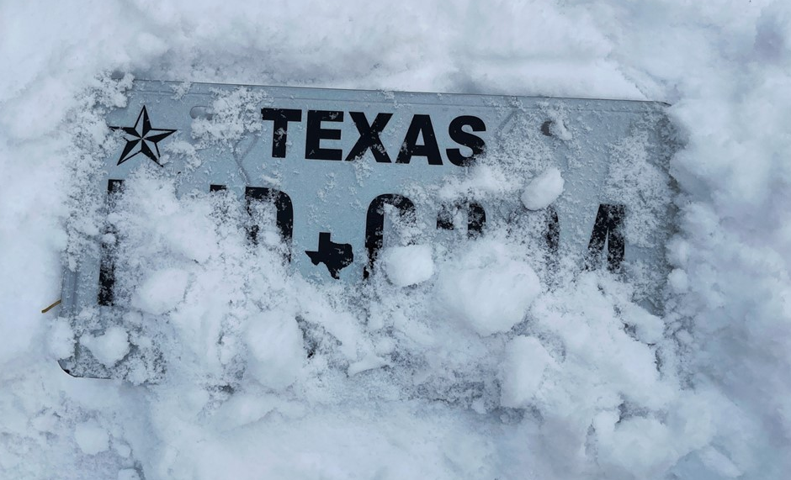
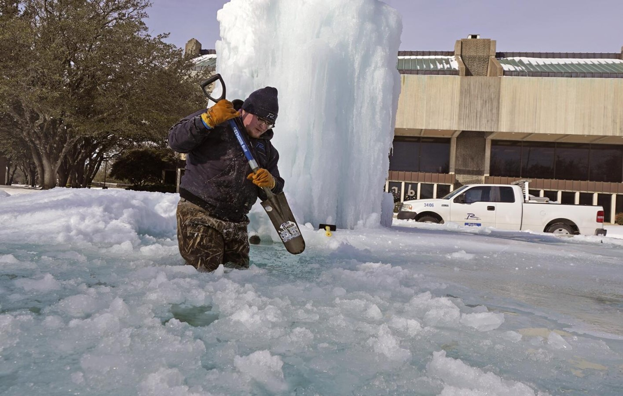
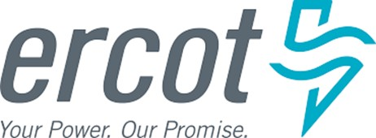
Texas Valentine’s Freeze FIASCO, Feb. 2021… Who pays for $16 billion?
WINTER STORM Feb 2021
ERCOT overcharged power companies $16 billion for electricity during winter freeze
FEB. 2021
Vistra stock drops sharply as market surprised by up to $1.3B in Texas losses
$9,000 per MWh

Slide 15
Setting the Landscape: Global New Projects and Financing Drivers
Key Drivers for Financing New Nuclear are different overseas than in USA
  Much of the world lacks cheap natural gas (of US + CAN, under $4 / mBtu).
  No other country is extending 80 GWs+ of already built nuclear capacity.
  Carbon emission policy in USA is very fragmented; will not be resolved soon.
  Most other countries regulate electricity rate policy nationally, not regionally or by state
  Many other countries define new nuclear energy goals, “UK for 24 GWs by 2050” – USA does not
Is URBAN Growth and Reliability now the #1 Driver for
new nuclear capacity globally?
Does Energy Security surpass Carbon Policy as driver for new nuclear? [NATO Region, Asia]
  -- EU Gas price roller coaster in 2022, plus cut off of Russian supply. Nations seek Energy Sovereignty.
Intermittent Wind and Solar for URBAN energy is very ill-suited… OPTIONS?
-- Mass transit and large-scale shift to Electric vehicles in OECD cities demands 24/7 Nuclear
-- Wind and solar do not effectively charge millions of new EVs in cities, nor power for rail.
Major shifts coming in Industrial sectors- from N.gas to Hydrogen, some by nuclear
Nuclear is the only “always-on, emission-free, small footprint” solution
Why less new nuclear build in USA?
Major urban growth is now OUTSIDE OECD

Slide 16
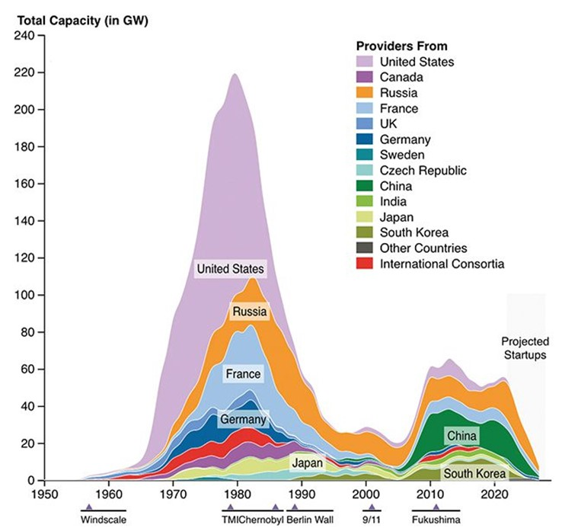
Historical Construction of Nuclear Plants, and current “Arena Share”
Historical waves of New Build in Nuclear Energy
National Vendors dominate New Build:
China & Russia… then EDF, S.Korea
https://www.powermag.com/being-pro-nuclear-wont-be-enough-heres-why/

Slide 17
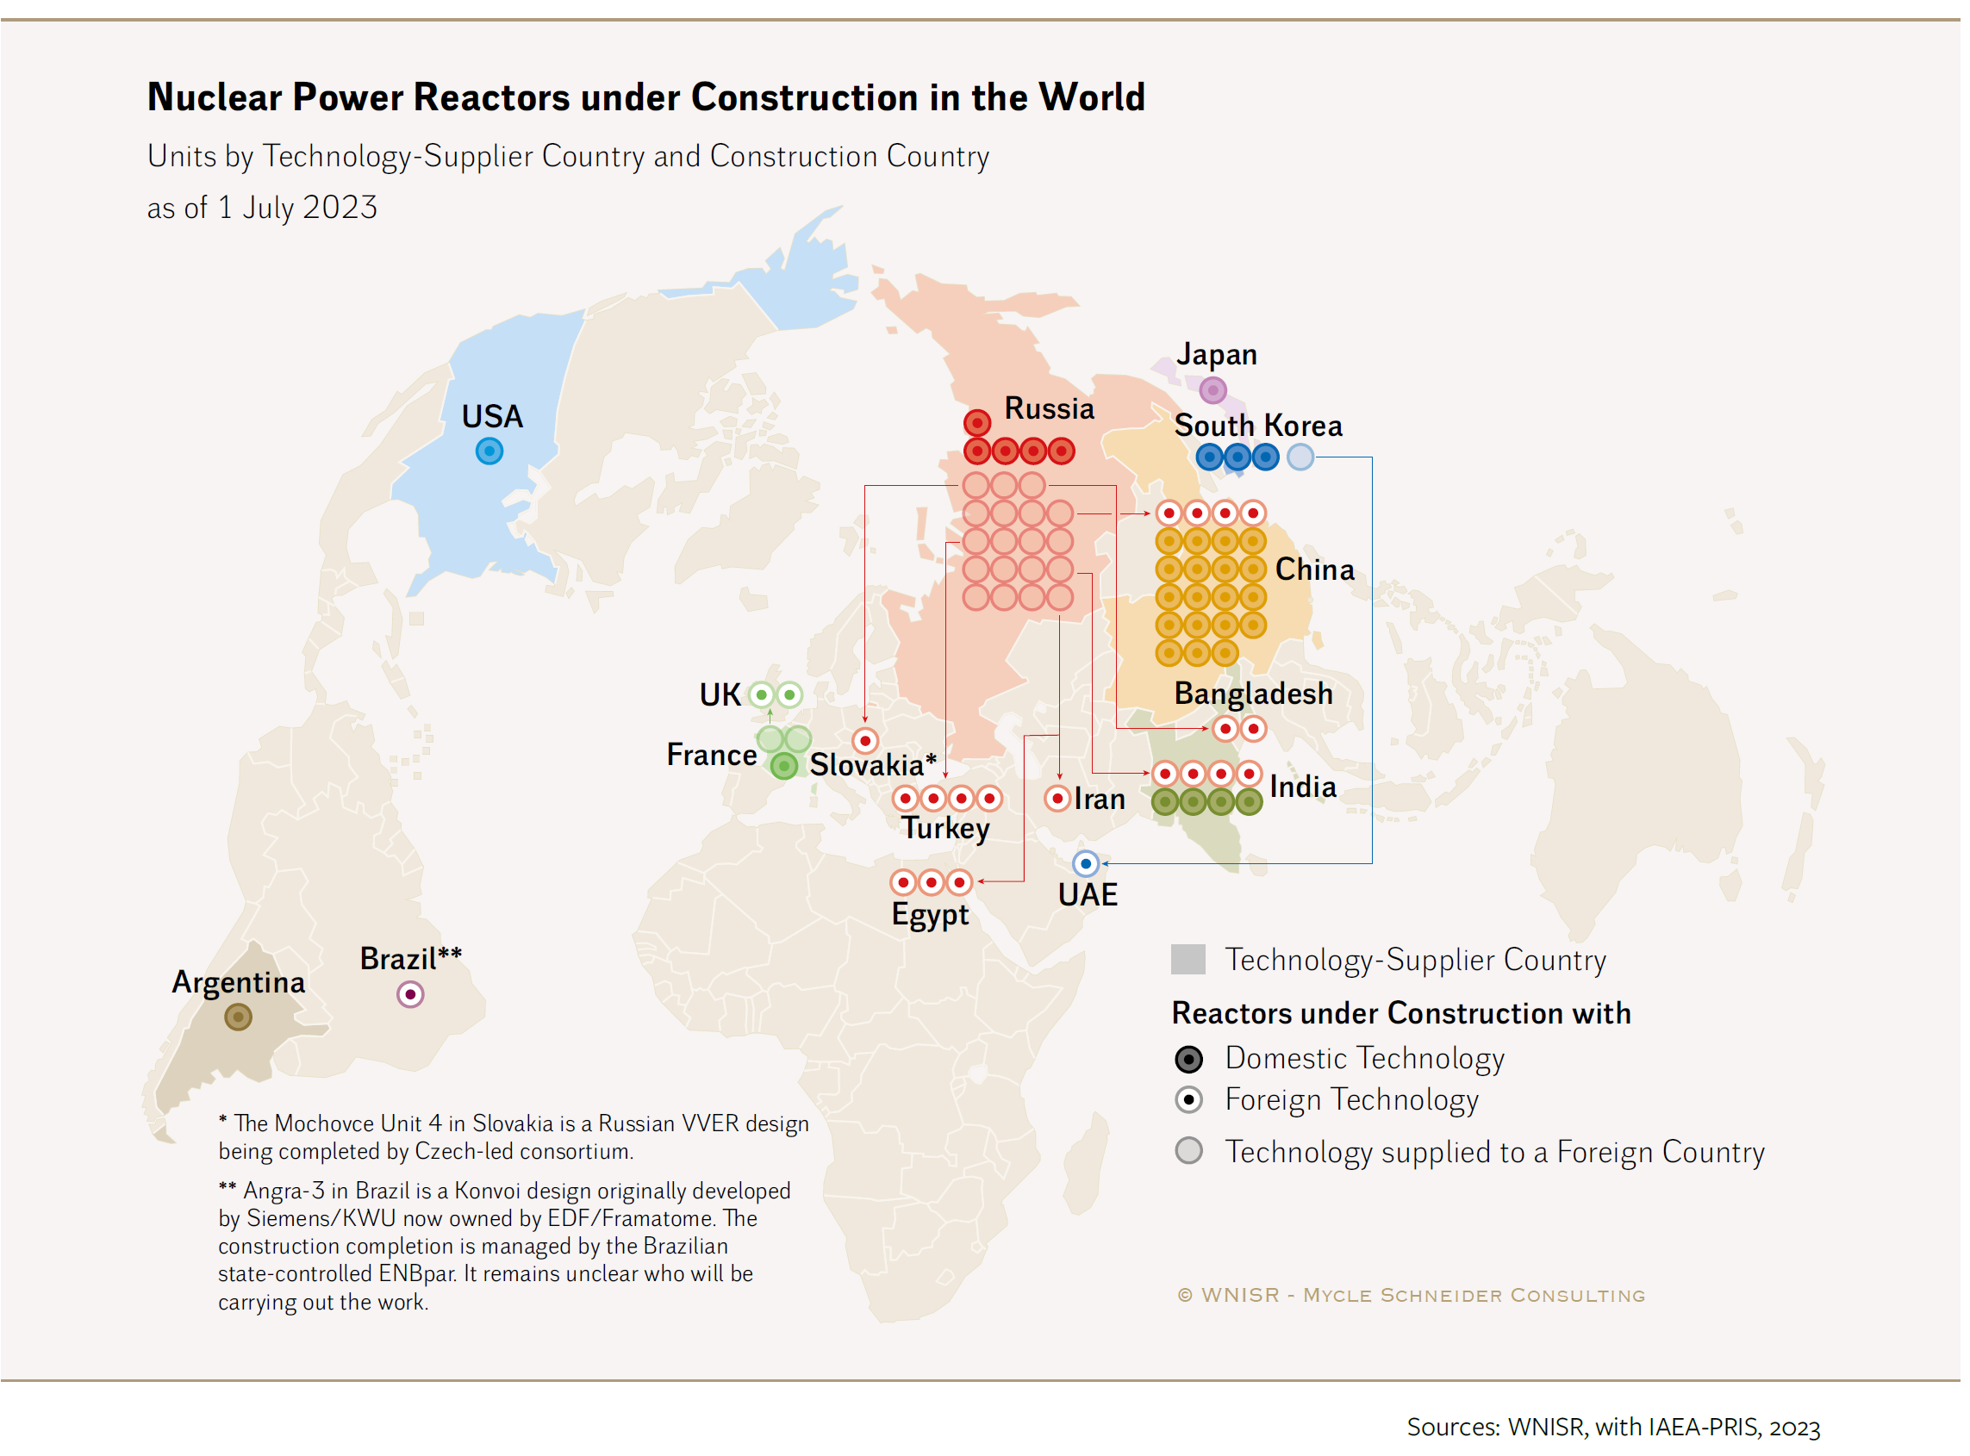
WNISR: Nuclear Reactors Under Construction by Vendor Country - July 2023
New Construction for Nuclear Plants is concentrated in MacKinder’s “HEARTLAND”
WHY?
Vogtle
now online
Possible backlog in N.Am:
TMI redo for MSFT (PA)
Restart at Palisades, MI
Diablo Canyon (CA)?
SMR at OPG (CAN)
SMR at TVA (Tenn)
SMR at Kemmerer, WY
Kairos with Google
AWS with X-energy
https://www.worldnuclearreport.org/IMG/pdf/wnisr2022-v3-hr.pdf

Slide 18
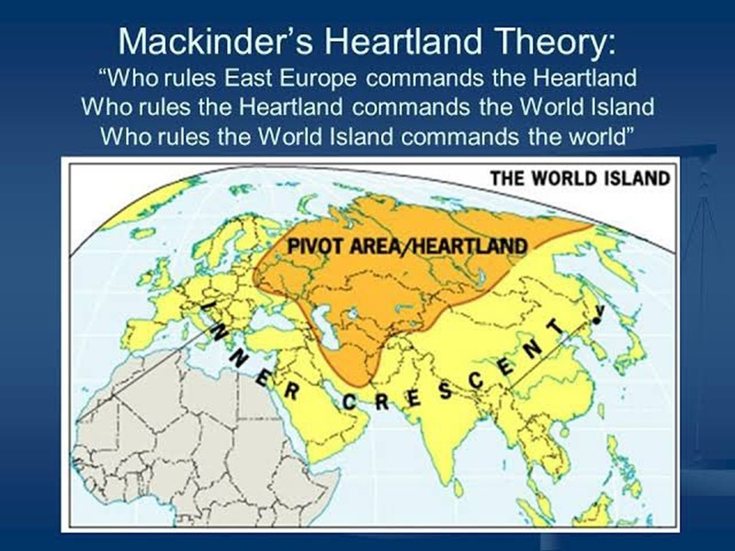
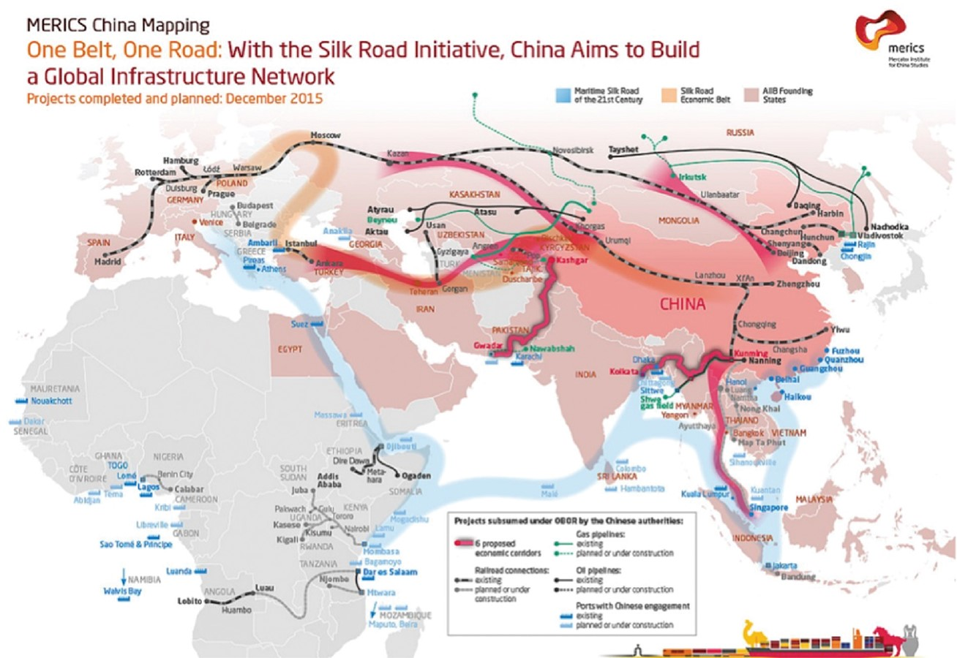
MacKinder’s HEARTLAND THEORY now magnified by Belt & Route Intiative
China - Russia Belt & Route Initiative
brings Mackinder’s Prophecy (from LSE) to Life –
Russia and China look to consolidate Eurasia;
Conflicts will spring up along Crescent Border region
1904
Cyber-
attacks
In N.Am
2014
“RIMLANDS”
“RIMLANDS” – where more conflicts will arise
CFR: www.cfr.org/report/conflicts-watch-2024

Slide 19
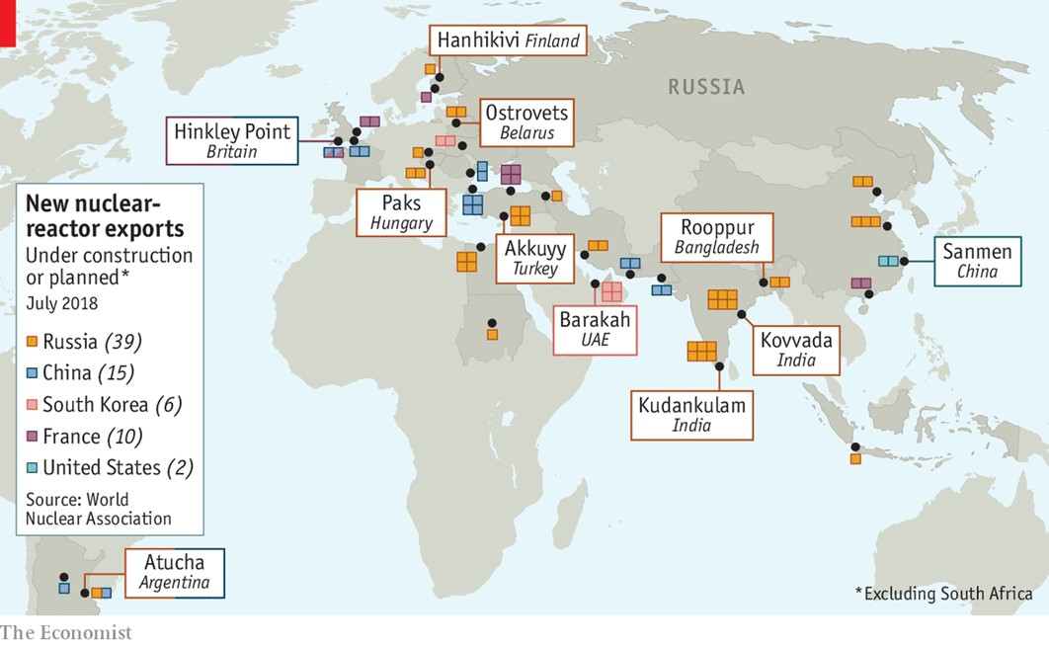
Economist 2018: Russia leads world in International Reactor Projects…
“China is its only real competitor”... or as some believe – They are working as a TANDEM.
Russia leads the world in Reactor Projects (Aug 2018)
The Economist: “China is its only real competitor…
Russia’s nuclear programme has endured for two main reasons. Its designs are cheap, and Rosatom enjoys the backing of the state, which helps it absorb hard-to-insure risks like nuclear meltdowns. Its competitors trail hopelessly: France’s Areva (now Orano) has started building only two plants in the past ten years, in Finland and China; both are delayed and over budget. KEPCO, South Korea’s energy company, is facing a domestic backlash against nuclear power, while Westinghouse, in America, is only now emerging from bankruptcy.
Russia’s only real competitor is China, another country where government and business are tightly entwined. Until recently China has focused on meeting soaring demand for electricity at home. But importing raw materials and exporting technology is a better long-term bet, and so it has started to look abroad. A Chinese state-backed firm is partly funding Hinkley Point in Britain, and others are involved in plants in Argentina and Turkey. Yet although China will surely catch up, for now Russia has no serious rivals in the export of nuclear technology.
In a world that needs to generate much more electricity from nuclear power if it is to take de-carbonisation seriously, that is a sobering thought.
Aug 7th 2018
https://www.economist.com/graphic-detail/2018/08/07/russia-leads-the-world-at-nuclear-reactor-exports

Slide 20

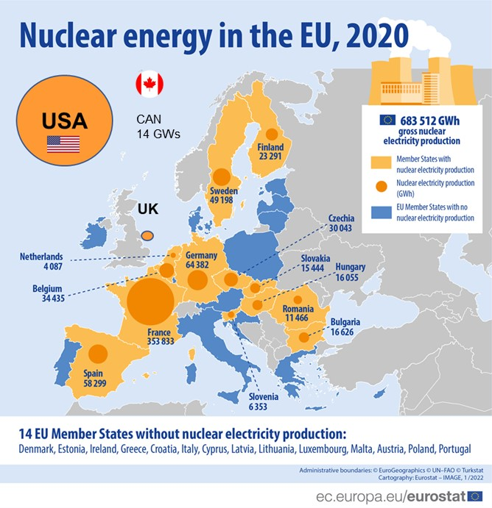
Nov 6: EU Balkan Alliance for Nuclear SMRs… “Energy Sovereignty”
6 Nov. 2023
Twelve European Union member countries asked the European Commission to create an industrial alliance for small modular nuclear reactors. Their representatives are scheduled to meet on the sidelines of the European Nuclear Energy Forum in Bratislava.
In a joint letter, Bulgaria, Croatia, Finland, France, Hungary, the Netherlands, Poland, the Czech Republic, Romania, Slovakia, Slovenia and Sweden called for investment incentives for small modular reactors (SMRs). In a joint letter, the informal group urged the European Commission to create an industry alliance for the segment, arguing the move would help build a value chain in the European Union, AFP reported.
The member states said it would strengthen energy sovereignty and the domestic industry’s competitiveness. Earlier, they formed a so-called Nuclear Alliance with Belgium and Estonia, while Italy and the United Kingdom are observers.

Slide 21
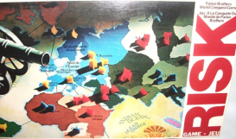
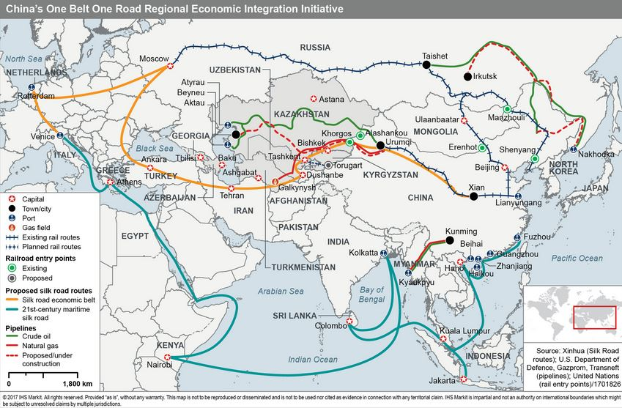







China using nuclear units to reinforce BELT-ROUTE INITIATIVE (BRI) with Russia
Russia actively locking up Marine Route sites (ports), with Military Basing Rights
NUCLEAR CAPACITY (GWs)
[IAEA, WNA data] 2020 2030 2040
USA 96 80? 60?
China 48 120 200
-- Exports (Pak, UK) 4 12? 30?
Russia 28 36 42
-- Exports (LDCs) 10 16? 28?
India 10 18 30
WORLD * 440 480 600
Is Russia winning projects by focusing on LCOE?
No, they focus on the BUY-side with client Govts.
5
Overland
BELT
?
?
?
*Forecast varies based on rate of retirements, license renewals. EU will see more retirements.
?
$100B
?
Russian Sphere
SUDAN
?
May 2015
?
Marine
Route
Active Russian Nuclear Project… most bolstering global trade hubs for BRI
Chinese nuclear plants along BELT path have not been sited yet (proposed)
© ADPaterson

Slide 22

State Owners & National Vendors Dominate
As of 2023:
103,000 MWs Total
(Adding to IAEA “Under construction” -- including deals with designated
sites in negotiation, licensing.)
Unlike in USA, State Enterprises own Nuclear Plants, and National Vendors bid on the new construction.
BOTH sides: Supply & Demand.
Do not expect the bidding to be “fair”…
Rosatom and CGN and EDF subsidize their vendors.
Will Data Center demand expand Private Sector deals now to 2030?
US model

Slide 23

Nuclear Plant Ownership, Construction 2020: Sovereign Owners vs Private Utilities
How does Ownership affect Financing Structure ?
Size of bubble = Reactor GWs now under construction
Gov’t
Owned
ADPaterson
Sovereigns dominate new orders. USA and Japan built their fleets of reactors in smaller regional utilities, rather than in national enterprises.
Private
Owned
Operating Capacity ➔
ADPaterson

Slide 24


Sovereign Nuclear Energy Landscape 2030
Asia, MidEast continue to dominate new construction
Size of bubble = Reactor GWs now under construction
Gov’t
Owned
Reassess with Data Centers, Industrial
Demand …
ADPaterson
Private
Owned
EXAMPLE: 30 GWs,
but no nuclear
[$15B in revenues]
Operating Capacity ➔
ADPaterson
Verdigris Capital

Slide 25

SUMMARY: Global Competitive Landscape
Most of the next wave of NEW build is overseas (not N.America)
Several Nuclear Financing Models vie for primacy… BUY-side?
Sovereign Finance Models dominate outside USA
USA Private Utility model is the exception.
How will Data Centers be financed?
Cost is a major factor, but Key Risks are critical to financing.
Strategic Sovereign interests play a large role… GEO-politics, not LCOE
Emissions savings are a BIG factor in Europe, Asia vs USA
Sovereign BUY-side financing will take share in the “Arena”
USA must accelerate GenIV to remain competitive,
mindful of addressing critical risks in financing

Slide 26


AN ALLIED MODEL, Finance the BUY-side: SMRs by 2040 in GWs
NATO Region
Possible
SMRs by 2040:
>100 GWs
(some at military bases)
© ADPaterson
SMRs by 2040 (GWs)
N.America: 32
UK & Scandia: 16
Euro area: 40
MENA: . 12
TOTAL (GWs): 100
Some for power, add making fuels, chem, hydrogen, fertilizer, desalination, mining
NATO Territory is a Region to review for SMR installations, using manufactured SMRs or Micro-reactors (3MW-30MWs).
Based on open sources and plans announced by NATO member countries, this represents an EBI estimate of potential capacity by ANP to be deployed by 2040.
[ Not a NATO estimate ]
8 GWs
4 GWs
Since the invasion of Ukraine in Feb. 2022, and the onset of a severe Energy Crisis in EU, the urgent drivers for SMRs:
* Improved Mission Readiness
* Reduced Base Vulnerability
* Alternative energy supply – What if fuel is constrained?
Aviation fuel, Diesel… ?
* Making liquid fuels and
hydrogen from EU sources
* Higher reliability for Power
* Electric Urban transport
* District heating in cities
12 GWs
4
20 GWs
EU: 40 GWs
8
4 GWs
8?
6
12
2
4
2
2
CHINA in 2022 (WNA data):
52 GWs Operating,
24 GWs under construction. 44 GWs sited, planned.
MENA:
12 GWs
© ADPaterson
AFRICOM could represent another 20 GWs
https://www.deviantart.com/nutshellcountries/art/Nato-2022-925202802

Slide 27
GLOBAL TRENDS – Wrap up
Russia, France will continue to win bids by going long on buy-side
China is very focused on building large reactors internally (>30 GWs).
-- China will build their own designs now (Hualong One, plus SMRs
-- Local Hazardous Air Pollution (HazAPs) are a bigger driver than GHGs
Europe now includes “Nuclear” in Clean Energy Taxonomy
Eastern Europe must and will use Nuclear to shift from coal, gas
USA can use NATO alliance on BUY-side (common specs)
-- Many NATO allies exclude Russia and China from bidding
-- Romania plays “above its weight” by seeking to pioneer SMR applications
Data Centers seeking “Always-on, Zero emission” power is a game-changer
Heavy Industry will use Nuclear SMRs for Steam, Heat and Power 24/7

Slide 28


Continuing the Dialog on “Nuclear SMRs in NATO” with NPS EAG
10 Nov. 2022
Arlington, VA
“Energy Sovereignty will be the Westphalian Principle for the 21st Century”
https://nationalinterest.org/feature/energy-sovereignty-will-be-westphalian-principle-21st-century-200724
The SMART “Energy Transition” is one that encompasses multiple options, including Nuclear Energy.
Renewables alone are not sufficient.”
ADM Mike Hewitt, CEO – IP3

Slide 29
















IP3 and Allied Nuclear Partners Ecosystem
(with access/relationships to other top U.S. and International Vendors as needed*)
IP3 and ANP Ecosystem
*Potential Tier 2
Participants
Core Energy Companies
Security Companies`
Industrial Technologies
Air Products
Bloom Energy
Cummins
First Solar USA
GTS in VA
Greenko Group
ITM Power
KBR (TRIGTM)
NextChem
NextGen Biomass
PlugPower
Scatec (RE)
Stamicarbon
Valmet
Nuclear SMR Technologies
GE-Hitachi
NuScale
Rolls-Royce SMR
TerraPower
Terrestrial Energy
X-Energy
MANA

Slide 30
Discussion

Slide 31



Optional Module on Evolution of “Market State” from Nation State
In a Public-Private Partnership…
How is the Nature of the State Changing
In an Era of “Strained Sovereigns” ?
Autumn 2008

Slide 32

IMF Chief warns of “Unforgiving Conditions for State Finances”
Tripling Nuclear Capacity by 2050
with only Public Finance is IMPOSSIBLE.
20 Oct. 2024
IMF chief warns of ‘unforgiving’ debt backdrop and low growth
Kristalina Georgieva says governments’ reluctance to rein in spending heightens public finances challenge
“Our forecasts point to an unforgiving combination of low growth and high debt — a difficult future,” said Georgieva. Countries faced “high and rising public debt — way higher than before the pandemic”, she added, even after a fall in debt-to-GDP levels as inflation lifted nominal growth.
The managing director’s remarks ahead of next week’s IMF and World Bank annual meetings come as global public debt heads to a record $100tn by the end of 2024. Borrowing surged during the early stages of the coronavirus outbreak as economies were locked down. Many governments, including those of the world’s largest economies, are yet to bring spending under control.
www.ft.com/content/b61ca971-0569-4142-8a55-92252965ff56

Slide 33
Outline: Public-Private Investment Partnerships 3.0
WHY EMPLOY A FINANCIAL RISK MODEL, based on Experts?
Tripling Nuclear MUST engage Private Capital… $5 TRILLION in Financing
Geometric pace and scale cannot be met by National Budgets alone
-- IMF: “National budget funding will be increasingly stressed or unstable”.
Private Financing will force a Risk Framework, vs Utility LCOE Cost Model
-- yes, costs matter, but value of SMRs offers Best Value vs Least cost
-- Innovative financing structures for fleets of SMRs offer VALUE to Govts.
-- The Utility Balance Sheet model is cost-driven, and averse to risk.
Our Risk Questionnaire focused on Industry Experts and Project structure
Govt negotiation can engage PPP structures with equity and debt.
PPP 3.0 entails: Subsidies, Regulatory Reform, and Negotiated risk-sharing – more than merely a “cost per MWh”. Best value is the goal.
… Reliability, emissions reduction, industrial decarbonization add value.

Slide 34

Nation-State (1600-1990) ➔ Market State (1990 -- )
Market States seek roles to enable rather than provide – as Umpire, not Judge. Funding for nuclear power may evolve toward more public-private financing.

Slide 35
Bobbitt on Market States: Types
Shield of Achilles: War, Peace and the Course of History, Philip Bobbitt (2002)
“The nation state is being replaced by the market state. Unlike the nation state, the market state will not see itself as more than a minimal provider or re-distributor; it will simply try to maximize the choices available to individuals. But it will not take a single form any more than the nation state did. Roosevelt, Hitler and Stalin had radically different ideas about how to improve a nation's material well-being, and even about what legitimately constituted a "nation". So, too, the market state will reflect variations – in attitudes to sovereignty rather than to race, class or legal process.
One can imagine three principal versions. The first is an Entrepreneurial Market State. This would reflect a broadly libertarian view. It would tend to keep state intervention to a minimum and confine itself to nurturing tangible and intangible (for example, education) infrastructure. The second is a Managerial Market State. This would be more sensitive to egalitarianism, and it would attempt through long-range planning to give more weight to the interests of posterity. The third is a Mercantile Market State. This would be more consensual and more protectionist. It would try to keep control over capital both monetary and human – through immigration controls, for example.
For entrepreneurial states [USA, Canada], sovereignty is transparent, a function of the state's adherence to human rights norms; a state that wages a campaign of ethnic cleansing against its own people, therefore, forfeits sovereignty because sovereignty arises from the people. For managerial states [EU], sovereignty is the translucent creation of international institutions and can be pierced only with the endorsement of those institutions. For mercantile states [Asia], sovereignty is opaque, and cannot be breached for any reason by any state except as a response to an attack.
The entrepreneurial market state seeks leadership through the production and marketing of collective goods that the world wants – goods such as organizing humanitarian interventions, implementing anti-proliferation and pro-environment regimes, and underwriting the security of states that would otherwise have to convert their economic strength into military assets. The managerial market state seeks international power through its participation in a regional economic and political zone. The mercantile state seeks market share above all else in order to gain relative dominance in the international market; it disengages from international affairs and emphasizes the renewal of community.”
Marketing the Future of the State by Philip Bobbitt The New Statesman, January 17, 2003
http://www.utexas.edu/law/faculty/pbobbitt/marketing.html

Slide 36
Bobbitt Themes / Market State Framework
Bobbitt on his constitutional diagnosis:
“Market States are not the ideal, but since 1990 they are emerging.”
“Market States seek roles to enable rather than provide, to expand or optimize opportunities for their citizens, to reduce transaction costs rather than provide services directly, in contrast to Nation-States looking to maximize social welfare. They are umpires, not judges. They set rules for market operators more than decide outcomes.”
“Mercantile Market States (Asia) are more consensual and more protectionist, and keep control over capital both monetary and human.” Less immigration. Cities drive policy.
“Managerial Market States (EU), Government planning, more sensitive to egalitarianism, attempt through long-range planning to give more weight to posterity, sustainability.”
“Entrepreneurial Market States (N.Am) reflect a broadly libertarian view, tend to less intervention in markets, focused on providing public goods, and favoring pluralism and innovation.” More functions are privatized. Wealthy suburbs.
Threats to Nation-States (Bobbitt):
Triggering shift to Market-States
WMDs in hands of Terrorists eroding force monopoly
International pressures for democratization, human rights
Global trade, communications (competitiveness pressures)
Global media encroaching on cultural norms and narratives
NOW: Sovereign debt crisis, fiscal strains, and dependence on external financing
http://www.law.columbia.edu/fac/Philip_Bobbitt

Slide 37

Politics: Evolving Legitimacy of the State
Shield of Achilles: War, Peace and the Course of History (2001), Philip Bobbitt
1555
Peace of
Augsburg
1648
Peace of
Westphalia
1713
Treaty of
Utrecht
1815
Congress
of Vienna
1919
Treaty of
Versailles
1990
Charter
of Paris
Princely
State
Kingly
State
Territorial
State
State -
Nation
Nation
- State
Market
State
Religious
Wars
Thirty-Years
War
Wars of
Louis XIV
(Bourbons)
Napoleonic
Wars
World
War I
WW II
Cold War
Each constitutional order asserts a unique basis for legitimacy
1494
Renaissance;
Charles VIII (FR)
Invades Italy
Holy Roman
Empire
(Habsburgs)
1567
Dutch
Revolt
1588
Spanish
Armada
sunk
1643-1715
Louis XIV
“La Loi, C’est Moi”
Hohenzollern
Dynasty in
Prussia
1649
Charles I (UK)
beheaded;
1688
Glorious
Revolution
(Britain);
Commonwealth
1776
American
Revolution
1789
French
Revolution
Napoleonic
Empires
1870
Formation
of Germany
USSR
Revolution
1917
1980
“Reagan –
Thatcher
Revolutions”
(privatization;
Union-busting)
Re-engineering
Government.
German Unification
1990
Dissolution
of USSR;
End of Cold War;
CFE Treaty
Ming Dynasty (1363 – 1644)
Qing Dynasty in China (1644 – 1912)
Choson Dynasty in Korea (1390– 1897)

Slide 38
Market States: Mercantile, Managerial, Entrepreneurial

Slide 39
Market States & Policy Approaches
Types of Market States and Policy Approaches to Key Risks and Issues
Different market state types address risks and key issues differently…
Dispatch priority or tariff regulation is a financial market oriented policy

Slide 40
Symbiosis of the State and Nuclear Technology
An Era of “Strained Sovereigns” presages Market States
Energy is not just a commodity; it undergirds SOCIAL compacts.
National sovereignty and style of government directly bears on the policies, incentives, licensing and management of nuclear power.
- In many cases, the State is Nuclear Power (state-owned utilities)
How nuclear power is managed bears on National Sovereignty.
- Weber (1919): “Nation-states wield a monopoly on legitimate use of force.”
- And, there are clear, high-value civilian nuclear uses for energy and medicine
But, Nation-States are straining under social contracts – pensions, welfare / health programs, military, national deficits, sovereign debt.
More reliable, safer energy without emissions can strengthen societies: older OECD societies, and younger Emerging Nations. Less fossil use.
“Peace through strength”: Nuclear technology wields unique power not only as a weapon, but as a superior propulsion and dense energy source. No other technology carries this potency…, if managed well.
The Advent of Market States will shape how nuclear power is financed, negotiated and utilized by “Strained Sovereigns” in the 21st Century. Deployment is not only about cost competitiveness, but Societal Commitments.

Slide 41
Emerging Observations with Market States – 2012
The Nuclear Resurgence is being led by Mercantile Market States, primarily in Asia. A more top-down style of governance (versus pluralistic politics with substantial openings for interveners and court actions) aid this longer term commitment to nuclear power. Mega-cities are a major driver.
Most of the Managerial Market States in Europe, are engaged in Rollback, given little population or energy demand growth. The two EU states not engaged in full “Rollback”, UK and France, are P5 nations.
Status in UN Security Council and nuclear military and commercial assets influences national strategy.
The Fukushima disaster was a severe accident (albeit with less dispersion than Chernobyl), it is only slowing down the Nuclear Renaissance, rather than reversing it. Prior to Fukushima, Japan was committed to maintaining its nuclear fleet of 50 reactors (44 GWs; 30% of national electricity supply), including long-term strategies for electrifying vehicles. But Japan’s population is not growing, and it is not a military Nuclear Power (P5). Election of LDP in Dec. 2012, will reverse Rollback.
After a pause to review designs, China, Russia, and USA are moving ahead with construction – all P5 countries. S.Korea, Taiwan, and India, all “Next 5” nuclear nations are moving ahead also – more evidence that Mercantile Asian countries are seizing the lead in the Nuclear Renaissance.
Russia is increasingly driven by energy consumption in Asia, not Europe, since its character has evolved as a Mercantile state (resource-rich, export-driven), not Managerial (alliance-oriented), and it is a P5 country. Recession in Europe and long-term growth prospects in Asia will draw investment.
USA and Canada as Entrepreneurial Market States can join or rejoin the Renaissance, but face cheaper natural gas prices than elsewhere. Maintaining market leadership in nuclear will entail a combination of public policies, private financing, and stronger commitment to innovation, like SMRs. Outreach to Emerging Nations / Partnerships offer a path to sustaining leadership and global impact.

Slide 42
Background sides for Q&A

Slide 43









WNISR: Nuclear Reactors Under Construction by Host Country - July 2023
Large Reactors in the ARENA
23
Rosatom at Akkuyu
Barakah for UAE with KEPCO,
5600 MWs
CEG repowering TMI for MSFT?
Vogtle
58 GWs

Slide 44



And, Renewable sources do not stack up well on these Drivers
Wind and Solar cannot effectively provide energy to Major Urban Areas
POWER THIS…
MANHATTAN
Just Wind and Solar for Boston?
Chicago: Snowmageddon 2011

