Slide 1
Participatory governance to improve resilience and implement a just and green energy transition
Mia Landauer (Dr. nat. techn., M.Sc.)
Arctic Centre, University of Lapland, Finland
EnergIntell, Bucharest, Romania
24 October, 2024

Slide 2
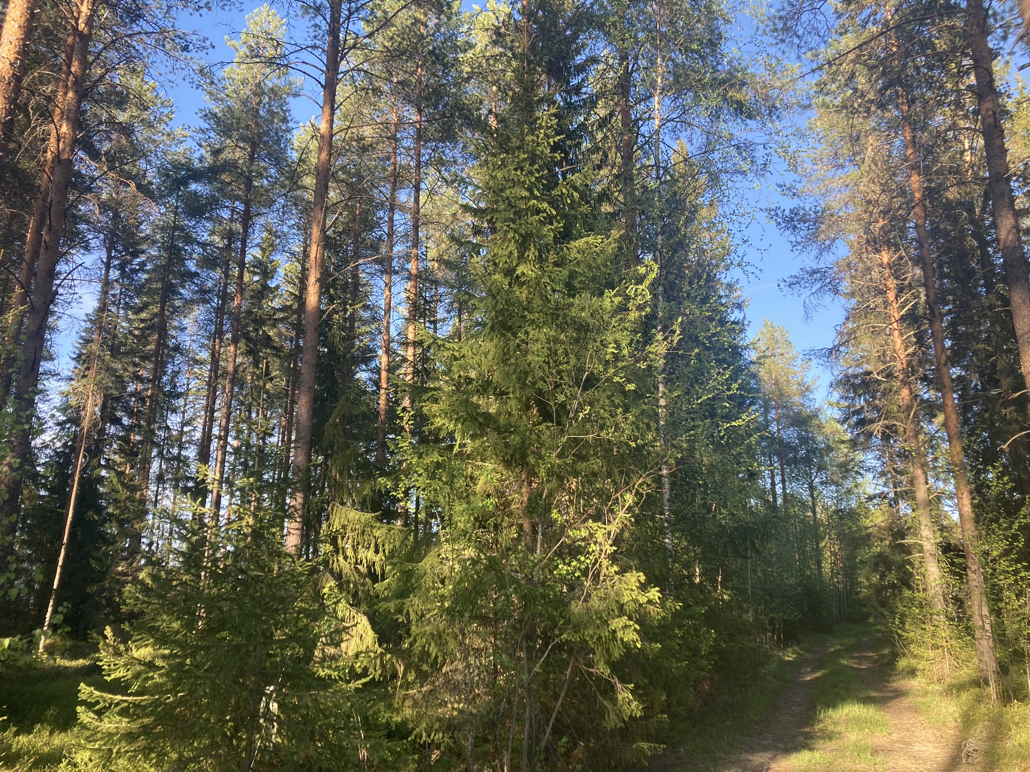
content
Participatory governance – benefits and challenges
Northern region’s investment potential and Nordic energy transition
Arctic local livelihoods: example of a system affected by land use
Energy justice
Participation to build resilience
The participatory research project REBOUND
Summary
Credit: Mia Landauer

Slide 3
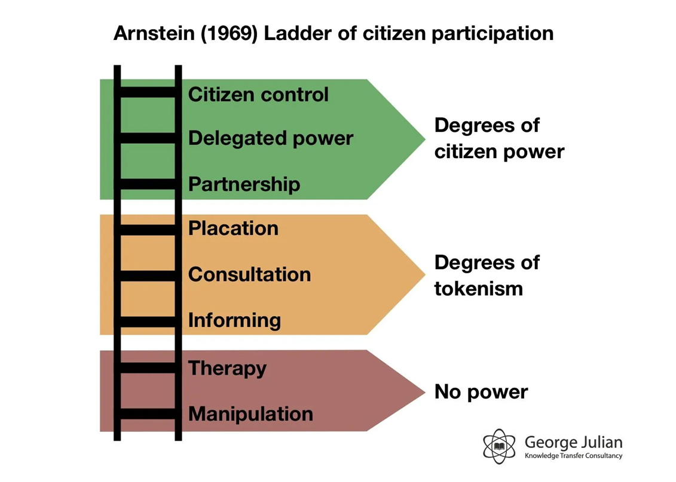
What is participatory governance?
“Participatory governance” widely refers to the democratic mechanisms which are intended to involve citizens in public policy-making processes. (Palumbo, 2017)
Credit: Pixabay

Slide 4
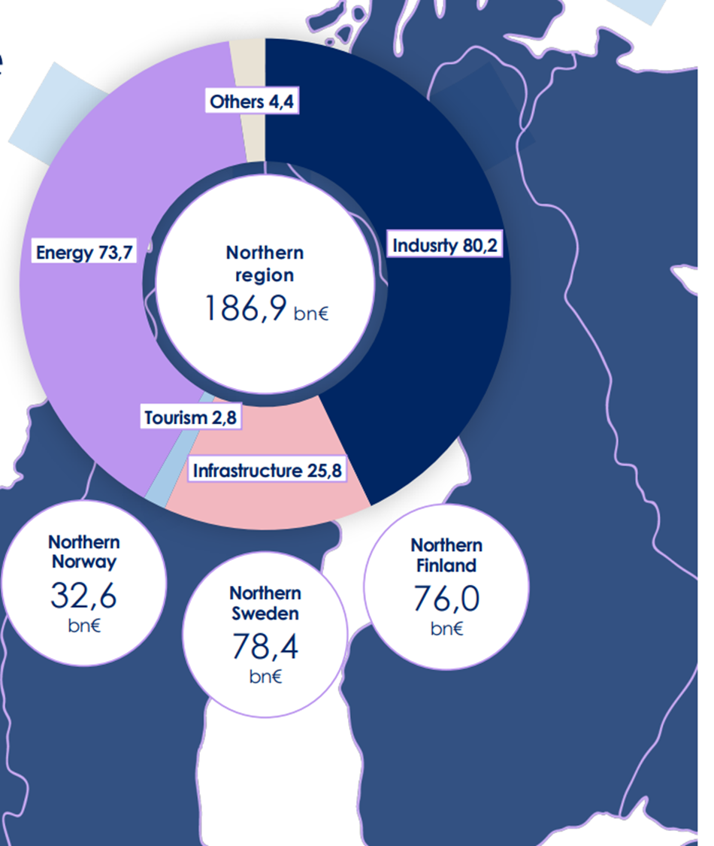
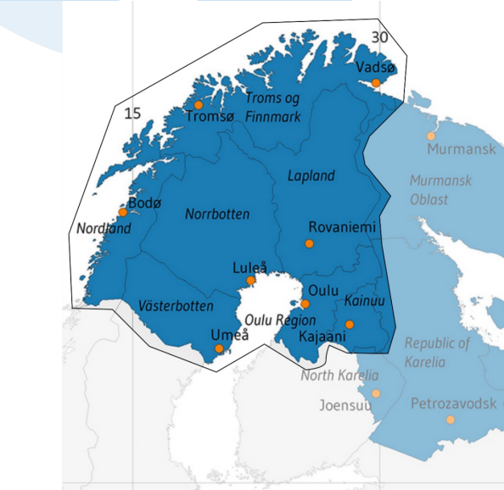
Northern region Investment potential
Source: Lapland Chamber of Commerce 2023

Slide 5
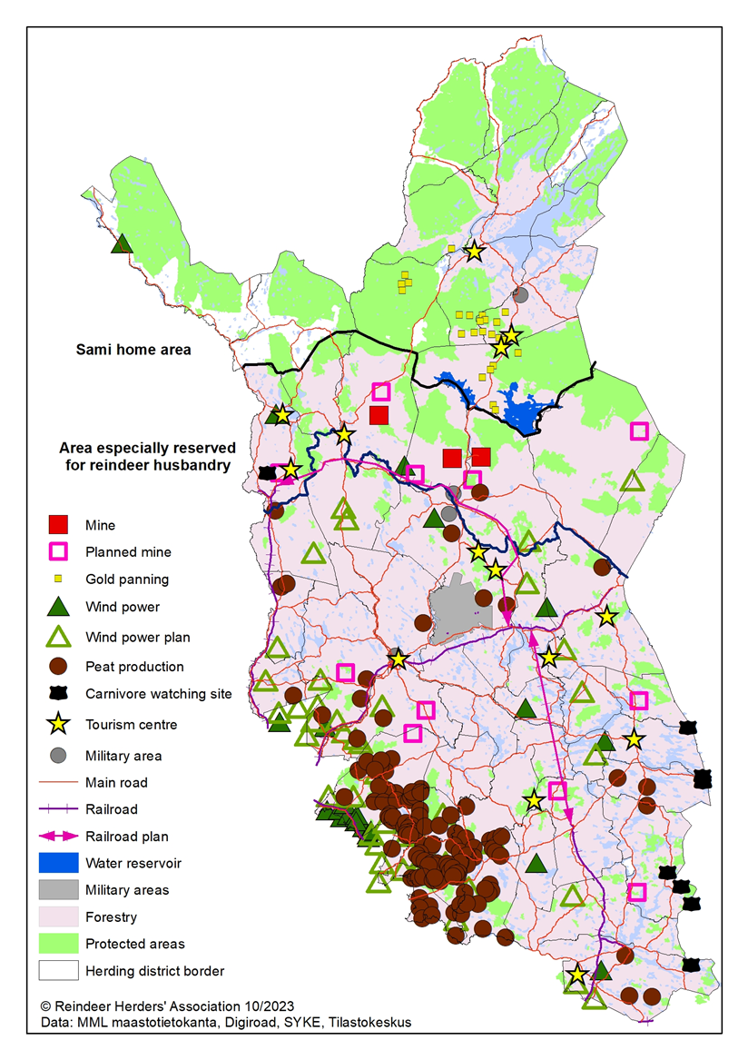
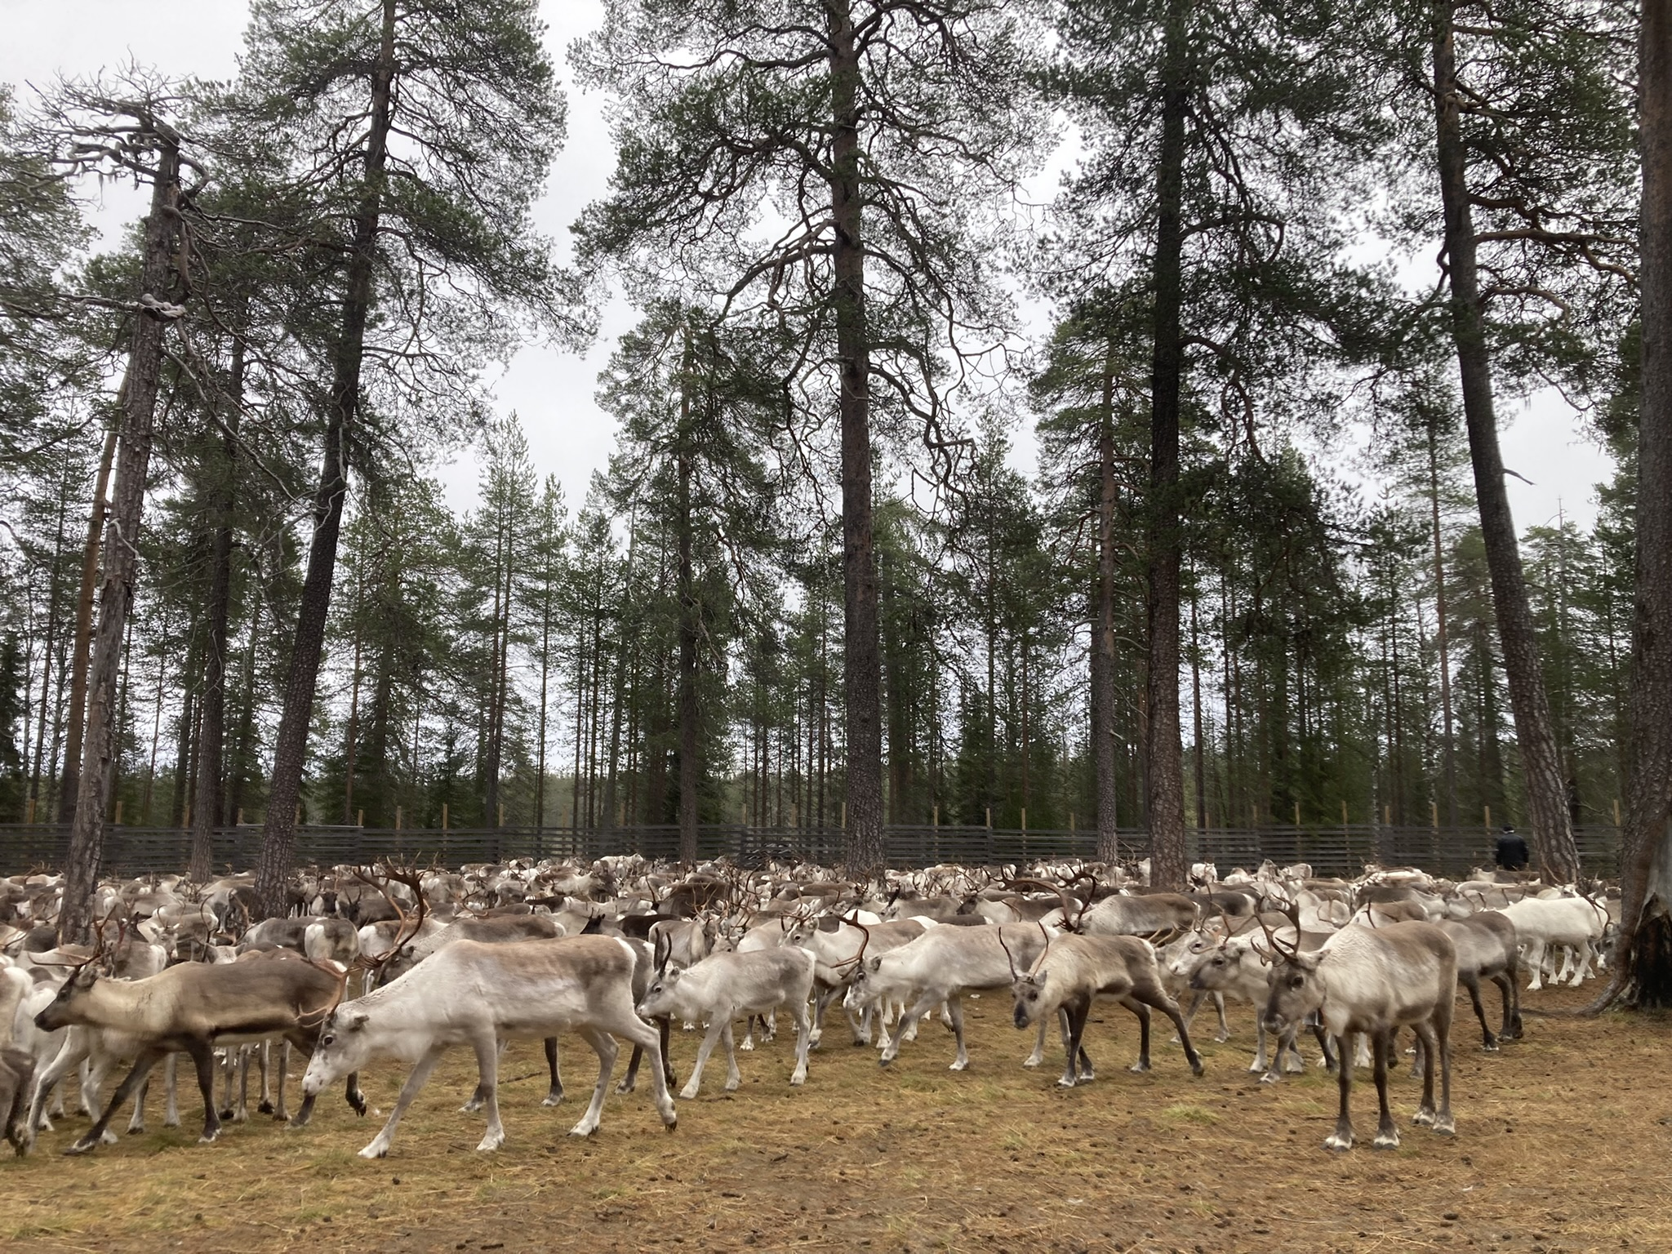
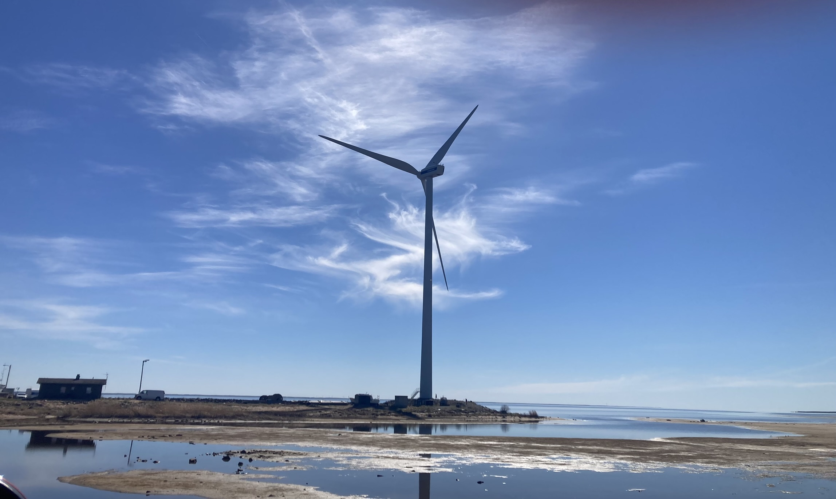
Nordic Energy transition
Reindeer management area of Finland
© European Commission
Photo credits: Mia Landauer

Slide 6
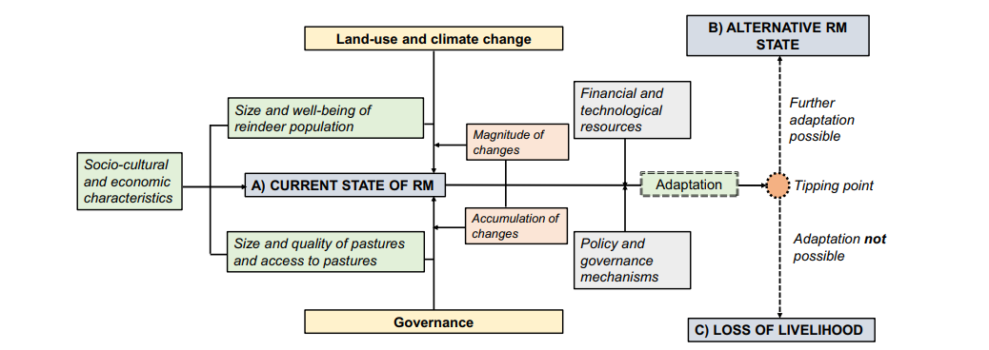
social-ecological system: reindeer management
Landauer, Rasmus & Forbes (2021) ”What drives reindeer management in Finland towards social and ecological tipping points?”
Regional Environmental Change 21 (2) e32. 10.1007/s10113-021-01757-3

Slide 7
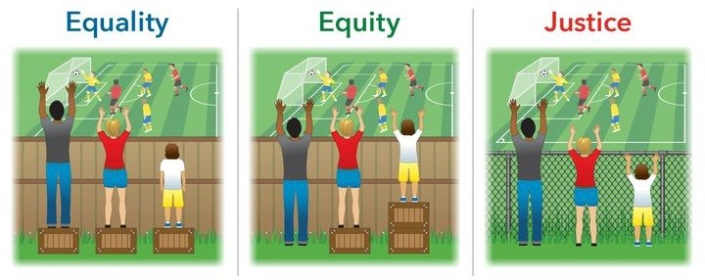
What is (ENERGY) justice?
What does justice mean for different actors and sectors? (plurality of worldviews and values, recognition justice)
Who should be involved and have a say when energy systems are being designed and deployed? (procedural justice)?
Who bears the benefits, risks and losses and how are these distributed? (distributive and restorative justice)
Book recommendation, Open access:
Ohlsson, J., & Przybylinski, S. (Eds.). (2023). Theorising Justice: A Primer for Social Scientists. Policy Press.
Steiner, 2019

Slide 8
Participation to build resilience
Socio-cult.
Env. & Econ.
Nature-based livelihoods
Energy industry
Just green transition
Arts, design, Education
Land-use planning
Legislation
Governance
Background image: CASI Project/Interreg
Notes:
JUSTICE and PARTICIPATION are core components of sustainable development and natural resource management.

Slide 9
Rebound – just green transition
Notes:
Emphasizes inclusion of different actors’ values and worldviews when planning and implementing green transition projects
Co-develops tools and methods to examine the boundaries of land use such as participatory and art-based methods and service design to engage various actors and sectors
The main outcome is a boundary organization ”Virtual Centre for Arctic Green Transition”

Slide 10
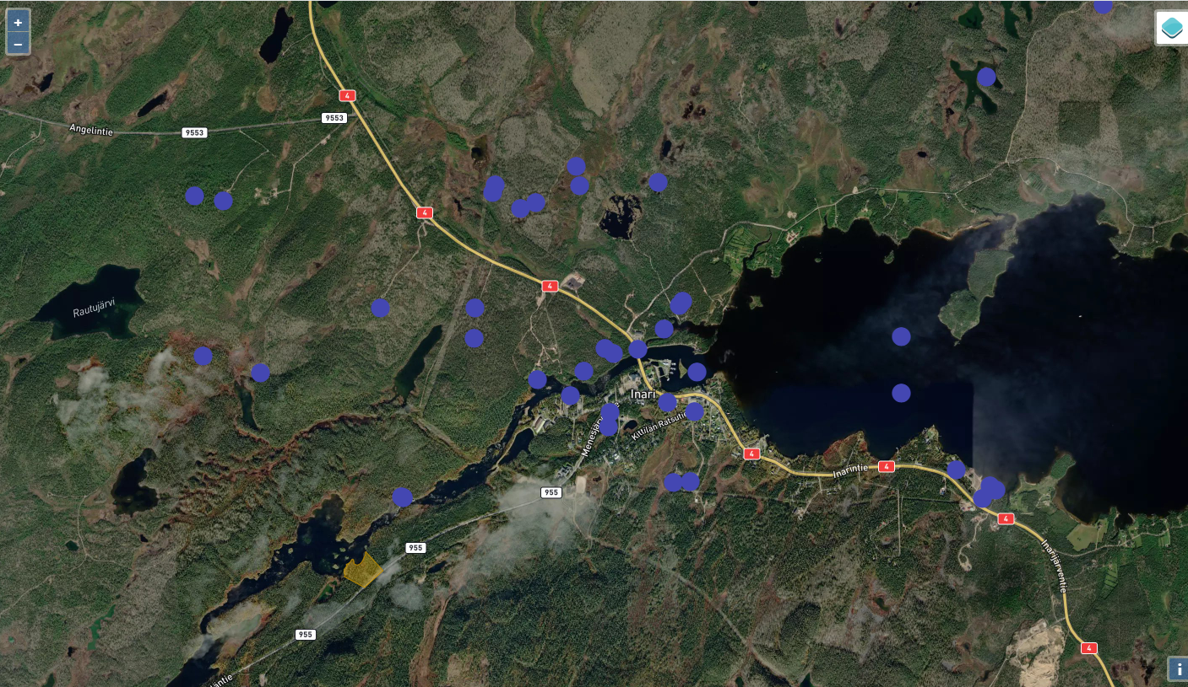
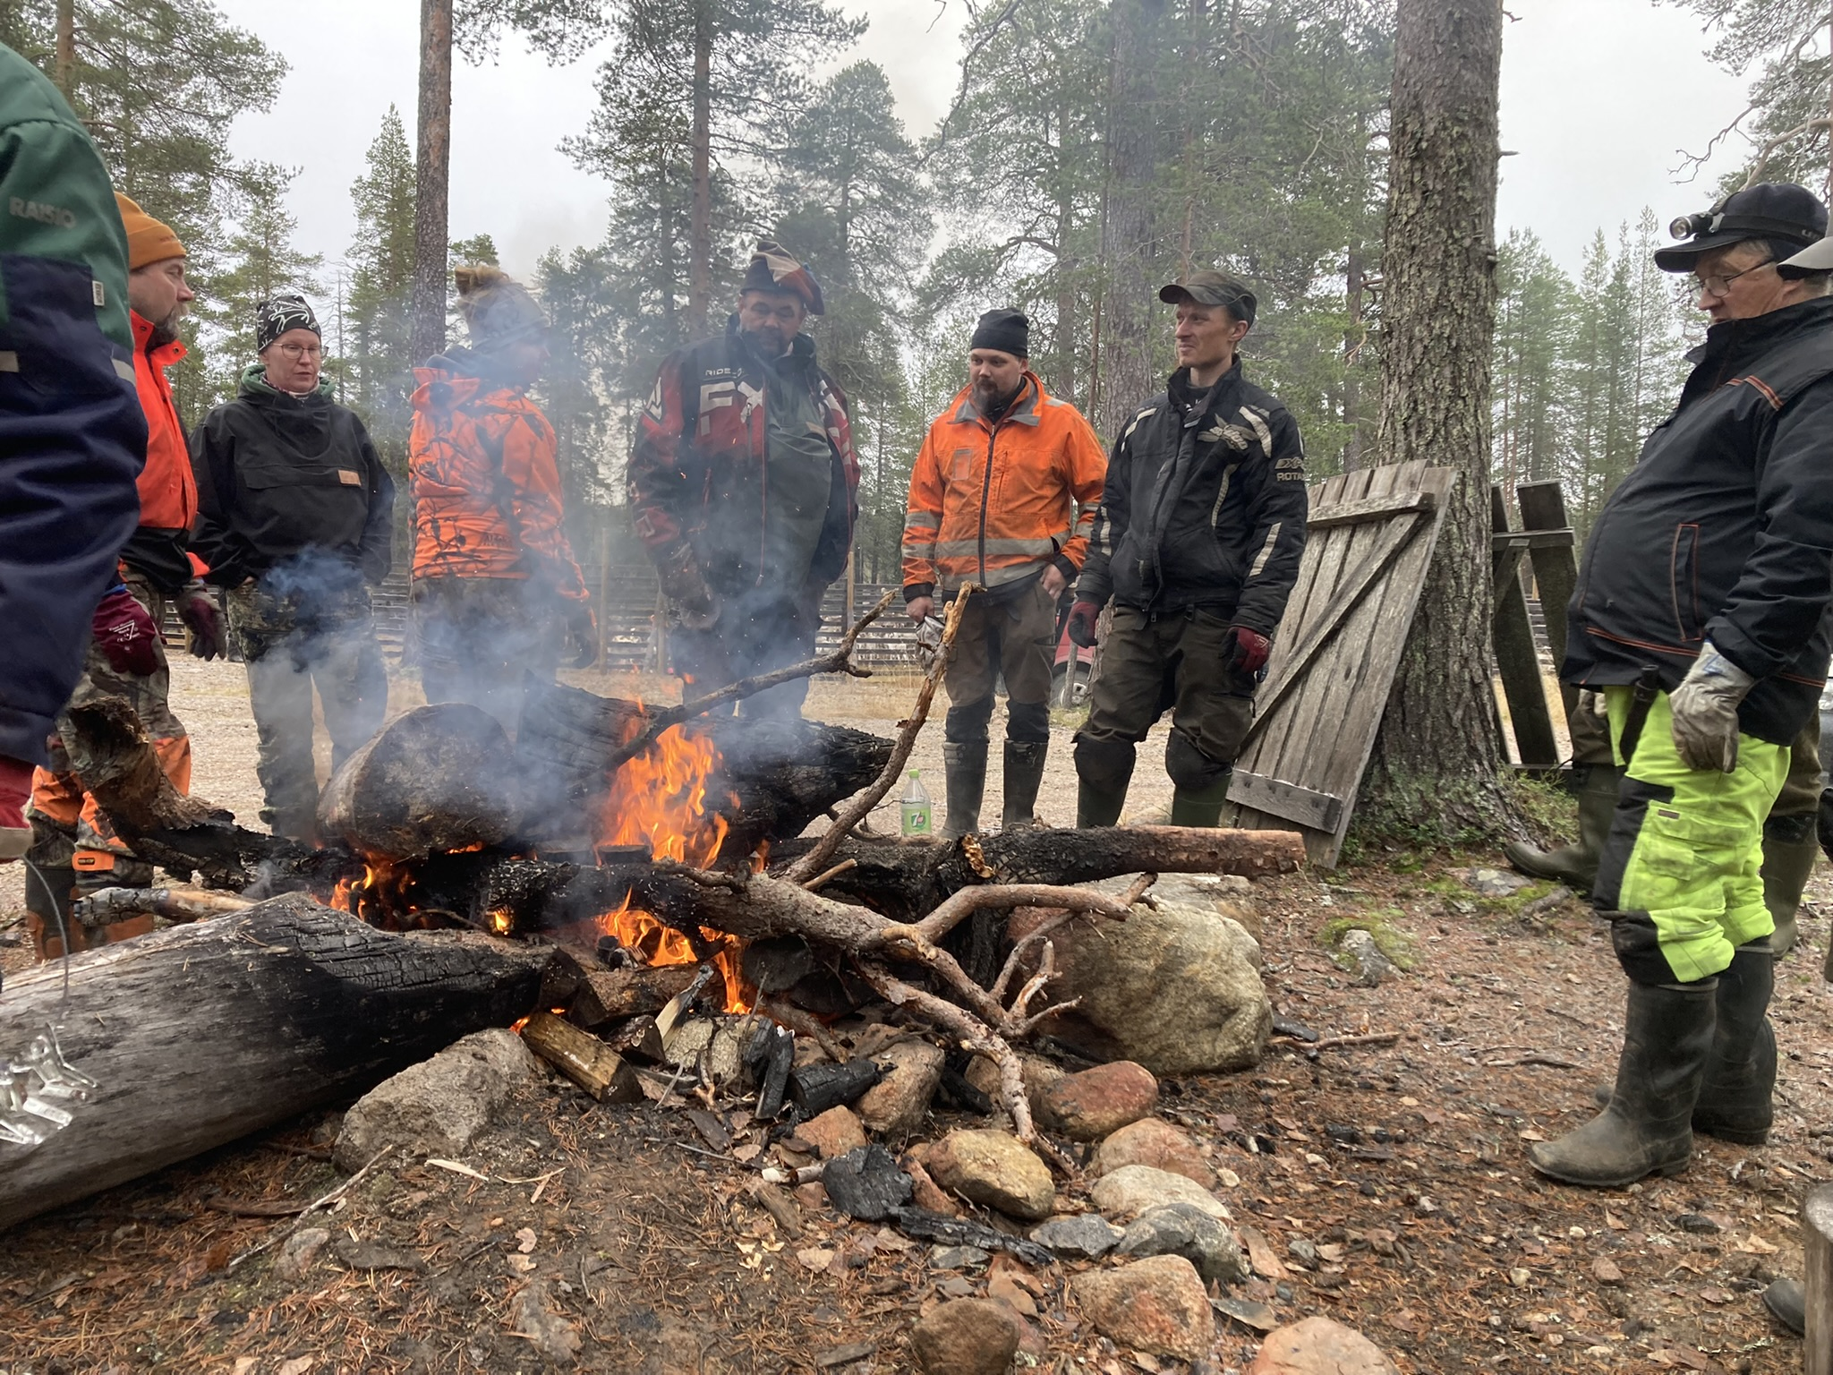
Co-production tools and methods
Credits: Juulia Tikkanen / Mia Landauer / Arctic Hubs

Slide 11
Summary
Participatory governance
Fosters sustainable energy development and deployment
Empowers local and Indigenous communities and supports co-creation of knowledge
Helps identifying environmental and societal challenges when developing energy infrastructure projects
Participatory governance aligns with the broader principles of democracy and human rights which are key for a just and green energy transition.
Credit: Mia Landauer

Slide 12
Thank you!
mia.landauer@ulapland.fi
arcticcentre.org/FI/rebound
@reboundproject
@rebound-justgreentransition

